Slide 1
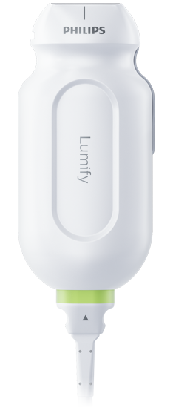
55yo man with history of HF and COPD presents with sub-acute dyspnea and cough.
Q: Based on the findings in this apical lung view, what is the likely diagnosis?
COPD exacerbation
Scroll or Use Arrows to Advance and Reverse Animations
1x
Name this Structure
A Lines
Recurring artifact produced by back-and-forth reflections between air in the lung and transducer, repeated over and over.
Recurring image = the tissue between transducer and the air.
Pleural line
HEAD
2x
Name this
Imaging Finding
A lines
3x
Rib Shadow
Rib Shadow
Name this imaging finding
Notes:
Objectives:
Use POCUS to identify normal pleural and aerated lung in a patient with sub-acute dyspnea to diagnose a COPD exacerbation.
Describe the mechanism that produces a-lines and similar reflection artifacts throughout the body.
Instructions:
Have the image pulled up in presenter mode before learners look at the screen, to avoid revealing the diagnosis. Ask a learner to provide an overall interpretation. Then advance through the animations to prompt learners with key questions and reveal the findings, diagnosis, and teaching points. You can go back to prior graphics and questions by using the back arrow on the keyboard or by scrolling back on the mouse wheel.
POCUS image interpretation: Normal lung sliding = normal pleura A-profile = aerated lung deep to the visceral pleura in this specific window.
Diagnosis:
Likely COPD exacerbation based on the clinical stem and normal lung sliding with a-profile on POCUS.
Take home points
A-lines on lung US are a recurring artifact produced by back-and-forth reflections of US waves between air in the chest and the transducer.
A-lines with no lung sliding = air in the pleura or diseased pleura with aerated lung.
A-lines with normal lung sliding = well aerated lung just deep to the visceral pleura in a specific window. Alternatively, increased density in the same window would produce B-lines
Reference
“ACP POCUS 3: Lung Ultrasound.” ACP, 1 Oct. 2022, www.acponline.org/cme-moc/online-learning-center/acp-pocus-3-lung-ultrasound.

