Slide 1
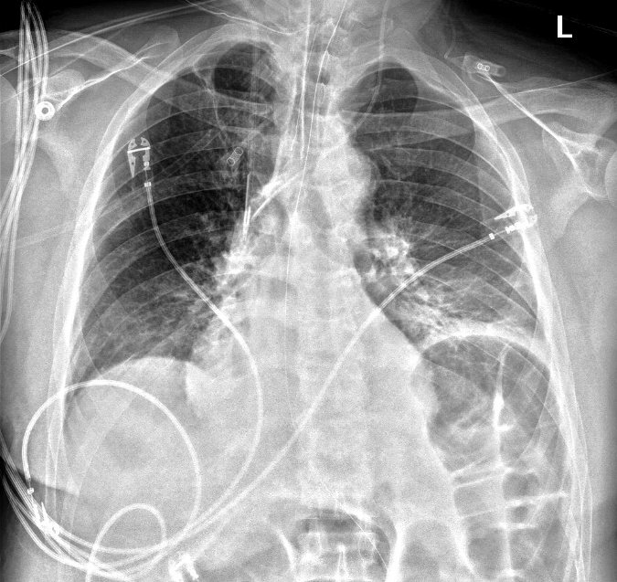
52 yo M w/ myasthenia gravis admitted for respiratory failure and septic shock of unclear source.
What is your overall interpretation?
Small left basilar consolidation, elevated left hemidiaphragm, dilated loops of bowel.
What invasive devices are present?
Are the central lines in the appropriate position?
Right IJ dialysis catheter
Left IJ central line (triple lumen)
OG tube
Esophageal probe
Small left basilar consolidation with air bronchograms
ET tube
Scroll or use arrows to advance and reverse slide animations
Left hemidiaphgram elevation
Dilated loops of bowel
Images courtesy of
Samantha King, MD
Notes:
Objectives:
Identify left and right central venous catheters (CVCs) on a chest x ray and the appropriate location of their placement
Instructions: Ask a leaner to provide an overall interpretation. Advance using the arrows or scroll wheel on the mouse reveal subsequent questions with answers and graphics. You can go back to prior graphics and questions by using the back arrow or scrolling back on the mouse wheel.
Official CXR Read:. The right IJ dialysis catheter and left central venous catheter terminate in the distal superior vena cava. The endotracheal team terminates above the level of the carina. An esophageal probe and orogastric tube is present.
Continued edema with bibasilar opacities. Small pleural effusions. No pneumothorax. Dilated bowel.
Diagnosis: left lower lobe pneumonia, non-specific bowel dilation
Take home points:
An internal jugular central venous catheter should terminate in the distal superior vena cava, approximately at the level of the carina
Dialysis catheters are thicker and less flexible than triple lumen catheters, and therefore preferentially placed on the right (straighter trajectory)
References:
Goodman, L. R. (2019). Felson's Principles of Chest Roentgenology E-Book: A Programmed Text. Netherlands: Elsevier Health Sciences.

Slide 2
52 yo M w/ myasthenia gravis admitted for respiratory failure and septic shock of unclear source.
What is your overall interpretation?
Small left basilar consolidation, elevated left hemidiaphragm, dilated loops of bowel.
Are the central lines in the appropriate position?
IJ
IJ
Right IJ dialysis catheter
Left IJ central line (triple lumen)
Subclavian
Subclavian
HD catheters are thicker and less flexible than triple lumen catheters, and therefore preferentially placed on the right (straighter trajectory).
Central line placement:
Should terminate in the distal superior vena cava, at about the level of the carina.
SVC
Carina
Scroll or use arrows to advance and reverse slide animations
Images courtesy of
Samantha King, MD
Notes:
Objectives:
Identify left and right internal jugular central venous catheters (CVCs) on a chest x ray and the appropriate location their placement
Instructions: Ask a leaner to provide an overall interpretation. Advance using the arrows or scroll wheel on the mouse reveal subsequent questions with answers and graphics. You can go back to prior graphics and questions by using the back arrow or scrolling back on the mouse wheel.
Official CXR Read:. The right IJ dialysis catheter and left central venous catheter terminate in the distal inferior vena cava. The endotracheal team terminates above the level of the carina. An esophageal probe and orogastric tube is present.
Continued edema with bibasilar opacities. Small pleural effusions. No pneumothorax. Dilated bowel.
Diagnosis: left lower lobe pneumonia, non-specific bowel dilation
Take home points:
An internal jugular central venous catheter should terminate in the distal superior vena cava, approximately at the level of the carina
Dialysis catheters are thicker and less flexible than triple lumen catheters, and therefore preferentially placed on the right (straighter trajectory)
References:
Goodman, L. R. (2019). Felson's Principles of Chest Roentgenology E-Book: A Programmed Text. Netherlands: Elsevier Health Sciences.

