Slide 1
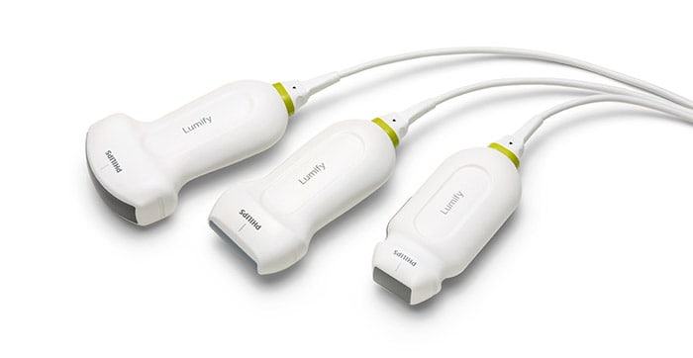
Click these buttons to REVEAL & HIDE answers and graphics
Which transducer is best for Parasternal long axis (PLAX) view?
Which transducer is best for Parasternal long axis (PLAX) view?
Proper positioning for PLAX?
PLAX Anatomy Review
Phased
Array
Common uses for PLAX View?
Linear
Curvilinear
CASES
Footprint fits in intercostal space.
Lower frequency allows for deep penetration.
Notes:
Image acquisition:
-With the transducer just lateral to the left sternal border at approximately the 3rd or 4th rib space, point the probe marker toward the patient’s right shoulder.
-A standard PLAX view, should have a near horizontal septum and deep pericardium. The RV and base of the LV (but not the apex) and both aortic and mitral valves visible should all be visible.
-The RV will be seen anteriorly.
-Adjust your depth to 1cm deeper than the descending thoracic aorta is visible in the far field.
-The pericardium should be roughly flat on the screen.
EPSS is evaluated in this view using M-Mode. Eyeball test, the anterior mitral leaflet should look like it is about to slap the interventricular septum
<7mm normal
>10 c/w CHF
Caveat: If patient has AR or MS will increase EPSS
See EPSS talk for more information
LV free wall contraction in interventricular thickening are markers of systolic function. You should see the LV cavity size decrease in a normal functioning heart.
GIF obtained from : https://www.renalfellow.org/2019/06/07/introduction-to-focused-cardiac-ultrasound-the-parasternal-long-axis-view/

Slide 2
Supine
or
Left Lateral
Which transducer is best for Parasternal long axis (PLAX) view?
Proper positioning for PLAX?
PLAX Anatomy Review
Common uses for PLAX View?
CASES
Ultrasound Position?
If poor visualization?
Left 3rd intercostal with marker toward right shoulder.
Reposition to left lateral decubitus
End expiratory hold
Notes:
Image acquisition:
-With the transducer just lateral to the left sternal border at approximately the 3rd or 4th rib space, point the probe marker toward the patient’s right shoulder.
-A standard PLAX view, should have a near horizontal septum and deep pericardium. The RV and base of the LV (but not the apex) and both aortic and mitral valves visible should all be visible.
-The RV will be seen anteriorly.
-Adjust your depth to 1cm deeper than the descending thoracic aorta is visible in the far field.
-The pericardium should be roughly flat on the screen.
EPSS is evaluated in this view using M-Mode. Eyeball test, the anterior mitral leaflet should look like it is about to slap the interventricular septum
<7mm normal
>10 c/w CHF
Caveat: If patient has AR or MS will increase EPSS
See EPSS talk for more information
LV free wall contraction in interventricular thickening are markers of systolic function. You should see the LV cavity size decrease in a normal functioning heart.
GIF obtained from : https://www.renalfellow.org/2019/06/07/introduction-to-focused-cardiac-ultrasound-the-parasternal-long-axis-view/

Slide 3
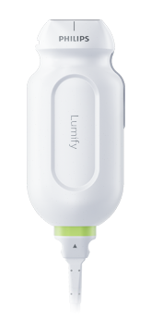
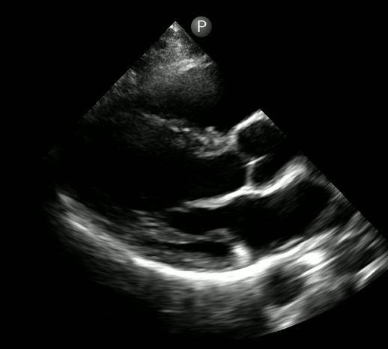
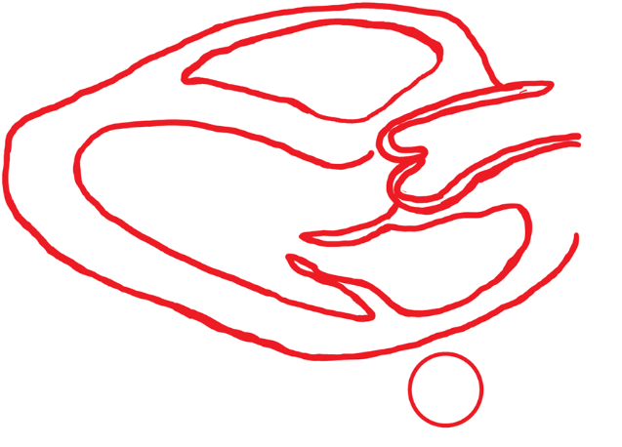
Which transducer is best for Parasternal long axis (PLAX) view?
Proper positioning for PLAX?
RV
PLAX Anatomy Review
AV
LV
Add Labels
LVOT
Hide Labels
Add Outlines
MV
LA
Hide Outlines
Common uses for PLAX View?
Ao
Image courtesy of Brandon Fainstad, MD
CASES
RV = Right Ventricle LVOT= Left Ventricle Outflow Track AV= Aortic Valve MV= Mitral Valve LA = Left Atrium Ao = Descending Aorta
Notes:
Image acquisition:
-With the transducer just lateral to the left sternal border at approximately the 3rd or 4th rib space, point the probe marker toward the patient’s right shoulder.
-A standard PLAX view, should have a near horizontal septum and deep pericardium. The RV and base of the LV (but not the apex) and both aortic and mitral valves visible should all be visible.
-The RV will be seen anteriorly.
-Adjust your depth to 1cm deeper than the descending thoracic aorta is visible in the far field.
-The pericardium should be roughly flat on the screen.
EPSS is evaluated in this view using M-Mode. Eyeball test, the anterior mitral leaflet should look like it is about to slap the interventricular septum
<7mm normal
>10 c/w CHF
Caveat: If patient has AR or MS will increase EPSS
See EPSS talk for more information
LV free wall contraction in interventricular thickening are markers of systolic function. You should see the LV cavity size decrease in a normal functioning heart.
GIF obtained from : https://www.renalfellow.org/2019/06/07/introduction-to-focused-cardiac-ultrasound-the-parasternal-long-axis-view/

Slide 4
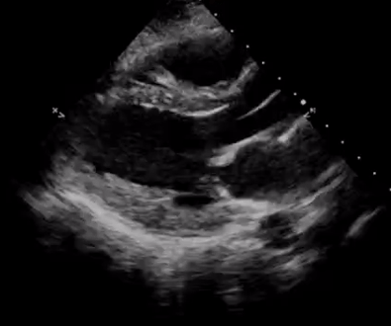
1. Assess chamber size
Which transducer is best for Parasternal long axis (PLAX) view?
2. Evaluate Systolic Function
Gross assessment of Thickening and Contracting
End-point septal separation (see EPSS talk)
Proper positioning for PLAX?
Rule of Thirds
PLAX Anatomy Review
Common uses for PLAX View?
3. Other Considerations
CASES
Septal flattening or bowing -> increased RV pressure
Pericardial effusion
Notes:
Image acquisition:
-With the transducer just lateral to the left sternal border at approximately the 3rd or 4th rib space, point the probe marker toward the patient’s right shoulder.
-A standard PLAX view, should have a near horizontal septum and deep pericardium. The RV and base of the LV (but not the apex) and both aortic and mitral valves visible should all be visible.
-The RV will be seen anteriorly.
-Adjust your depth to 1cm deeper than the descending thoracic aorta is visible in the far field.
-The pericardium should be roughly flat on the screen.
EPSS is evaluated in this view using M-Mode. Eyeball test, the anterior mitral leaflet should look like it is about to slap the interventricular septum
<7mm normal
>10 c/w CHF
Caveat: If patient has AR or MS will increase EPSS
See EPSS talk for more information
LV free wall contraction in interventricular thickening are markers of systolic function. You should see the LV cavity size decrease in a normal functioning heart.
GIF obtained from : https://www.renalfellow.org/2019/06/07/introduction-to-focused-cardiac-ultrasound-the-parasternal-long-axis-view/

Slide 5
Case 1 (5min)
A 65-year-old man with a history of diabetes and tobacco use presenting with several days of progressive dyspnea and non-productive cough. He denies similar prior episodes. He is afebrile, HR 88, normotensive, SpO2 92% on 2L NC. Exam notable for bibasilar rales w/ scattered wheezes, trace pedal edema, warm and well perfused.
Video
What is the diagnosis?
Click again to hide video and show next question
Heart failure with reduced ejection fraction
Diffuse hypokinesis (minimal thickening)
What is your next step in management?
LAE
(LA > LVOT)
Work up: formal echo, CT angiography vs. LHC to identify CAD and likely dx of ICM
Treatment: diuresis, initiation of GDMT with ACEI/ARB and BB
Courtesy of Brandon Fainstad, MD
Anterior leaflet of MV is >1cm from the septum
Image courtesy of Brandon Fainstad, MD
Go to Case 2
Notes:
Case 1:
Identify landmark structures.
Notable abnormalities
-Left atrium appears enlarged (rule of thirds)
-EPSS markedly reduced
-Not well visualized, but appears that LV free wall thickness not changing very much throughout cardiac cycle and LV cavity size does not significantly decrease during systole which points to decreased systolic function
Note: No pericardial effusion. Depth could be increased to better visualize descending aorta

Slide 6
Case 2 (5min)
A 40-year-old woman with no past medical history presents with several hours of acute onset pleuritic chest pain, dyspnea and light headedness. Pulmonary exam and CXR are unremarkable. She is afebrile, tachycardic to 127bpm, tachypneic to 28, BP is 85/50.
Video
What is the diagnosis?
Click again to hide video and show next question
RV overload. Likely obstructive shock from massive PE
What is your next step in management?
RV
Work-up: CTPE, (formal echo if no PE)
Treatment: heparin gtt and cal IR for catheter directed tPA vs IV tPA,.
Courtesy of Brandon Fainstad, MD
Back to Case 1
LV
Septal flattening
Image courtesy of Brandon Fainstad, MD
Notes:
Case 1:
Identify landmark structures.
Notable abnormalities
-Left atrium appears enlarged (rule of thirds)
-EPSS markedly reduced
-Not well visualized, but appears that LV free wall thickness not changing very much throughout cardiac cycle and LV cavity size does not significantly decrease during systole which points to decreased systolic function
Note: No pericardial effusion. Depth could be increased to better visualize descending aorta

