Slide 1
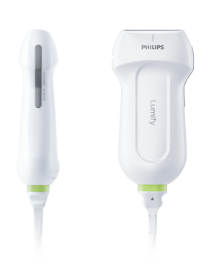
65-year-old man reports worsening dyspnea following a CT guided lung biopsy.
Pneumothorax
What is the most likely diagnosis?
Any time the visceral pleura is not sliding against the parietal pleura
What is the differential for NO lung sliding?
Not breathing
Pneumothorax
Pleural adhesions
Complete atelectasis
Phrenic nerve paralysis
Compare
No sliding
Sliding
Image courtesy of Cameron Baston, MD

Slide 2
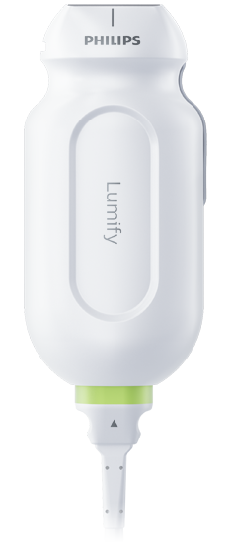
Spanning two rib spaces with the indicator toward the head.
Supine
Skin
SubQ/fat/muscle
Rib and Rib Shadow
Intercostal Muscle
Pleura
Image courtesy of Brandon Fainstad, MD
Notes:
Which transducer? – linear offers the highest resolution at a short depth. Curvilinear is better for deep structures but has a lower resolution (think FM compared to AM). Curvilinear is sufficient for most pleural assessments and is better for determining a and b profile.
Orientation? – Ribs should be at the periphery of the image with unobstructed plural view in the middle. This orientation will have increased reflection and deflection of US waves at the pleura because there is more curvature of the pleura vertically than horizontally.
Skin – hyperechoic with organized linear architecture.
SubQ / fat / chest muscle – hypOechoic relative to the skin with less organized architecture from intermingled fat
Intercostal muscle – separated from SubQ and chest muscle by a dense hyperechoic fascial plane. Visible movement of striated intercostal muscles brining the ribs closer together as the patient exhales
Rib and rib shadow – Bones have a bright hyperechoic cortex then absorb almost all US waves so there is minimal signal deep to the cortex. This is different that air that will reflect or deflect most US waves and give a recurring image over and over again (a-lines)
Pleura – Linear hyperechoic line just deep to ribs. Key feature to look for is “LUNG SLIDEING”. This looks like twinkling or shimmering, often described as “ants on a log”. Any movement at the pleura (or deep to it) tells you ultrasound waves have made it to the visceral layer of the pleura and it is moving. If there is a pneumothorax US waves make it to the parietal layer (which does not move) then are reflected back from air between the visceral and parietal layers of the pleura.

