Slide 1
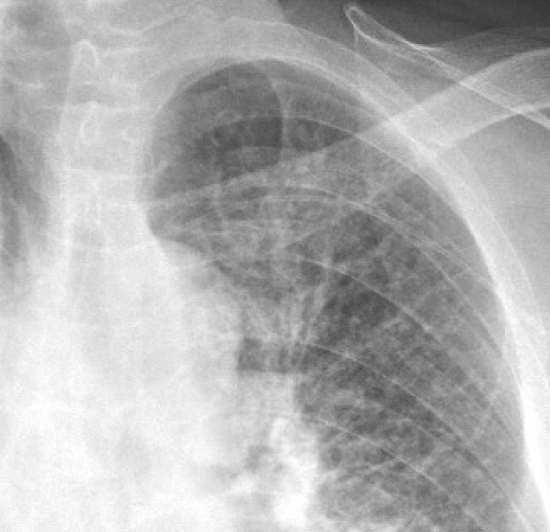
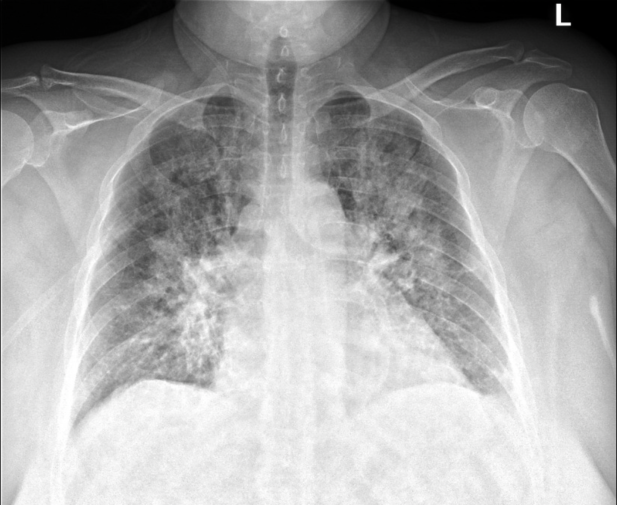
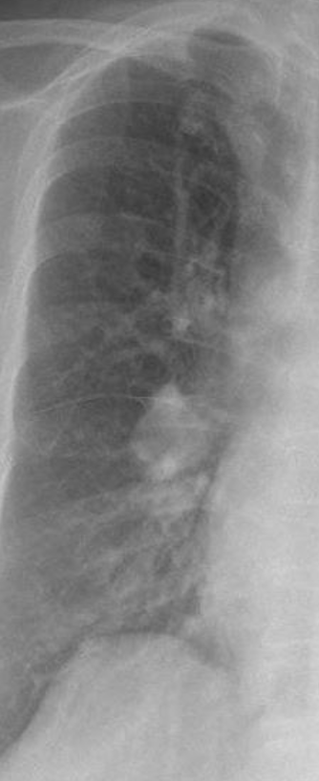
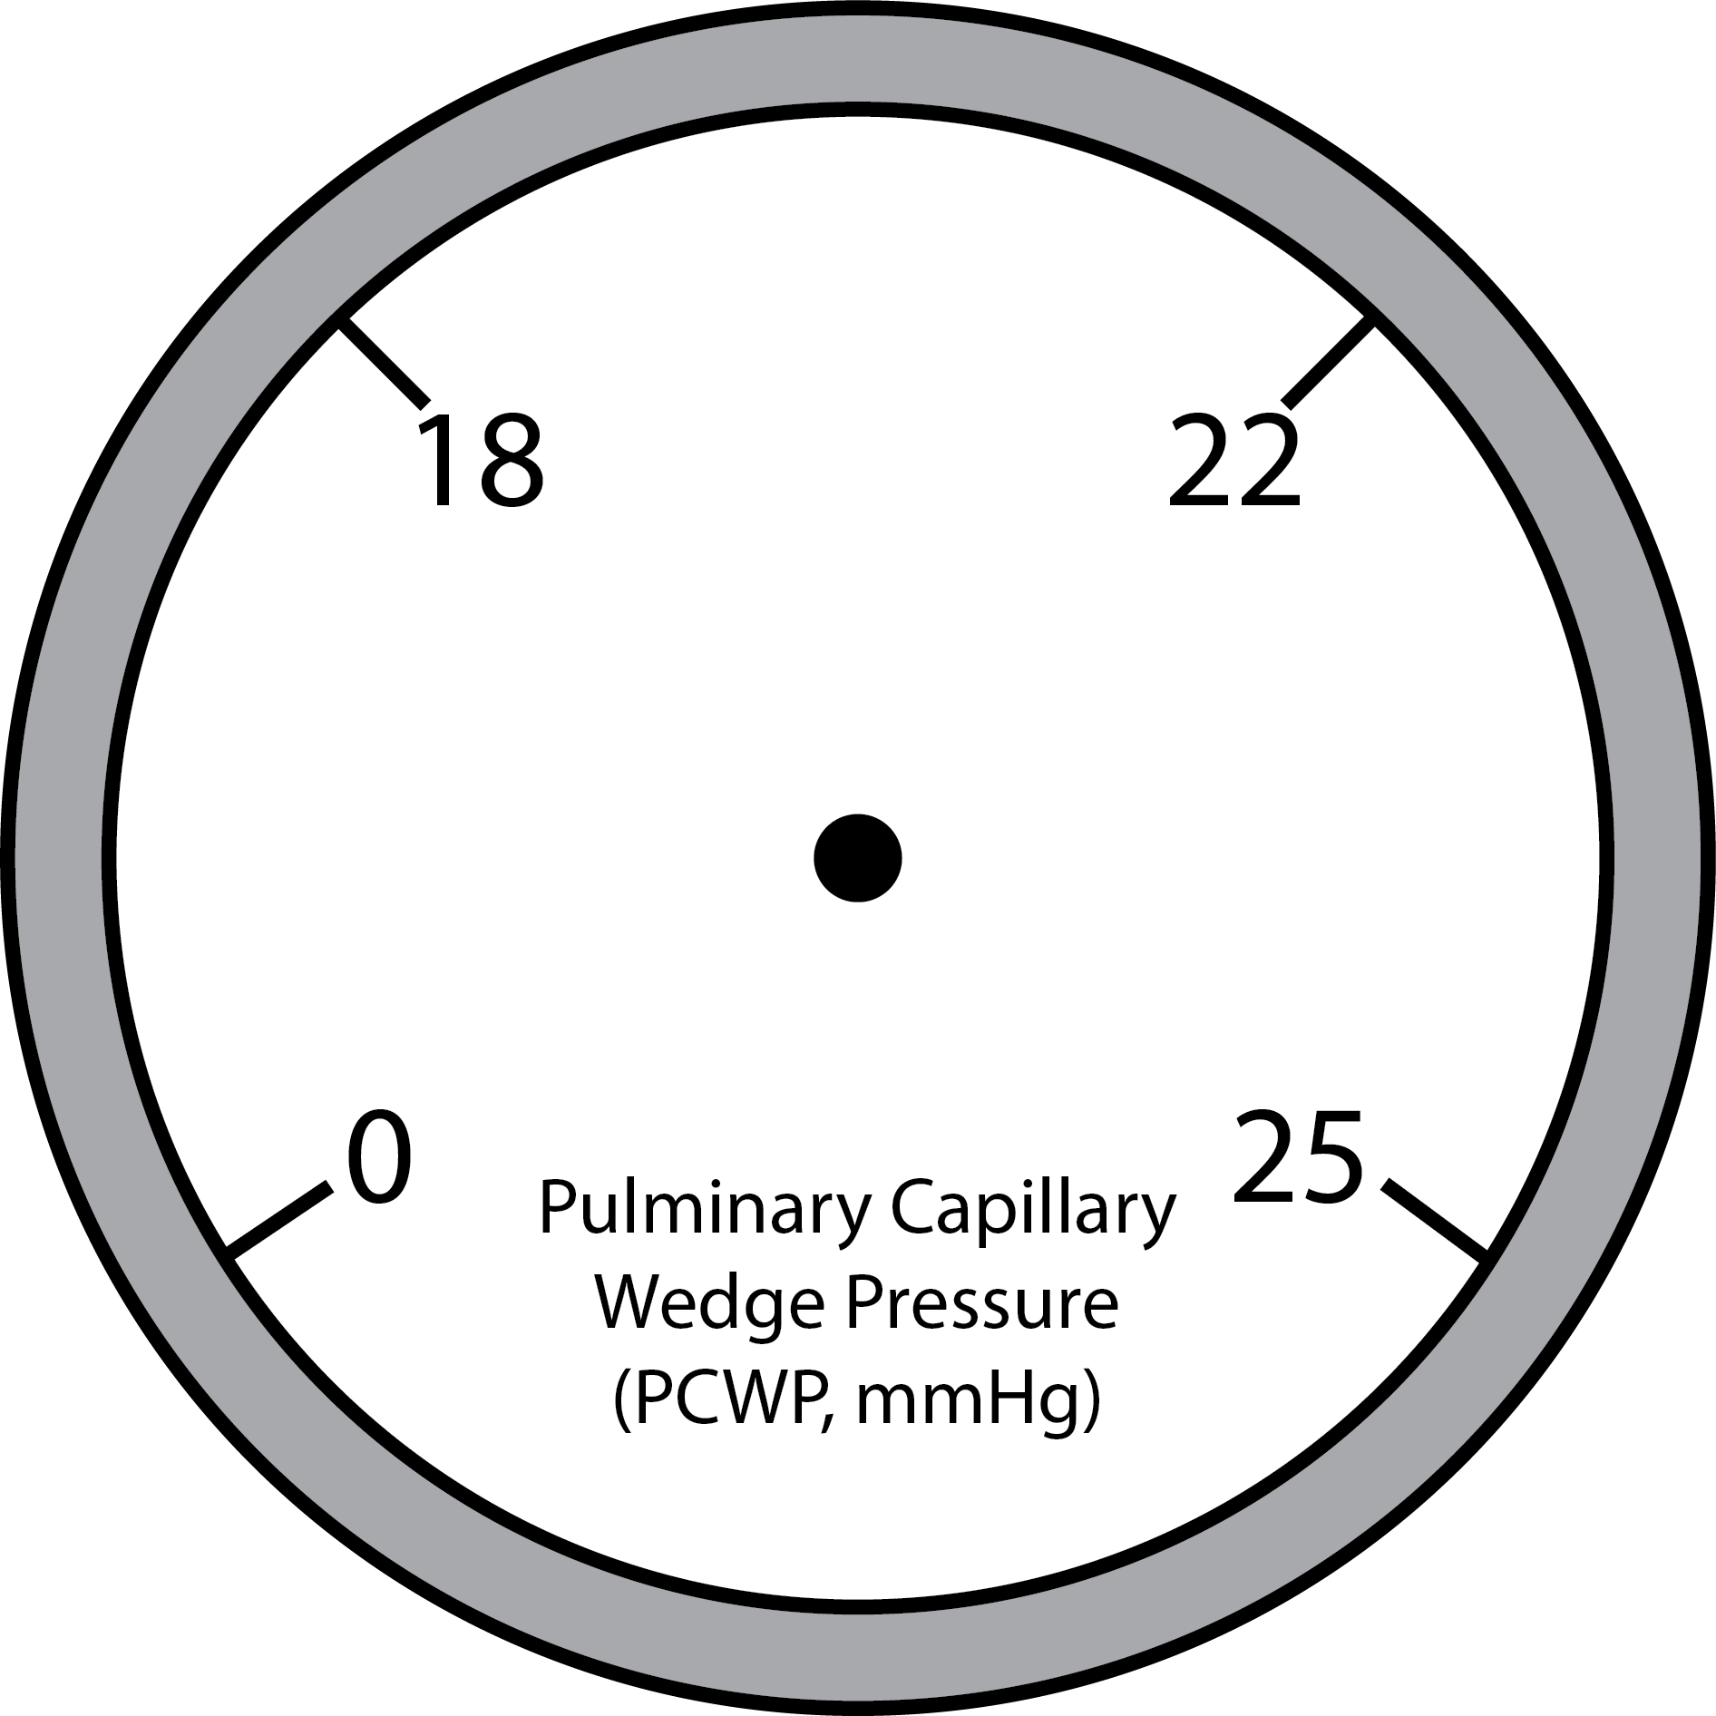
55-year-old man s/p STEMI with tachypnea, dyspnea, and cool extremities.
What is your overall interpretation?
Enlarged cardiac silhouette w/ bilateral perihilar enlargement and diffuse alveolar opacities.
Pulmonary edema due to cardiogenic shock.
What is the likely diagnosis?
What are the radiographic stages of left heart failure?
Images courtesy of
Daniel Gergen, MD
Alveolar opacities
Scroll or use arrows to advance and reverse slide animations
Interstitial prominence
Peribronchial cuffing
Kerley B lines
Perihilar enlargement
Enlarged cardiac silhouette
Cephalization
Notes:
Instructions: Ask a leaner to provide an overall interpretation. Advance the slide for subsequent questions.
CXR Read: enlarged cardiac silhouette with bilateral perihilar enlargement, haziness, and congestion. In addition, diffuse interstitial and alveolar opacities. Peribronchial cuffing is present. Kerley B lines are also observed at the periphery. Small left pleural effusion.
Diagnosis: pulmonary edema secondary to cardiogenic shock
Teaching:
Enlarged cardiac silhouette is defined as a cardiac silhouette that is greater than half of the internal thoracic diameter. The differential for an enlarged cardiac silhouette on chest radiograph includes, cardiomegaly, pericardial effusion, and portable/AP film.
The differential for perihilar enlargement includes, lymphadenopathy, malignancy, pulmonary arterial hypertension, and pulmonary venous hypertension. In the setting of STEMI and cardiogenic shock, acute perihilar enlargement is attributed to pulmonary venous hypertension.
This radiograph demonstrates a diffuse interstitial pattern. Other terms that could be utilized to describe this pattern are linear or reticular. In this case, the interstitial markings emanate from the hilum bilaterally and reach approximately 2/3 of the way to the pleural surface. Considering the clinical context, this is most consistent with cardiogenic pulmonary edema.
Radiographic stages of acute left heart failure (based on pulmonary capillary wedge pressure):
18 mmHg: cephalization of the upper lobe pulmonary vasculature. Best described as increased prominence of the upper lobe vasculature due to redistribution of blood flow.
22 mmHg: increased interstitial prominence, peribronchial cuffing, perihilar enlargement, and Kerley B lines
25 mmHg: alveolar opacities

