Slide 1
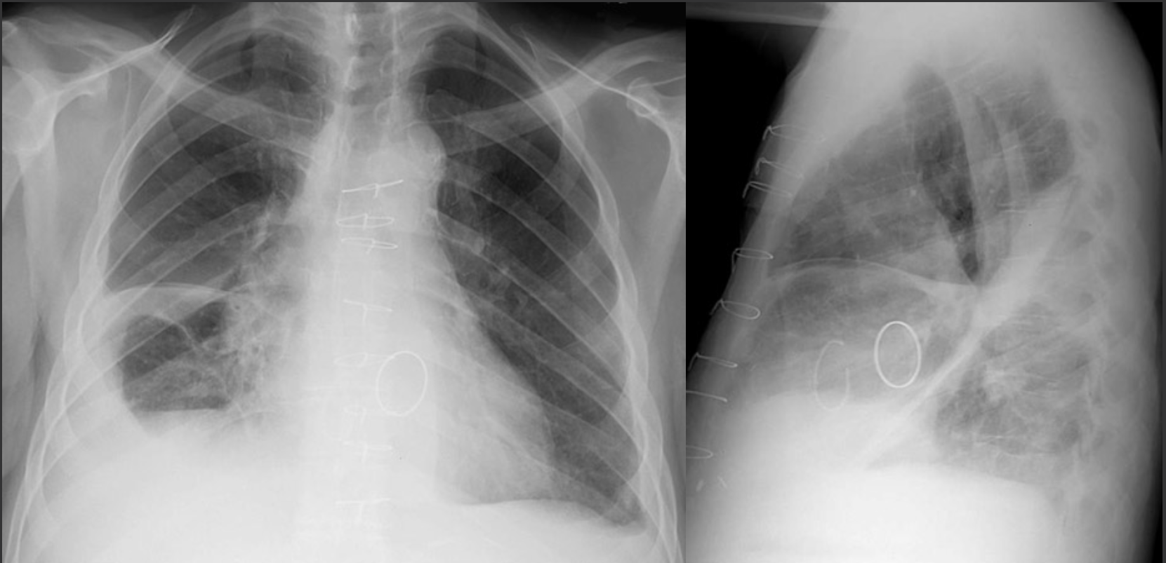
60-year-old presents to clinic with progressive orthopnea and dyspnea on exertion.
Sternotomy wires and two mechanical valves with bilateral pleural effusions and vascular congestion.
What is your overall interpretation?
Right minor fissure, right major fissure, right subpulmonic space and left costophrenic sulcus.
In which pleural spaces has fluid collected?
The right major fissure extends from the spine to the diaphragm. The left stops at the mediastinum.
How do you distinguish between the left and right major fissure on the lateral view?
RIGHT MINOR
FISSURE
RIGHT MINOR FISSURE
*Extends to diaphragm, past the mediastinum*
RIGHT SUBPULMONIC SPACE AND SULCUS
LEFT COSTOPHRENIC SULCUS
RIGHT MAJOR

