Slide 1
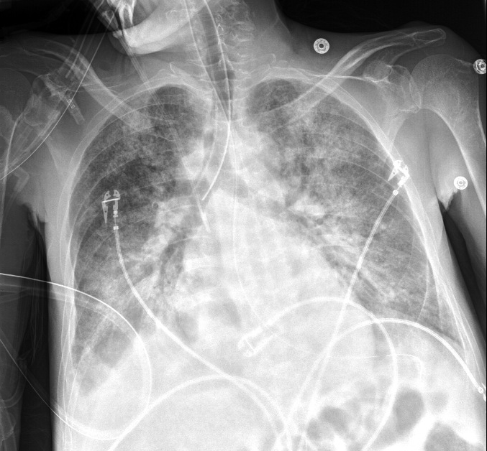
45-year-old man with ESRD develops acute hypoxemic respiratory failure.
What is your overall interpretation?
Diffuse bilateral alveolar infiltrates with air bronchograms, right mainstem intubation.
Endotracheal tube in right mainstem bronchus
Diffuse bilateral alveolar infiltrates
Diffuse bilateral alveolar infiltrates
Air bronchograms
Scroll or use arrows to advance and reverse slide animations
Small right pleural effusion
Images courtesy of
Samantha King, MD
Notes:
Objectives:
Describe the appropriate location of an endotracheal tube
Identify an endotracheal tube on CXR and determine whether it is in the appropriate position
Instructions: Ask a leaner to provide an overall interpretation. Advance using the arrows or scroll wheel on the mouse reveal subsequent questions with answers and graphics. You can go back to prior graphics and questions by using the back arrow or scrolling back on the mouse wheel.
Official CXR Read:. Right IJ line terminates in the distal SVC. Enteric tube reaches the proximal stomach. ET tube is been placed and extends approximately 1.7 cm into the right mainstem bronchus. Diffuse lung opacities more focal right basal consolidation. There are is a small right pleural effusion.
Diagnosis:. Acute respiratory distress syndrome secondary to sepsis from spontaneous bacterial peritonitis
Teaching: An endotracheal tube should terminate 2-4 cm above the carina. The tube must be low enough to ensure that the cuff will inflate below the vocal cords (avoid vocal cord trauma), and high enough to adequately ventilate both lungs.
Take home points:
An endotracheal tube should terminate 2-4 cm above the carina
References: Myrna C. B. Godoy, Barry S. Leitman, Patricia M. de Groot, Ioannis Vlahos, and David P. Naidich
Chest Radiography in the ICU: Part 1, Evaluation of Airway, Enteric, and Pleural Tubes
American Journal of Roentgenology 2012 198:3, 563-571

Slide 2
46 yo M with ESRD and cirrhosis, sepsis from SBP develops acute hypoxemic respiratory failure.
What is your overall interpretation?
Diffuse bilateral alveolar infiltrates with air bronchograms, right mainstem intubation.
What would be your next step in management?
What is the correct positioning for an endotracheal tube?
Endotracheal tube in right mainstem bronchus
Carina
The endotracheal tube should terminate 2-4 cm above the carina.
Left main bronchus
Right main bronchus
Images courtesy of
Samantha King, MD

Slide 3
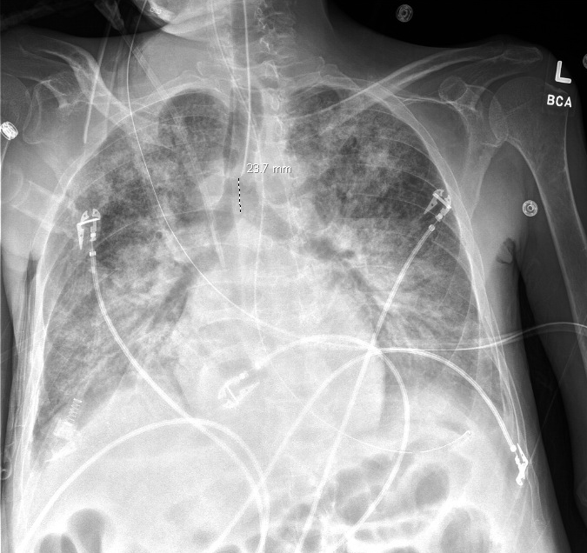
46 yo M with ESRD and cirrhosis, sepsis from SBP develops acute hypoxemic respiratory failure.
What is your overall interpretation?
Diffuse bilateral alveolar infiltrates with air bronchograms, right mainstem intubation.
What would be your next step in management?
What is the correct positioning for an endotracheal tube?
What is the correct positioning for an endotracheal tube?
Retract the endotracheal tube.
Endotracheal tube in appropriate position about 2.4 cm above the carina
Images courtesy of
Samantha King, MD
Repeat CXR after ET tube retracted 4 cm

Slide 4
46 yo M with ESRD and cirrhosis, sepsis from SBP develops acute hypoxemic respiratory failure.
What is your overall interpretation?
Diffuse bilateral alveolar infiltrates with air bronchograms, right mainstem intubation.
Bonus: what other invasive tubes and lines are present?
Right IJ dialysis catheter terminating in the SVC
Scroll or use arrows to advance and reverse slide animations
OG tube terminating in the proximal stomach
Images courtesy of
Samantha King, MD

