Slide 1
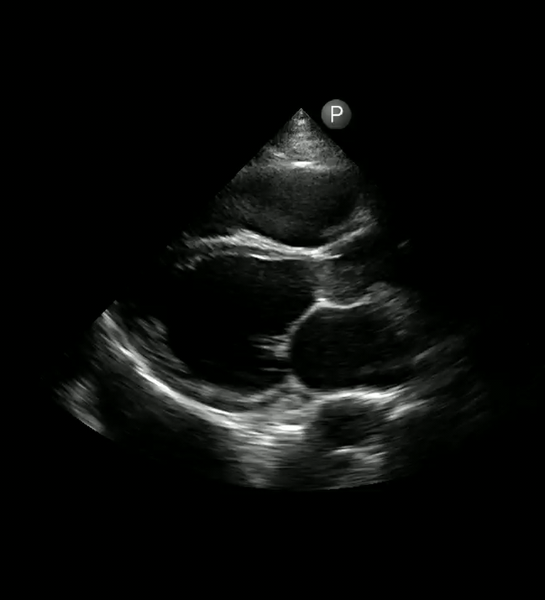
65-year-old with CAD presents with increased dyspnea and volume overload.
Severely reduced LVEF with enlarged left atrium in the setting of acutely decomp HF.
What is your image interpretation and most likely clinical diagnosis?
What measurement of the mitral valve can help assess LV systolic function?
P
PLAX
P
Images courtesy of
*******, MD
Notes:
Objectives:
Instructions: Ask a leaner to provide an overall interpretation. Advance using the arrows or scroll wheel on the mouse reveal subsequent questions with answers and graphics. You can go back to prior graphics and questions by using the back arrow or scrolling back on the mouse wheel.
Official POCUS interpretation:.
Clinical diagnosis:
Take home points:
References:

Slide 2
65-year-old with CAD presents with increased dyspnea and volume overload.
EPSS (end-point septal separation) - shortest distance from anterior MV leaflet to septum.
Mitral stenosis & aortic regurgitation will falsely increase EPSS -> Underestimation of EF
What EPSS distance suggests reduced systolic function?
What type of valvular dysfunction will falsely increase EPSS?
Formal echo, evaluation for ICM, diuresis followed by initiation of GDMT
What is the next step in management?
EPSS and EF
EPSS < 7mm suggests normal EF
EPSS > 10mm suggests reduced EF
EPSS >13mm suggests mod-sev rEF
P
M-Mode
Septum
23mm
Anterior MV
Images courtesy of
Tiffany Gardner, MD
Notes:
Objectives:
Instructions: Ask a leaner to provide an overall interpretation. Advance using the arrows or scroll wheel on the mouse reveal subsequent questions with answers and graphics. You can go back to prior graphics and questions by using the back arrow or scrolling back on the mouse wheel.
Official POCUS interpretation:.
Clinical diagnosis:
Take home points:
References:

