Slide 1
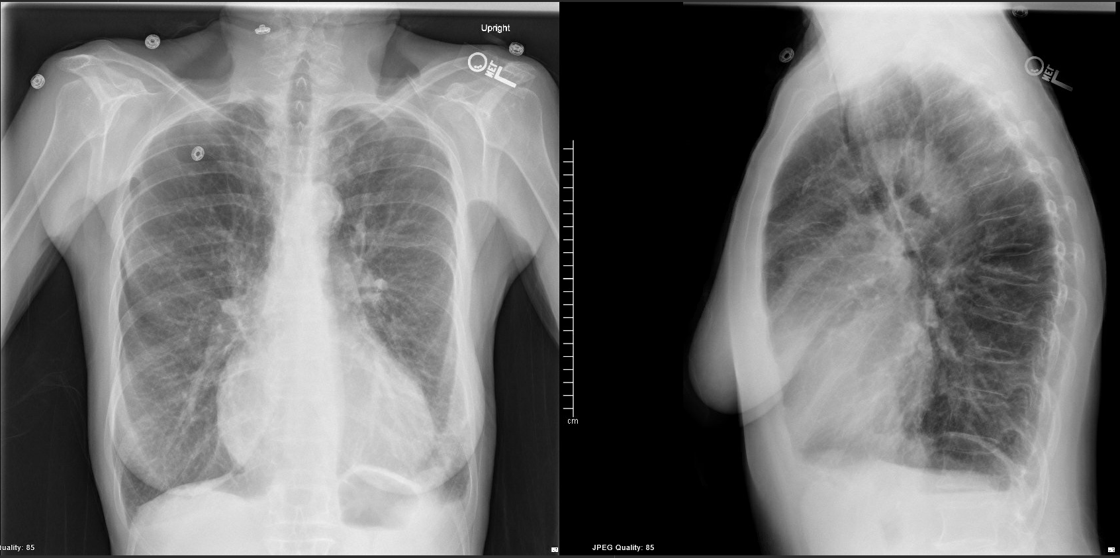
65yo woman presents to clinic with chronic progressive cough and dyspnea. Resting SpO2 87%.
Hyperinflated lung fields concerning for chronic obstructive pulmonary disease (COPD)
1. Tob cessation, 2. Pulm rehab, 3. Continuous O2, 4. Vaccinations, 5. Add LAMA & stop SAMA.
Two hospitalizations in past year. On a LABA and PRN SABA/SAMA. Next step in management?
What is your overall interpretation and clinical diagnosis?
Identify 6 characteristic radiographic features of COPD?
Increased size and lucency of apices.
Osteoporotic compression fractures from chronic steroid exposure -> Kyphosis
Anterior Mediastinal air
>9 ribs
Images courtesy of
Brandon Fainstad, MD
Elongated cardiac silhouette, NOT resting on diaphragm
Flattened diaphragm
Notes:
Objectives (after this session the learner will be able to):
1. Identify six characteristic radiographic features of chronic obstructive lung disease
2. Determine appropriate escalation of inhaler therapy and comprehensive care for a patient with uncontrolled COPD
Instructions: Ask a leaner to provide an overall interpretation. Advance using the arrows or scroll wheel on the mouse to reveal subsequent questions with answers and graphics. You can go back to prior graphics and questions by using the back arrow or scrolling back on the mouse wheel. Consider having learners break into brief pair-shares to discuss each question before advancing the slide.
Official CXR Read: Hyperinflated lung fields with apical predominant lucency, flattened diaphragm, anterior mediastinal air, and multiple osteoporotic compress fractures of the spine.
Clinical Diagnosis: COPD
Teaching:
This case highlights multiple characteristics of radiographic findings in COPD with apical emphysema. Bring attention to the rectangular shape of the thorax, opposed to the triangular shape seen with normal lungs.
The final questions asks for next steps in management. They likely have severe, stage 3 or 4 COPD, but symptoms and hospitalizations guide most decisions around selection of therapy. She is group C or D based on 2 or more exacerbations in the past year. Her comprehensive management should focus on limiting disease progression and enhancing function with tobacco cessation, pulmonary rehab, continuous O2, up to date vaccinations (influenza, streptococcal pneumonia and COVID). Her escalation of inhaler therapy should include the addition of a LAMA, stopping her SAMA, and consideration of an ICS if her eosinophils are greater than 100.
Refer to this talk on outpatient management of COPD (https://teachim.org/teaching_material/copd-outpatient/) for additional teaching resources.
Take home points:
References:
McLoud, Boiselle, & Boiselle, Phillip M. (2010). Thoracic radiology : The requisites (2nd ed., Requisites in radiology). Philadelphia: Mosby/Elsevier.
Halpin, D. M., Criner, G. J., Papi, A., Singh, D., Anzueto, A., Martinez, F. J., ... & Vogelmeier, C. F. (2021). Global initiative for the diagnosis, management, and prevention of chronic obstructive lung disease. The 2020 GOLD science committee report on COVID-19 and chronic obstructive pulmonary disease. American journal of respiratory and critical care medicine, 203(1), 24-36.

