Slide 1
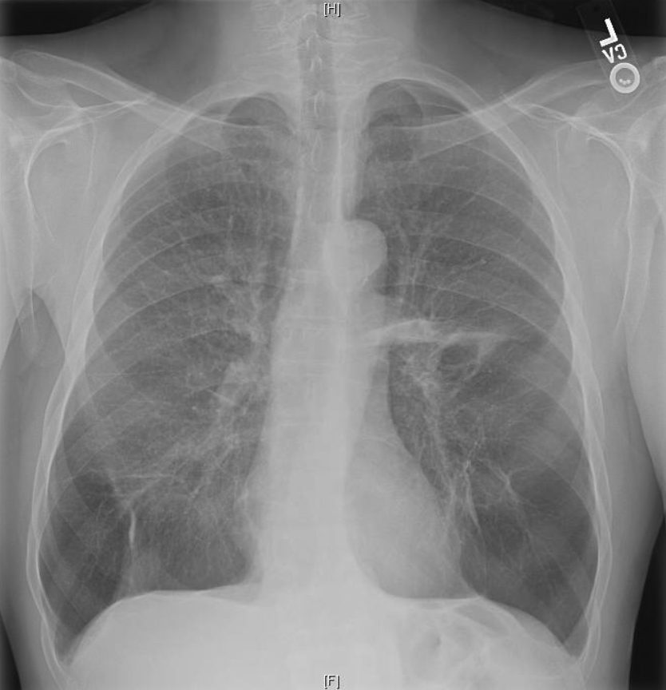
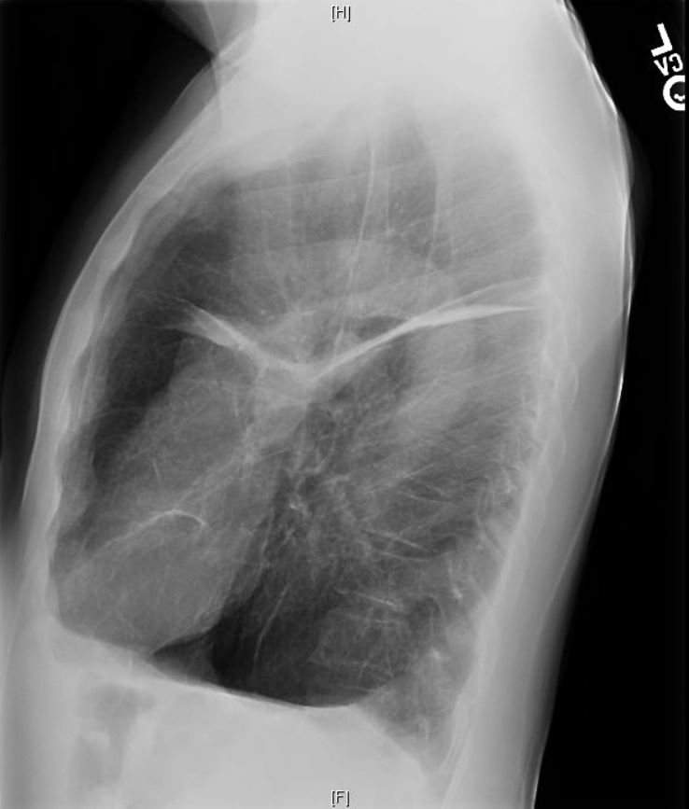
65yo man with active IVDU presents with chronic progressive dyspnea and obstructive pattern PFTs
What is your overall interpretation?
Bibasilar emphysema.
What is the physiologic mechanism and differential for basilar emphysema?
Images courtesy of
Lauren Brown, MD
Anterior Mediastinal air
Increased size and lucency at the bases.
Flattened diaphragm
Notes:
Instructions: Ask a leaner to provide a full interpretation of the new radiograph. Advance the slide for subsequent questions.
CXR interpretation: Hyperinflated lungs with flattening diaphragms. There is lucency at the bases reflecting basal-predominant emphysema. The upgoing vessels are fatter than normal reflecting redistribution because of the basal destruction. Flattening of the diaphragm is best seen on the lateral view.
Teaching: The basic concept to reinforce in this case is that inhaled substances and processes have a predominant impact on the upper lungs and hematogenous substances and processes have a predominant impact on the lower lobes. This case demonstrates that injected substances that are destructive to the lung parenchyma (e.g. crushed Ritalin) cause basilar destruction > apical.

Slide 2
65yo man with active IVDU presents with chronic progressive dyspnea and obstructive pattern PFTs
What is your overall interpretation?
Bibasilar emphysema.
What is the physiologic mechanism and differential for basilar emphysema?
Images courtesy of
Lauren Brown, MD
Upper Lung
V > Q
Damage from inhaled toxins
Inhaled Toxin Examples:
Tobacco
Tuberculosis
Hypersensitivity Pneumonitis
Vs.
Lower lung
Q > V
Damage from hematogenous
Toxins
Hematogenous Toxins Examples:
Alpha-1 antitrypsin disease
Venously injected compounds (e.g. crushed tablets)
Notes:
Instructions: Ask a leaner to provide a full interpretation of the new radiograph. Advance the slide for subsequent questions.
CXR interpretation: Hyperinflated lungs with flattening diaphragms. There is lucency at the bases reflecting basal-predominant emphysema. The upgoing vessels are fatter than normal reflecting redistribution because of the basal destruction. Flattening of the diaphragm is best seen on the lateral view.
Teaching: The basic concept to reinforce in this case is that inhaled substances and processes have a predominant impact on the upper lungs and hematogenous substances and processes have a predominant impact on the lower lobes. This case demonstrates that injected substances that are destructive to the lung parenchyma (e.g. crushed Ritalin) cause basilar destruction > apical.

Slide 3
65yo man with active IVDU presents with chronic progressive dyspnea and obstructive pattern PFTs
What is your overall interpretation?
Compare the features of basilar vs. apical predominant emphysema
Basilar Emphysema
Apical Emphysema
Vs.
Notes:
Instructions: Ask a leaner to provide a full interpretation of the new radiograph. Advance the slide for subsequent questions.
CXR interpretation: Hyperinflated lungs with flattening diaphragms. There is lucency at the bases reflecting basal-predominant emphysema. The upgoing vessels are fatter than normal reflecting redistribution because of the basal destruction. Flattening of the diaphragm is best seen on the lateral view.
Teaching: The basic concept to reinforce in this case is that inhaled substances and processes have a predominant impact on the upper lungs and hematogenous substances and processes have a predominant impact on the lower lobes. This case demonstrates that injected substances that are destructive to the lung parenchyma (e.g. crushed Ritalin) cause basilar destruction > apical.

