Slide 1
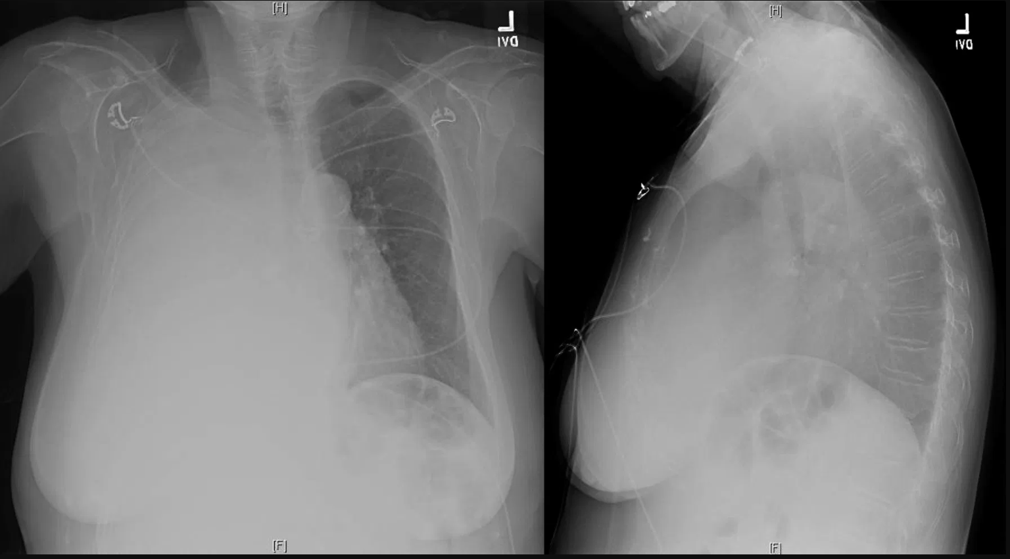
70yo woman with metastatic renal cell carcinoma presents with dyspnea and hypoxemia.
What is your overall interpretation?
Opacification of the right hemithorax with tracheal deviation away from the opacity.
What is the likely diagnosis?
Malignant pleural effusion.
What is the next best step in management for this patient?
Diagnostic and therapeutic thoracentesis.
What are other processes cause structure deviation away from the opacity?
Deviate towards opacity (volume losing lesion) | No deviation | Deviate away from opacity (volume occupying lesion)
Pneumonectomy Lobar or lung collapse Pulmonary agenesis and hypoplasia | Consolidation Diffuse pleural mass Chest wall mass | Massive pleural effusion Diaphragmatic hernia Large Pulmonary mass
Images courtesy of
Lauren Brown, MD
Notes:
Instructions: Ask a leaner to provide an overall interpretation. Advance the slide for subsequent questions.
CXR Read: Opacification of right hemithorax with tracheal deviation away from the opacity. No notable opacities or effusion on the left.
Diagnosis: Malignant right sided pleural effusion from metastatic RCC.
Teaching: The differential for any large lung opacity is often narrowed by determining if it is a volume occupying (mass) lesion by deviation of mediastinum and trachea away from the lesion versus volume losing (collapse) by deviation toward the lesion. This is particularly notable with opacification of a hemithorax, as in this case. The differential of a volume occupying opacification of a hemithorax is exclusively a large pleural effusion.

