Slide 1
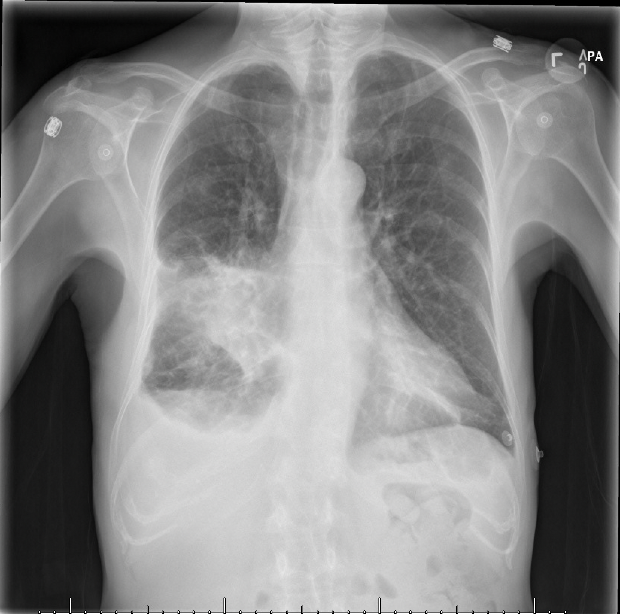
60-year-old-woman with three days of fevers and productive cough.
What is your overall interpretation?
Dense right middle lobe consolidation and small right pleural effusion.
How do you know this consolidation is in the right middle lobe?
Silhouette sign with obscuration of the right heart border.
Right middle lobe pneumonia and parapneumonic effusion.
What is your final diagnosis?
Right middle lobe consolidation
Right heart border
IF Silhouetted | Suggests Affected Lobe
L hemi-diaphragm | LLL
L heart border | Lingula
R hemi-diaphragm | RLL
R heart border | RML
Descending aorta | LLL
Pleural effusion
Scroll or use arrows to advance and reverse slide animations
Image courtesy of
Daniel Gergen, MD
Notes:
Objectives:
Use the silhouette sign to localize a right middle lobe pneumonia and parapneumonic effusion on chest x-ray.
Instructions: Ask a leaner to provide an overall interpretation. Advance using the arrows or scroll wheel on the mouse reveal subsequent questions with answers and graphics. You can go back to prior graphics and questions by using the back arrow or scrolling back on the mouse wheel.
Official CXR Read:. Dense right middle lobe consolidation and small right pleural effusion
Diagnosis: Right middle lobe pneumonia and parapneumonic effusion
Take home points:
Silhouette sign is defined as a loss of the normal radiographic silhouette, or interface, making it difficult to distinguish the borders of two different tissues. This results when substances of similar density are in direct contact.
A consolidation which obscures the right heart border is in the right middle lobe.
A pleural effusion next to a pneumonia is termed a parapneumonic effusion
References:
Goodman, L. R. (2019). Felson's Principles of Chest Roentgenology E-Book: A Programmed Text. Netherlands: Elsevier Health Sciences.

