Slide 1
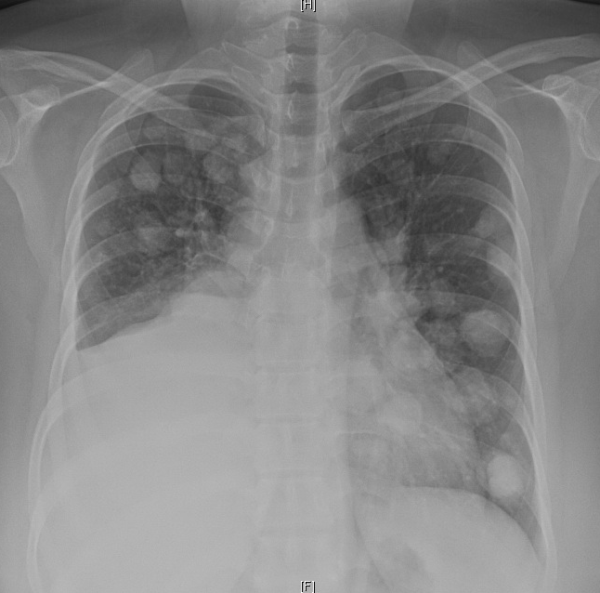
45yo woman presents with dyspnea, weight loss and pleuritic chest pain.
Numerous bilateral, basilar-predominant, well-defined nodules with R pleural effusion.
What is your overall interpretation?
What characteristics of these lesions are suspicious for metastases?
R Pleural Effusion
Images courtesy of
Lauren Brown, MD
Notes:
Instructions: Ask a leaner to provide a full interpretation of the new radiograph. Ask them to describe the nodules then advance through the slide for subsequent questions and graphics.
CXR Interpretation: Numerous bilateral basilar predominant, well-defined pulmonary nodules, concerning for metastases. Large right pleural effusion.
Diagnosis: Diffusely metastatic neuroendocrine tumor from unknown primary.
Teaching: Lung metastases are typically are well-defined, distributed toward the bases and the periphery reflecting hematogenous spread. There is also probably right-sided pleural metastasis based on the effusion. Primary lung cancer nodules tends to have ill-defined spiculated margins and are often located centrally or apically.

Slide 2
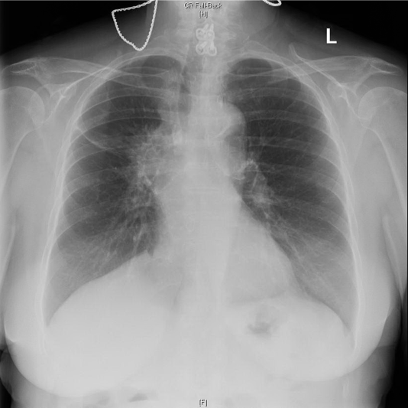
45yo woman with presents with dyspnea, weight loss and pleuritic chest pain.
Numerous bilateral, basilar-predominant, well-defined nodules with R pleural effusion.
What is your overall interpretation?
All the above. Hematogenous spread makes them bilateral and basilar. Well-defined because it is not native lung tissue.
What characteristics of these lesions are suspicious for metastases?
Metastases to the Lung
Vs
Primary Lung Cancer
Images courtesy of
Lauren Brown, MD
Notes:
Instructions: Ask a leaner to provide a full interpretation of the new radiograph. Ask them to describe the nodules then advance through the slide for subsequent questions and graphics.
CXR Interpretation: Numerous bilateral basilar predominant, well-defined pulmonary nodules, concerning for metastases. Large right pleural effusion.
Clinical Diagnosis: Diffusely metastatic neuroendocrine tumor from unknown primary.
Teaching: Lung metastases are typically well-defined, distributed bilaterally toward the bases and the periphery reflecting hematogenous spread. There is also a right-sided pleural metastasis based on the effusion. Primary lung cancer nodules tends to have ill-defined spiculated margins and are often located centrally or apically.

