Slide 1
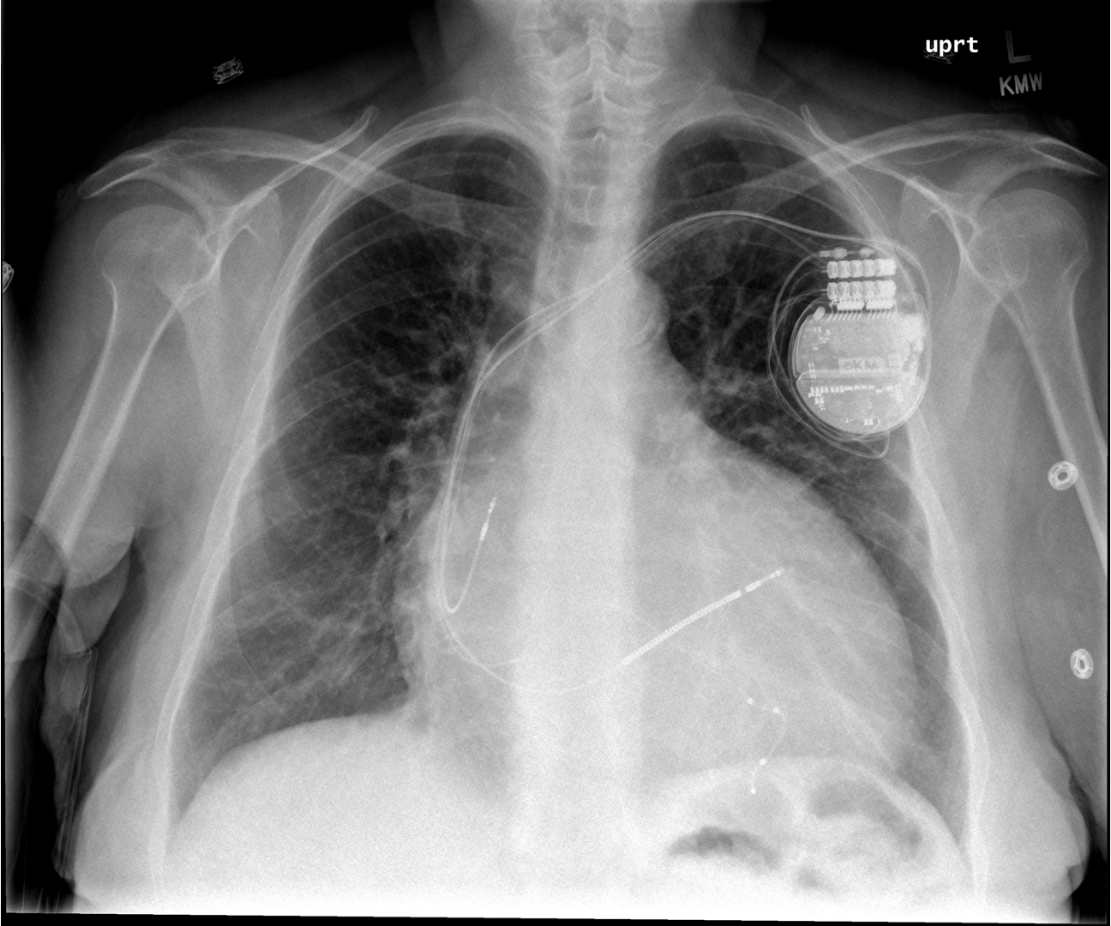
A 40yo with a history of non-ischemic cardiomyopathy presents with orthopnea.
Enlarged cardiac silhouette, cardiac device present.
What is your overall interpretation?
Cardiac device
Cardiac silhouette > ½ width of chest
Images courtesy of
Tami Bang, MD
Notes:
Objectives (after this session the learner will be able to):
Differentiate between a pacemaker and ICD on chest x ray.
Identify the location of cardiac device leads on a chest x ray.
Describe the indications and benefits of a CRT-D.
Instructions: Ask a leaner to provide an overall interpretation. Advance using the arrows or scroll wheel on the mouse reveal subsequent questions with answers and graphics. You can go back to prior graphics and questions by using the back arrow or scrolling back on the mouse wheel.
Official CXR Read:. Enlarged cardiac contour. Pacing device in place. No focal consolidation. No pleural effusions.
Clinical Diagnosis:. Cardiogenic shock due to non-ischemic cardiomyopathy
Teaching: This is usually 2-4 sentences of expanded explanations for major teaching points (usually Q2). Include references if quoting rules or specific numbers.
This patient has a cardiac resynchronization therapy – defibrillator (CRT-D). This device contains three leads. The leads are introduced into the subclavian vein. One lead terminates in the right atrium and senses electrical activity. The next lead terminates in the right ventricle, where it can pace. The final lead courses from the right atrium into the coronary sinus (which drains the cardiac veins) and abuts the left ventricle, where it can pace this chamber. Simultaneous pacing of the right and left ventricle (resynchronization therapy) can improve ejection fraction, NYHA classification, reduce hospitalizations and mortality in patients with severe heart failure who have a prolonged QRS (>150ms or LBBB and >130ms). Most patients with an indication for CRT have a concomitant indication for an ICD as primary prevention of SCD. (1, 2) However, a CRT-D comes with limitations and risks including higher costs, higher infection risk, greater likelihood of recall and less reliable pacing. (3)
Take home points:
A thick charge coil seen on an intracardiac device lead is for defibrillation
Cardiac resynchronization therapy with bi-V pacing is indicated for LVEF <35% and a QRS >120ms to improve EF, HF symptoms, hospitalizations and all-cause mortality.
References:
Russo A, Stainback R, Bailey S, et al. ACCF/HRS/AHA/ASE/HFSA/SCAI/SCCT/SCMR 2013 Appropriate Use Criteria for Implantable Cardioverter-Defibrillators and Cardiac Resynchronization Therapy. J Am Coll Cardiol. 2013 Mar, 61 (12) 1318–1368.https://doi.org/10.1016/j.jacc.2012.12.017
Tang AS, Wells GA, Talajic M, Arnold MO, Sheldon R, Connolly S, Hohnloser SH, Nichol G, Birnie DH, Sapp JL, Yee R, Healey JS, Rouleau JL; Resynchronization-Defibrillation for Ambulatory Heart Failure Trial Investigators. Cardiac-resynchronization therapy for mild-to-moderate heart failure. N Engl J Med. 2010 Dec 16;363(25):2385-95. doi: 10.1056/NEJMoa1009540. Epub 2010 Nov 14. PMID: 21073365.
Providência R, Kramer DB, Pimenta D, Babu GG, Hatfield LA, Ioannou A, Novak J, Hauser RG, Lambiase PD. Transvenous Implantable Cardioverter-Defibrillator (ICD) Lead Performance: A Meta-Analysis of Observational Studies. J Am Heart Assoc. 2015 Oct 30;4(11):e002418. doi: 10.1161/JAHA.115.002418. PMID: 26518666; PMCID: PMC4845221.

Slide 2
A 40yo with a history of non-ischemic cardiomyopathy presents with orthopnea.
Both.
Can this device pace, defibrillate, or both?
Thin pacing leads
Thick defibrillator coil
Images courtesy of
Tami Bang, MD
Notes:
Objectives (after this session the learner will be able to):
Differentiate between a pacemaker and ICD on chest x ray.
Identify the location of cardiac device leads on a chest x ray.
Describe the indications and benefits of a CRT-D.
Instructions: Ask a leaner to provide an overall interpretation. Advance using the arrows or scroll wheel on the mouse reveal subsequent questions with answers and graphics. You can go back to prior graphics and questions by using the back arrow or scrolling back on the mouse wheel.
Official CXR Read:. Enlarged cardiac contour. Pacing device in place. No focal consolidation. No pleural effusions.
Clinical Diagnosis:. Cardiogenic shock due to non-ischemic cardiomyopathy
Teaching: This is usually 2-4 sentences of expanded explanations for major teaching points (usually Q2). Include references if quoting rules or specific numbers.
This patient has a cardiac resynchronization therapy – defibrillator (CRT-D). This device contains three leads. The leads are introduced into the subclavian vein. One lead terminates in the right atrium and senses electrical activity. The next lead terminates in the right ventricle, where it can pace. The final lead courses from the right atrium into the coronary sinus (which drains the cardiac veins) and abuts the left ventricle, where it can pace this chamber. Simultaneous pacing of the right and left ventricle (resynchronization therapy) can improve ejection fraction, NYHA classification, reduce hospitalizations and mortality in patients with severe heart failure who have a prolonged QRS (>150ms or LBBB and >130ms). Most patients with an indication for CRT have a concomitant indication for an ICD as primary prevention of SCD. (1, 2) However, a CRT-D comes with limitations and risks including higher costs, higher infection risk, greater likelihood of recall and less reliable pacing. (3)
Take home points:
A thick charge coil seen on an intracardiac device lead is for defibrillation
Cardiac resynchronization therapy with bi-V pacing is indicated for LVEF <35% and a QRS >120ms to improve EF, HF symptoms, hospitalizations and all-cause mortality.
References:
Russo A, Stainback R, Bailey S, et al. ACCF/HRS/AHA/ASE/HFSA/SCAI/SCCT/SCMR 2013 Appropriate Use Criteria for Implantable Cardioverter-Defibrillators and Cardiac Resynchronization Therapy. J Am Coll Cardiol. 2013 Mar, 61 (12) 1318–1368.https://doi.org/10.1016/j.jacc.2012.12.017
Tang AS, Wells GA, Talajic M, Arnold MO, Sheldon R, Connolly S, Hohnloser SH, Nichol G, Birnie DH, Sapp JL, Yee R, Healey JS, Rouleau JL; Resynchronization-Defibrillation for Ambulatory Heart Failure Trial Investigators. Cardiac-resynchronization therapy for mild-to-moderate heart failure. N Engl J Med. 2010 Dec 16;363(25):2385-95. doi: 10.1056/NEJMoa1009540. Epub 2010 Nov 14. PMID: 21073365.
Providência R, Kramer DB, Pimenta D, Babu GG, Hatfield LA, Ioannou A, Novak J, Hauser RG, Lambiase PD. Transvenous Implantable Cardioverter-Defibrillator (ICD) Lead Performance: A Meta-Analysis of Observational Studies. J Am Heart Assoc. 2015 Oct 30;4(11):e002418. doi: 10.1161/JAHA.115.002418. PMID: 26518666; PMCID: PMC4845221.

Slide 3
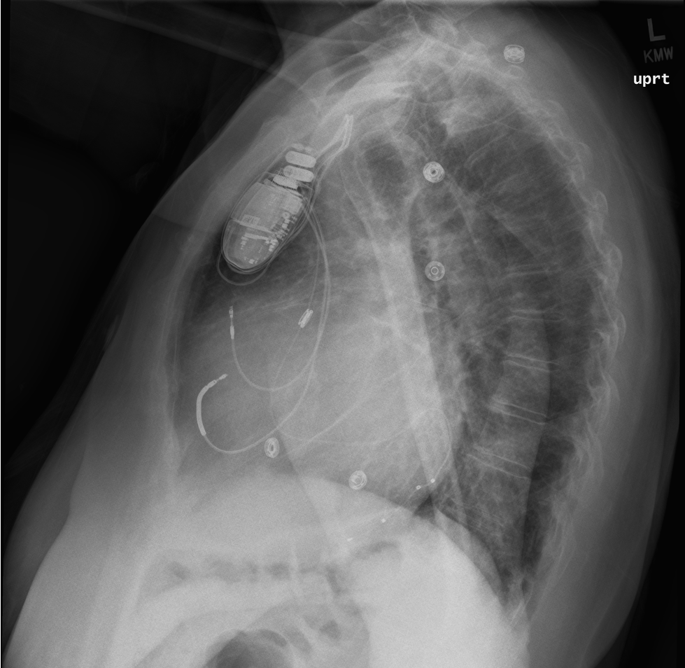
A 40yo with a history of non-ischemic cardiomyopathy presents with orthopnea.
Right atrium, right ventricle, coronary sinus. Atrial sensed, Bi-V pacer with ICD (CRT-D)
In which anatomical space does each lead terminate? And how would you describe this device?
LVEF <35%, QRS >120ms: CRT to improve EF, NYHA, hospitalizations and mortality
LVEF <35%, NYHA II-III: ICD for primary prevention of death from ventricular dysrhythmia
Given the clinical stem, what is the most likely indication(s) for this cardiac device?
1
Right atrium
2
Right ventricle
Images courtesy of
Tami Bang, MD
Coronary sinus -> LV
3
Notes:
Objectives (after this session the learner will be able to):
Differentiate between a pacemaker and ICD on chest x ray.
Identify the location of cardiac device leads on a chest x ray.
Describe the indications and benefits of a CRT-D.
Instructions: Ask a leaner to provide an overall interpretation. Advance using the arrows or scroll wheel on the mouse reveal subsequent questions with answers and graphics. You can go back to prior graphics and questions by using the back arrow or scrolling back on the mouse wheel.
Official CXR Read:. Enlarged cardiac contour. Pacing device in place. No focal consolidation. No pleural effusions.
Clinical Diagnosis:. Cardiogenic shock due to non-ischemic cardiomyopathy
Teaching: This is usually 2-4 sentences of expanded explanations for major teaching points (usually Q2). Include references if quoting rules or specific numbers.
This patient has a cardiac resynchronization therapy – defibrillator (CRT-D). This device contains three leads. The leads are introduced into the subclavian vein. One lead terminates in the right atrium and senses electrical activity. The next lead terminates in the right ventricle, where it can pace. The final lead courses from the right atrium into the coronary sinus (which drains the cardiac veins) and abuts the left ventricle, where it can pace this chamber. Simultaneous pacing of the right and left ventricle (resynchronization therapy) can improve ejection fraction, NYHA classification, reduce hospitalizations and mortality in patients with severe heart failure who have a prolonged QRS (>150ms or LBBB and >130ms). Most patients with an indication for CRT have a concomitant indication for an ICD as primary prevention of SCD. (1, 2) However, a CRT-D comes with limitations and risks including higher costs, higher infection risk, greater likelihood of recall and less reliable pacing. (3)
Take home points:
A thick charge coil seen on an intracardiac device lead is for defibrillation
Cardiac resynchronization therapy with bi-V pacing is indicated for LVEF <35% and a QRS >120ms to improve EF, HF symptoms, hospitalizations and all-cause mortality.
References:
Russo A, Stainback R, Bailey S, et al. ACCF/HRS/AHA/ASE/HFSA/SCAI/SCCT/SCMR 2013 Appropriate Use Criteria for Implantable Cardioverter-Defibrillators and Cardiac Resynchronization Therapy. J Am Coll Cardiol. 2013 Mar, 61 (12) 1318–1368.https://doi.org/10.1016/j.jacc.2012.12.017
Tang AS, Wells GA, Talajic M, Arnold MO, Sheldon R, Connolly S, Hohnloser SH, Nichol G, Birnie DH, Sapp JL, Yee R, Healey JS, Rouleau JL; Resynchronization-Defibrillation for Ambulatory Heart Failure Trial Investigators. Cardiac-resynchronization therapy for mild-to-moderate heart failure. N Engl J Med. 2010 Dec 16;363(25):2385-95. doi: 10.1056/NEJMoa1009540. Epub 2010 Nov 14. PMID: 21073365.
Providência R, Kramer DB, Pimenta D, Babu GG, Hatfield LA, Ioannou A, Novak J, Hauser RG, Lambiase PD. Transvenous Implantable Cardioverter-Defibrillator (ICD) Lead Performance: A Meta-Analysis of Observational Studies. J Am Heart Assoc. 2015 Oct 30;4(11):e002418. doi: 10.1161/JAHA.115.002418. PMID: 26518666; PMCID: PMC4845221.

