Slide 1
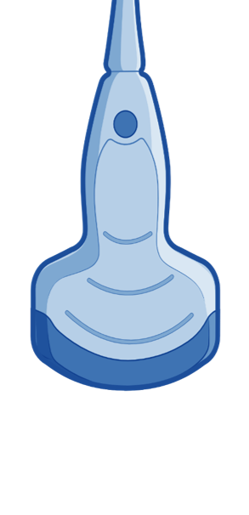
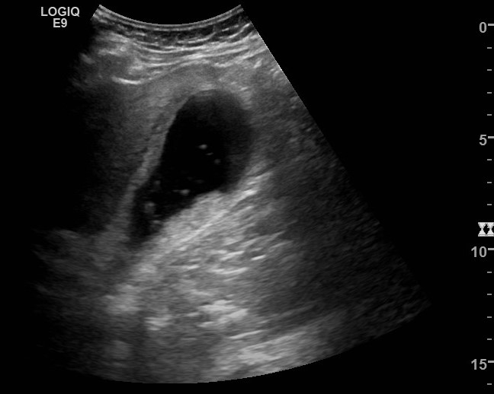
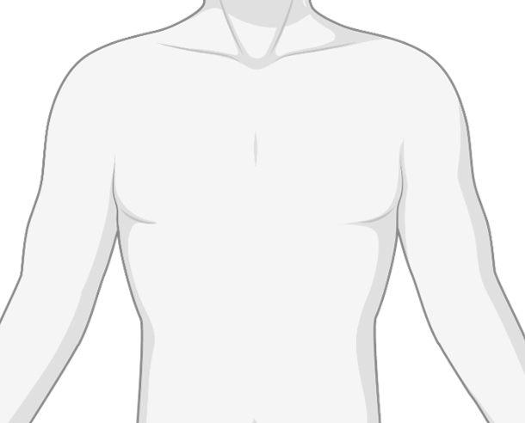
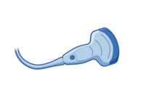
55yo obese woman with presents with severe epigastric pain. Afebrile, WBC 15, normal LFTs.
Gallstones at bladder neck with sludge and a thickened GB wall: Acute Cholecystitis
What is your overall interpretation and clinical diagnosis?
Normal GB wall <3mm | Thickened in cirrhosis, hepatitis, pancreatitis, & hypoalbuminemia
What is a normal GB wall thickness and when does a thickened GB not suggest cholecystitis?
Normal LFTs
Why is this case less concerning for choledocholithiasis and/or cholangitis?
7mm
Gallbladder
Liver
Sludge
Images courtesy of
Brandon Fainstad MD
Gallstones
Notes:
Objectives:
To identify key structures including liver, gallbladder, and biliary stones
To recognize which probe should be used for biliary pathology
Instructions: Ask a leaner to provide an overall interpretation. Advance using the arrows or scroll wheel on the mouse reveal subsequent questions with answers and graphics. You can go back to prior graphics and questions by using the back arrow or scrolling back on the mouse wheel.
Official POCUS interpretation: Likely obstructing gallstones at neck of gallbladder with layering and floating sludge material. The gallbladder wall is thickened at 7mm without pericholecystic fluid, consistent with cholecystitis in the correct clinical context.
Clinical diagnosis: Cholelithiasis with acute cholecystitis
Take home points:
A thickened gallbladder is defined as >3mm but may be due to surrounding inflammation or low oncotic pressure rather than cholecystitis.
Gallstones have a hyperechoic rim and, most importantly, an echogenic shadow that helps differentiate it from tumefactive sludge and polyps.
References:
Soni NJ. Point of care ultrasound. 2nd edition. ed. St. Louis, MO: Elsevier; 2019

Slide 2
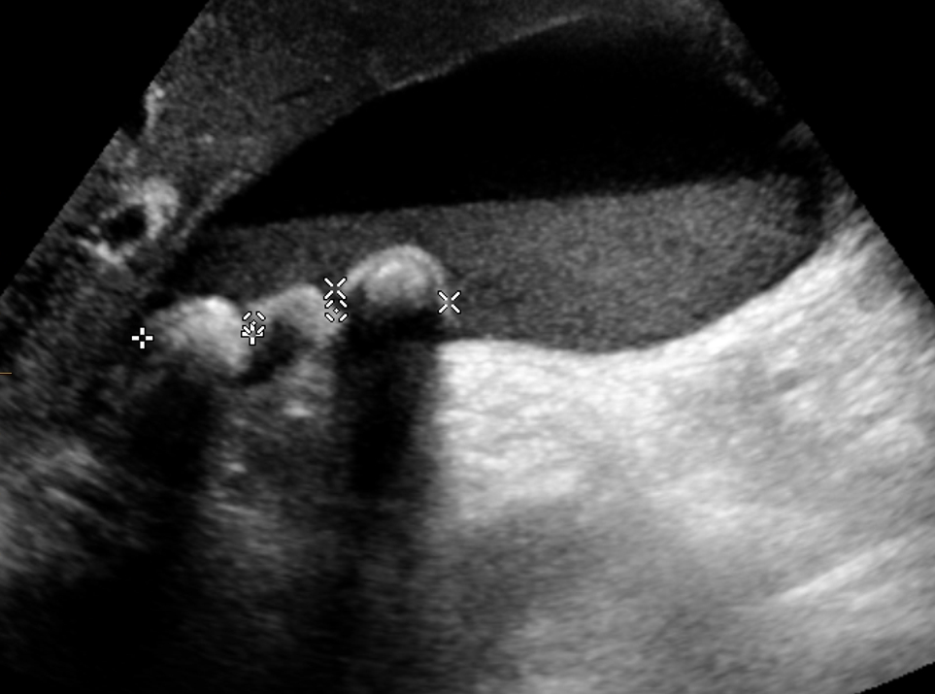
55yo obese woman with presents with severe epigastric pain. Afebrile, WBC 15, normal LFTs.
Both are echogenic and gravity dependent. Only stones create ACOUSTIC SHADOWING
How do you differentiate between stones and sludge?
Gallstones
Sludge
Case courtesy of Dr Chris O'Donnell, Radiopaedia.org, rID: 19516
Notes:
Objectives:
To identify key structures including liver, gallbladder, and biliary stones
To recognize which probe should be used for biliary pathology
Instructions: Ask a leaner to provide an overall interpretation. Advance using the arrows or scroll wheel on the mouse reveal subsequent questions with answers and graphics. You can go back to prior graphics and questions by using the back arrow or scrolling back on the mouse wheel.
Official POCUS interpretation: likely obstructing gallstones at neck of gallbladder with layering and floating sludge material. The gallbladder wall is thickened at 7mm without pericholecystic fluid, consistent with cholecystitis in the correct clinical context.
Clinical diagnosis: Cholelithiasis with biliary colic/acute cholecystitis
Take home points:
- Bedside POCUS can be used to identify cholelithiasis
- With clinical history and measuring the gallbladder wall > 3mm, you can identify cholecystitis
References:
Soni NJ. Point of care ultrasound. 2nd edition. ed. St. Louis, MO: Elsevier; 2019
Case image courtesy of Dr Chris O'Donnell, Radiopaedia.org, <a href="https://radiopaedia.org/cases/9558?lang=us">rID: 19516</a>

Slide 3
How to obtain long and short axis views of the GB
LONG AXIS VIEW
P
SHORT AXIS VIEW
Images courtesy of
Carolina Ortiz-Lopez, MD
P
Notes:
Objectives:
To identify key structures including liver, gallbladder, and biliary stones
To recognize which probe should be used for biliary pathology
Instructions: Ask a leaner to provide an overall interpretation. Advance using the arrows or scroll wheel on the mouse reveal subsequent questions with answers and graphics. You can go back to prior graphics and questions by using the back arrow or scrolling back on the mouse wheel.
Official POCUS interpretation: likely obstructing gallstones at neck of gallbladder with layering and floating sludge material. The gallbladder wall is thickened at 7mm without pericholecystic fluid, consistent with cholecystitis in the correct clinical context.
Clinical diagnosis: Cholelithiasis with biliary colic/acute cholecystitis
Take home points:
- Bedside POCUS can be used to identify cholelithiasis
- With clinical history and measuring the gallbladder wall > 3mm, you can identify cholecystitis
References:
Soni NJ. Point of care ultrasound. 2nd edition. ed. St. Louis, MO: Elsevier; 2019

