Slide 1
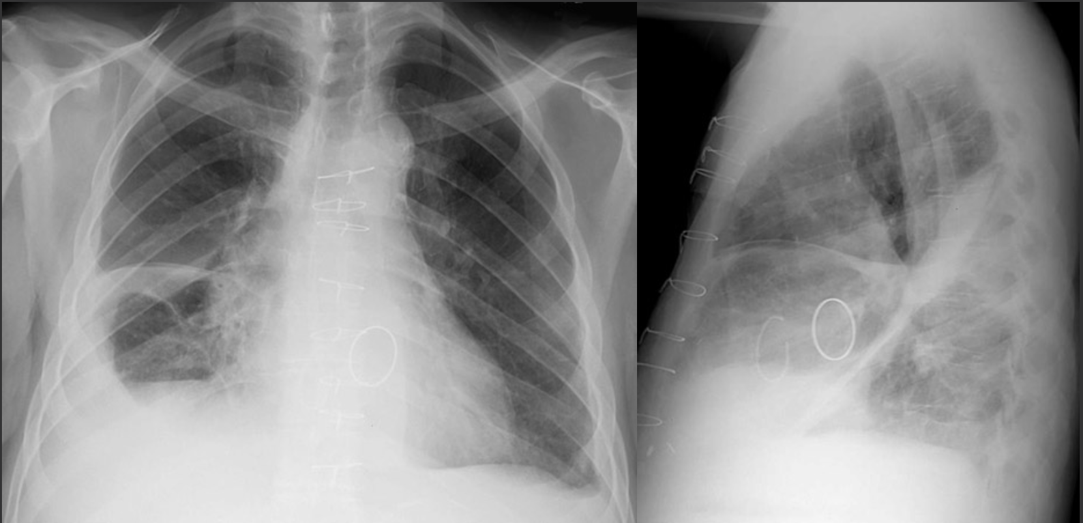
60yo presents to clinic with progressive orthopnea and dyspnea on exertion.
What is your overall interpretation?
Sternotomy wires and two mechanical valves with bilateral pleural effusions and vascular congestion.
In which pleural spaces has fluid collected?
Right minor fissure, right major fissure, right subpulmonic space and left costophrenic sulcus.
How do you distinguish between the left and right major fissure on the lateral view?
The right major fissure extends from the spine to the diaphragm. The left stops at the mediastinum.
RIGHT MINOR
FISSURE
RIGHT MINOR FISSURE
*Extends to diaphragm, past the mediastinum*
RIGHT SUBPULMONIC SPACE AND SULCUS
LEFT COSTOPHRENIC SULCUS
RIGHT MAJOR
Notes:
Objective:
Identify the minor and major fissures using a CXR with multiple pleural effusions.
Official CXR Read: Sternotomy wires with two prosthetic valves. Right middle and lower lobe airspace opacities with parapneumonic effusions in the right-sided fissures and subpulmonic space along with a small effusion in left costo-phrenic sulcus.
Diagnosis: Right middle lobe pneumonia and parapneumonic effusions
Teaching: The focus of this talk is on the identification of lobes and fissures. The right has a minor fissure seen on both AP and lateral views while the left does not have a minor fissure. The major fissure for either side is best seen on the lateral view and differentiated by whether or not the fissure extends all the way to the diaphragm (right) or stops at the mediastinum (left).

Slide 2
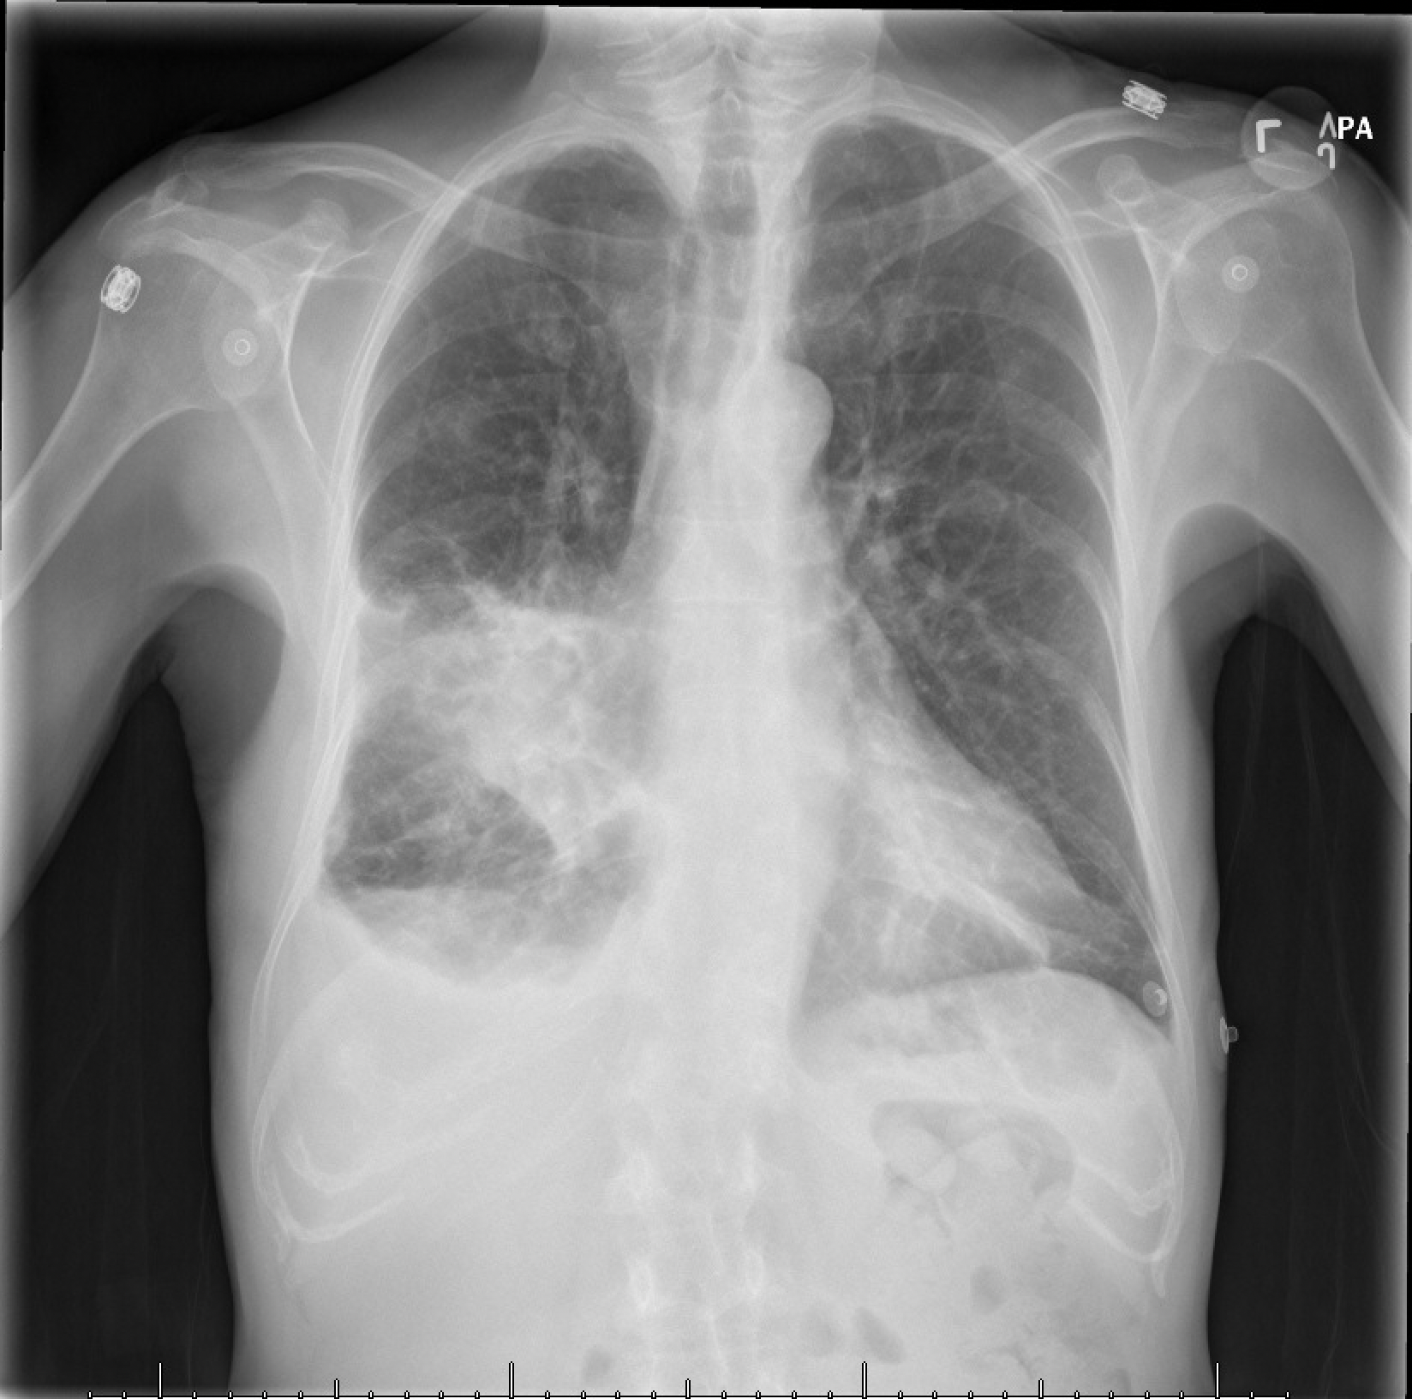
60yo presents with three days of fevers and productive cough.
What is your overall interpretation?
Dense right middle lobe consolidation and small right pleural effusion.
How do you know this consolidation is in the right middle lobe?
Silhouette sign with obscuration of the right heart border.
Right middle lobe pneumonia and parapneumonic effusion.
What is your final diagnosis?
Right middle lobe consolidation
Right heart border
IF Silhouetted | Suggests Affected Lobe
L hemi-diaphragm | LLL
L heart border | Lingula
R hemi-diaphragm | RLL
R heart border | RML
Descending aorta | LLL
Pleural effusion
Image courtesy of
Daniel Gergen, MD
Notes:
Objectives:
Use the silhouette sign to localize a right middle lobe pneumonia and parapneumonic effusion on chest x-ray.
Instructions: Ask a leaner to provide an overall interpretation. Advance using the arrows or scroll wheel on the mouse reveal subsequent questions with answers and graphics. You can go back to prior graphics and questions by using the back arrow or scrolling back on the mouse wheel.
Official CXR Read:. Dense right middle lobe consolidation and small right pleural effusion
Diagnosis: Right middle lobe pneumonia and parapneumonic effusion
Take home points:
Silhouette sign is defined as a loss of the normal radiographic silhouette, or interface, making it difficult to distinguish the borders of two different tissues. This results when substances of similar density are in direct contact.
A consolidation which obscures the right heart border is in the right middle lobe.
A pleural effusion next to a pneumonia is termed a parapneumonic effusion
References:
Goodman, L. R. (2019). Felson's Principles of Chest Roentgenology E-Book: A Programmed Text. Netherlands: Elsevier Health Sciences.

Slide 3
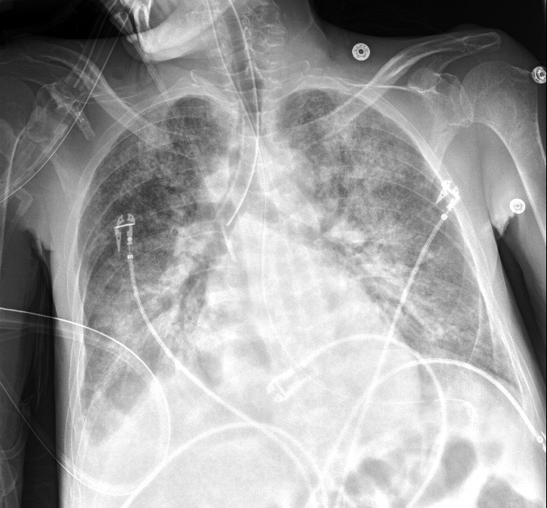
45yo with ESRD develops acute hypoxemic respiratory failure.
What is your overall interpretation?
Diffuse bilateral alveolar infiltrates with air bronchograms, right mainstem intubation.
Endotracheal tube in right mainstem bronchus
Diffuse bilateral alveolar infiltrates
Diffuse bilateral alveolar infiltrates
Air bronchograms
Small right pleural effusion
Images courtesy of
Samantha King, MD
Notes:
Objectives:
1. Identify an endotracheal tube on CXR and determine whether it is in the appropriate position.
Instructions: Ask a leaner to provide an overall interpretation. Advance using the arrows or scroll wheel on the mouse reveal subsequent questions with answers and graphics. You can go back to prior graphics and questions by using the back arrow or scrolling back on the mouse wheel.
Official CXR Read:. Right IJ line terminates in the distal SVC. Enteric tube reaches the proximal stomach. ET tube is been placed and extends approximately 1.7 cm into the right mainstem bronchus. Diffuse lung opacities more focal right basal consolidation. There are is a small right pleural effusion.
Diagnosis:. Acute respiratory distress syndrome secondary to sepsis from spontaneous bacterial peritonitis
Teaching: An endotracheal tube should terminate 2-4 cm above the carina. The tube must be low enough to ensure that the cuff will inflate below the vocal cords (avoid vocal cord trauma), and high enough to adequately ventilate both lungs.
Take home points:
An endotracheal tube should terminate 2-4 cm above the carina
References: Myrna C. B. Godoy, Barry S. Leitman, Patricia M. de Groot, Ioannis Vlahos, and David P. Naidich
Chest Radiography in the ICU: Part 1, Evaluation of Airway, Enteric, and Pleural Tubes
American Journal of Roentgenology 2012 198:3, 563-571

Slide 4
45yo with ESRD develops acute hypoxemic respiratory failure.
What is your overall interpretation?
Diffuse bilateral alveolar infiltrates with air bronchograms, right mainstem intubation.
What would be your next step in management?
What is the correct positioning for an endotracheal tube?
Endotracheal tube in right mainstem bronchus
Carina
The endotracheal tube should terminate 2-4 cm above the carina.
Left main bronchus
Right main bronchus
Images courtesy of
Samantha King, MD
Notes:
Objectives:
1. Identify an endotracheal tube on CXR and determine whether it is in the appropriate position.
Instructions: Ask a leaner to provide an overall interpretation. Advance using the arrows or scroll wheel on the mouse reveal subsequent questions with answers and graphics. You can go back to prior graphics and questions by using the back arrow or scrolling back on the mouse wheel.
Official CXR Read:. Right IJ line terminates in the distal SVC. Enteric tube reaches the proximal stomach. ET tube is been placed and extends approximately 1.7 cm into the right mainstem bronchus. Diffuse lung opacities more focal right basal consolidation. There are is a small right pleural effusion.
Diagnosis:. Acute respiratory distress syndrome secondary to sepsis from spontaneous bacterial peritonitis
Teaching: An endotracheal tube should terminate 2-4 cm above the carina. The tube must be low enough to ensure that the cuff will inflate below the vocal cords (avoid vocal cord trauma), and high enough to adequately ventilate both lungs.
Take home points:
An endotracheal tube should terminate 2-4 cm above the carina
References: Myrna C. B. Godoy, Barry S. Leitman, Patricia M. de Groot, Ioannis Vlahos, and David P. Naidich
Chest Radiography in the ICU: Part 1, Evaluation of Airway, Enteric, and Pleural Tubes
American Journal of Roentgenology 2012 198:3, 563-571

Slide 5
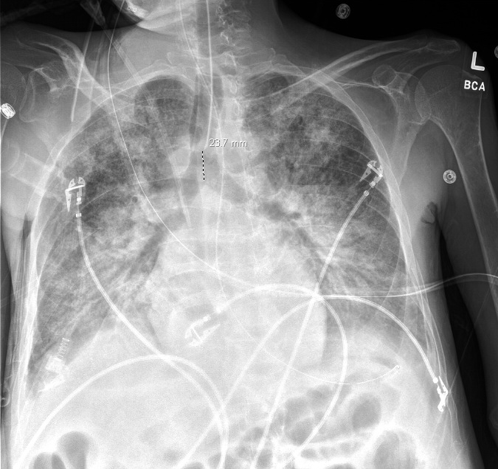
45yo with ESRD develops acute hypoxemic respiratory failure.
What is your overall interpretation?
Diffuse bilateral alveolar infiltrates with air bronchograms, right mainstem intubation.
What would be your next step in management?
What is the correct positioning for an endotracheal tube?
What is the correct positioning for an endotracheal tube?
Retract the endotracheal tube.
Endotracheal tube in appropriate position about 2.4 cm above the carina
Images courtesy of
Samantha King, MD
Repeat CXR after ET tube retracted 4 cm
Notes:
Objectives:
1. Identify an endotracheal tube on CXR and determine whether it is in the appropriate position.
Instructions: Ask a leaner to provide an overall interpretation. Advance using the arrows or scroll wheel on the mouse reveal subsequent questions with answers and graphics. You can go back to prior graphics and questions by using the back arrow or scrolling back on the mouse wheel.
Official CXR Read:. Right IJ line terminates in the distal SVC. Enteric tube reaches the proximal stomach. ET tube is been placed and extends approximately 1.7 cm into the right mainstem bronchus. Diffuse lung opacities more focal right basal consolidation. There are is a small right pleural effusion.
Diagnosis:. Acute respiratory distress syndrome secondary to sepsis from spontaneous bacterial peritonitis
Teaching: An endotracheal tube should terminate 2-4 cm above the carina. The tube must be low enough to ensure that the cuff will inflate below the vocal cords (avoid vocal cord trauma), and high enough to adequately ventilate both lungs.
Take home points:
An endotracheal tube should terminate 2-4 cm above the carina
References: Myrna C. B. Godoy, Barry S. Leitman, Patricia M. de Groot, Ioannis Vlahos, and David P. Naidich
Chest Radiography in the ICU: Part 1, Evaluation of Airway, Enteric, and Pleural Tubes
American Journal of Roentgenology 2012 198:3, 563-571

Slide 6
45yo with ESRD develops acute hypoxemic respiratory failure.
What is your overall interpretation?
Diffuse bilateral alveolar infiltrates with air bronchograms, right mainstem intubation.
Bonus: what other invasive tubes and lines are present?
Right IJ dialysis catheter terminating in the SVC
Scroll or use arrows to advance and reverse slide animations
OG tube terminating in the proximal stomach
Images courtesy of
Samantha King, MD
Notes:
Objectives:
1. Identify an endotracheal tube on CXR and determine whether it is in the appropriate position.
Instructions: Ask a leaner to provide an overall interpretation. Advance using the arrows or scroll wheel on the mouse reveal subsequent questions with answers and graphics. You can go back to prior graphics and questions by using the back arrow or scrolling back on the mouse wheel.
Official CXR Read:. Right IJ line terminates in the distal SVC. Enteric tube reaches the proximal stomach. ET tube is been placed and extends approximately 1.7 cm into the right mainstem bronchus. Diffuse lung opacities more focal right basal consolidation. There are is a small right pleural effusion.
Diagnosis:. Acute respiratory distress syndrome secondary to sepsis from spontaneous bacterial peritonitis
Teaching: An endotracheal tube should terminate 2-4 cm above the carina. The tube must be low enough to ensure that the cuff will inflate below the vocal cords (avoid vocal cord trauma), and high enough to adequately ventilate both lungs.
Take home points:
An endotracheal tube should terminate 2-4 cm above the carina
References: Myrna C. B. Godoy, Barry S. Leitman, Patricia M. de Groot, Ioannis Vlahos, and David P. Naidich
Chest Radiography in the ICU: Part 1, Evaluation of Airway, Enteric, and Pleural Tubes
American Journal of Roentgenology 2012 198:3, 563-571

Slide 7
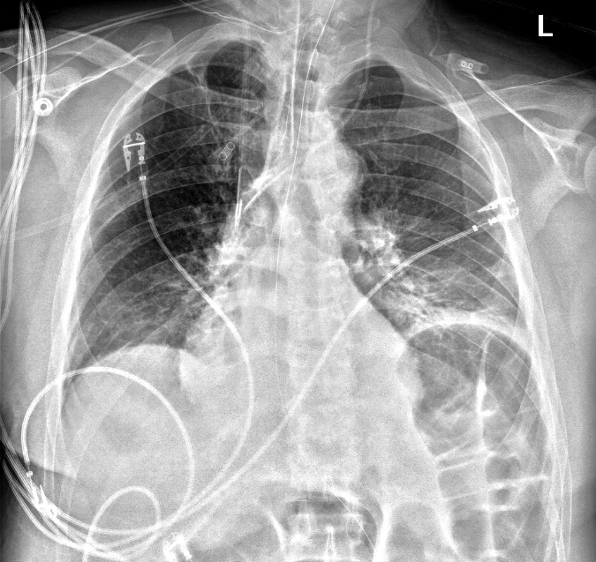
52 yo M w/ myasthenia gravis admitted for respiratory failure and septic shock of unclear source.
What is your overall interpretation?
Small left basilar consolidation, elevated left hemidiaphragm, dilated loops of bowel.
What invasive devices are present?
Are the central lines in the appropriate position?
Right IJ dialysis catheter
Left IJ central line (triple lumen)
OG tube
Esophageal probe
Small left basilar consolidation with air bronchograms
ET tube
Left hemidiaphgram elevation
Images courtesy of
Samantha King, MD
Dilated loops of bowel
Notes:
Objectives:
Identify left and right central venous catheters (CVCs) on a chest x ray and the appropriate location of their placement
Instructions: Ask a leaner to provide an overall interpretation. Advance using the arrows or scroll wheel on the mouse reveal subsequent questions with answers and graphics. You can go back to prior graphics and questions by using the back arrow or scrolling back on the mouse wheel.
Official CXR Read:. The right IJ dialysis catheter and left central venous catheter terminate in the distal superior vena cava. The endotracheal team terminates above the level of the carina. An esophageal probe and orogastric tube is present.
Continued edema with bibasilar opacities. Small pleural effusions. No pneumothorax. Dilated bowel.
Diagnosis: left lower lobe pneumonia, non-specific bowel dilation
Take home points:
An internal jugular central venous catheter should terminate in the distal superior vena cava, approximately at the level of the carina
Dialysis catheters are thicker and less flexible than triple lumen catheters, and therefore preferentially placed on the right (straighter trajectory)
References:
Goodman, L. R. (2019). Felson's Principles of Chest Roentgenology E-Book: A Programmed Text. Netherlands: Elsevier Health Sciences.

Slide 8
52 yo M w/ myasthenia gravis admitted for respiratory failure and septic shock of unclear source.
What is your overall interpretation?
Small left basilar consolidation, elevated left hemidiaphragm, dilated loops of bowel.
Are the central lines in the appropriate position?
IJ
IJ
Right IJ dialysis catheter
Left IJ central line (triple lumen)
Subclavian
Subclavian
HD catheters are thicker and less flexible than triple lumen catheters, and therefore preferentially placed on the right (straighter trajectory).
Central line placement:
Should terminate in the distal superior vena cava, at about the level of the carina.
SVC
Carina
Scroll or use arrows to advance and reverse slide animations
Images courtesy of
Samantha King, MD
Notes:
Objectives:
Identify left and right internal jugular central venous catheters (CVCs) on a chest x ray and the appropriate location their placement
Instructions: Ask a leaner to provide an overall interpretation. Advance using the arrows or scroll wheel on the mouse reveal subsequent questions with answers and graphics. You can go back to prior graphics and questions by using the back arrow or scrolling back on the mouse wheel.
Official CXR Read:. The right IJ dialysis catheter and left central venous catheter terminate in the distal inferior vena cava. The endotracheal team terminates above the level of the carina. An esophageal probe and orogastric tube is present.
Continued edema with bibasilar opacities. Small pleural effusions. No pneumothorax. Dilated bowel.
Diagnosis: left lower lobe pneumonia, non-specific bowel dilation
Take home points:
An internal jugular central venous catheter should terminate in the distal superior vena cava, approximately at the level of the carina
Dialysis catheters are thicker and less flexible than triple lumen catheters, and therefore preferentially placed on the right (straighter trajectory)
References:
Goodman, L. R. (2019). Felson's Principles of Chest Roentgenology E-Book: A Programmed Text. Netherlands: Elsevier Health Sciences.

Slide 9
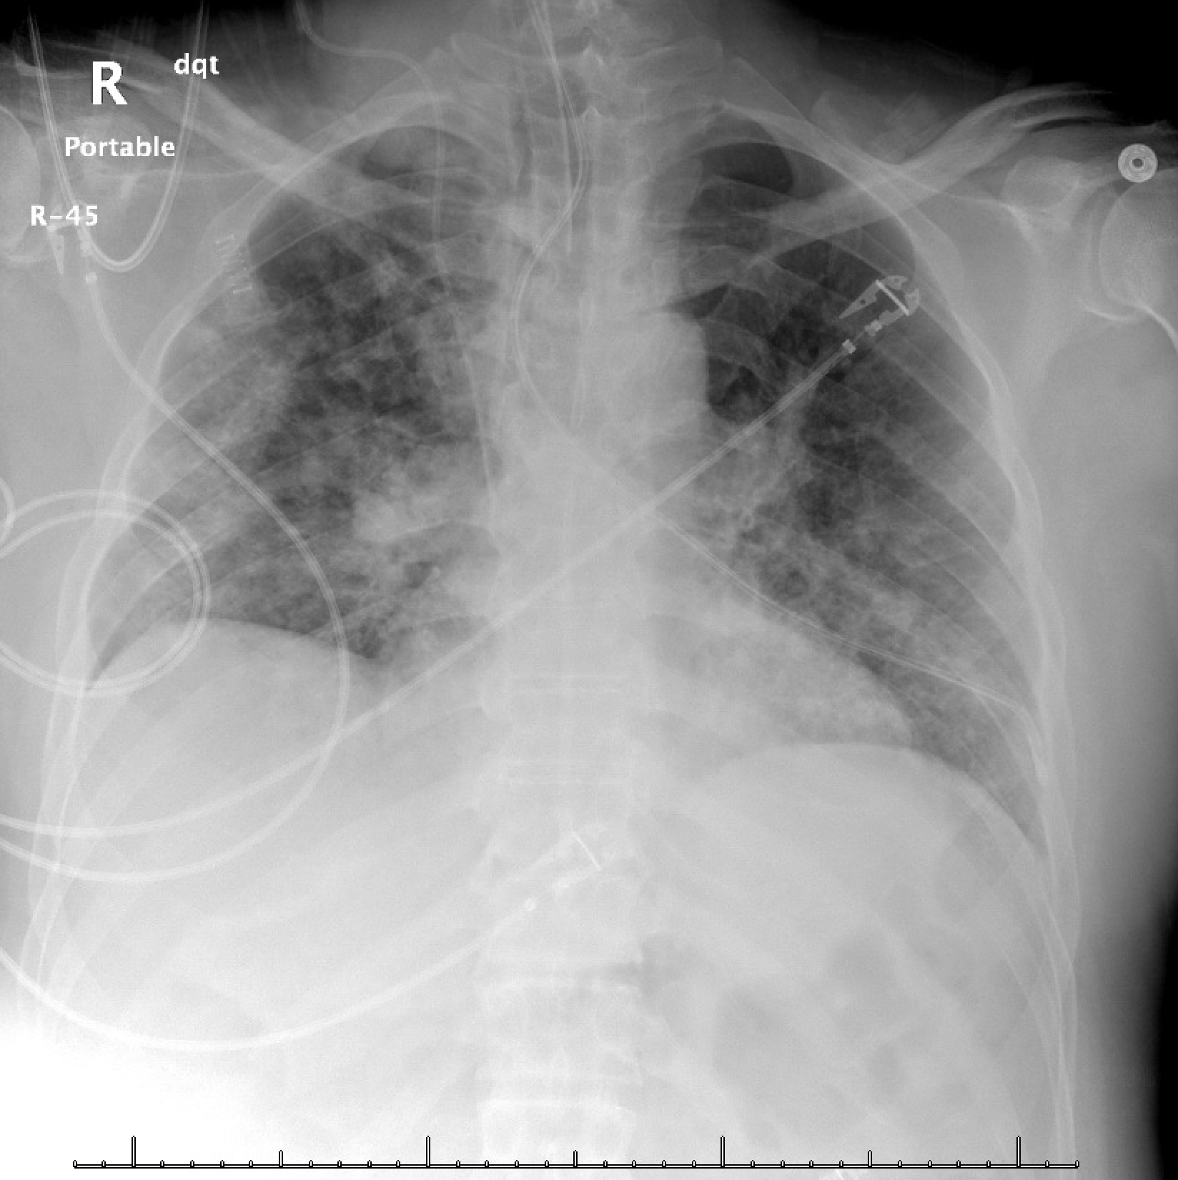
55yo with COVID-19 ARDS intubated in the ICU.
Extensive, multifocal alveolar opacities with endotracheal tube and right IJ CVC.
What is your overall interpretation of the radiograph?
Is the enteric tube in the correct location?
No. Enteric tube courses through left mainstem bronchus to lung periphery.
How do you determine whether an enteric tube is in the appropriate position?
RIJ CVC
ETT
2-5cm above carina
Alveolar opacities
Cavo-atrial (SVC-RA) junction
Enteric tube
Images courtesy of
Daniel Gergen, MD
Notes:
Instructions: Ask a leaner to provide an overall interpretation. Advance the slide for subsequent questions.
Objective:
1. Use two rules to determine the appropriate placement of a nasogastric or orogastric tube on chest x-ray.
CXR Read:
New weighted tip feeding tube appears to course through the left mainstem bronchus, with tip projecting over the lateral left lung. This may be in the pleural space, and a follow-up radiograph (after tube removal) is recommended, as this patient is at high risk for developing a pneumothorax. Endotracheal tube tip projects over the mid intrathoracic trachea. Right IJ central venous catheter tip projects over the superior vena cava.
In addition, extensive multifocal alveolar opacities.
Diagnosis: Mispositioned weighted feeding tube requiring removal and replacement
Teaching:
The radiograph demonstrates multifocal alveolar opacities due to ARDS.
The right internal jugular central venous catheter terminates at the cavoatrial (superior vena cava and right atrial) junction.
The endotracheal tube (ETT) terminates approximately 4 cm above the carina (goal of 2-5cm).
Gastric tubes (nasogastric, orogastric) are commonly placed for enteral access for medication administration and nutrition along with gastric decompression. Residents are often asked to confirm placement without an official radiologist interpretation.
A 2-step process for determining appropriate gastric tube placement:
Does the portion of the tube above the diaphragm remain midline? The esophagus is a midline structure. Any deviation of the enteric tube from the midline should raise suspicion for misplacement (i.e. trachea/bronchi) or curling within the esophagus.
Does the tube end below the diaphragm/cardiac silhouette? An enteric tube that ends above this level is likely not in the stomach, which increases the risk of aspiration.
(optional) Is the tip of the tube pointing towards the pylorus

Slide 10
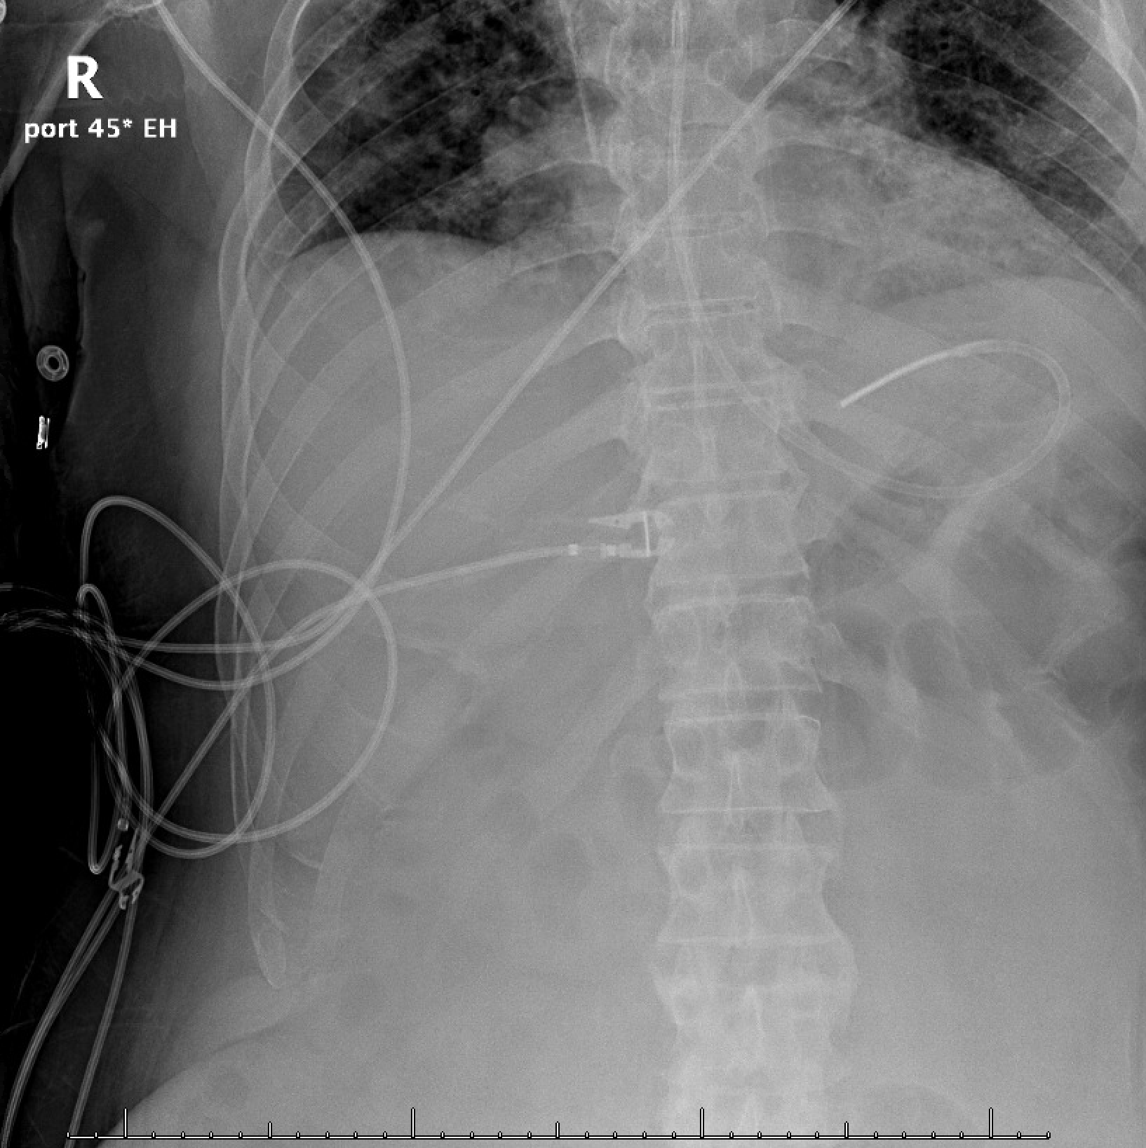
55yo with COVID-19 ARDS intubated in the ICU.
Extensive, multifocal alveolar opacities with endotracheal tube and right IJ CVC.
What is your overall interpretation of the radiograph?
Is the enteric tube in the correct location?
No. Enteric tube courses through left mainstem bronchus to lung periphery.
How do you determine whether an enteric tube is in the appropriate position?
Is enteric tube placement appropriate?
Does the tube change directions at the carina?
Does the tube end below the diaphragm/cardiac silhouette?
Carina
Repositioned Enteric Tube
Enteric tube
Images courtesy of
Daniel Gergen, MD
Notes:
Instructions: Ask a leaner to provide an overall interpretation. Advance the slide for subsequent questions.
CXR Read:
New weighted tip feeding tube appears to course through the left mainstem bronchus, with tip projecting over the lateral left lung. This may be in the pleural space, and a follow-up radiograph (after tube removal) is recommended, as this patient is at high risk for developing a pneumothorax. Endotracheal tube tip projects over the mid intrathoracic trachea. Right IJ central venous catheter tip projects over the superior vena cava.
In addition, extensive multifocal alveolar opacities.
Diagnosis: mispositioned weighted feeding tube requiring removal and replacement
Teaching:
The radiograph demonstrates multifocal alveolar opacities due to ARDS.
The right internal jugular central venous catheter terminates at the cavoatrial (superior vena cava and right atrial) junction.
The endotracheal tube (ETT) terminates approximately 4 cm above the carina (goal of 2-5cm).
Gastric tubes (nasogastric, orogastric) are commonly placed for enteral access for medication administration and nutrition along with gastric decompression. Residents are often asked to confirm placement without an official radiologist interpretation.
A 2-step process for determining appropriate gastric tube placement:
Does the portion of the tube above the diaphragm remain midline? The esophagus is a midline structure. Any deviation of the enteric tube from the midline should raise suspicion for misplacement (i.e. trachea/bronchi) or curling within the esophagus.
Does the tube end below the diaphragm/cardiac silhouette? An enteric tube that ends above this level is likely not in the stomach, which increases the risk of aspiration.
(optional) Is the tip of the tube pointing towards the pylorus

Slide 11
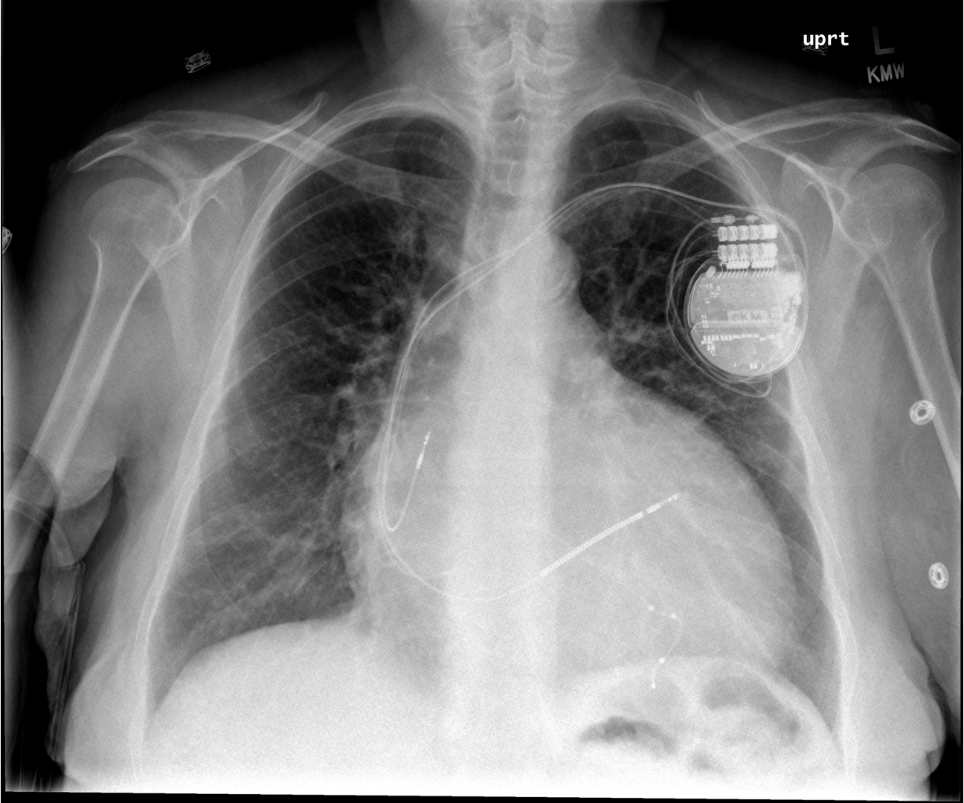
A 40yo with a history of non-ischemic cardiomyopathy presents with orthopnea.
Enlarged cardiac silhouette, cardiac device present.
What is your overall interpretation?
Cardiac device
Images courtesy of
Tami Bang, MD
Cardiac silhouette > ½ width of chest
Notes:
Objectives (after this session the learner will be able to):
Differentiate between a pacemaker and ICD on chest x ray.
Identify the location of cardiac device leads on a chest x ray.
Describe the indications and benefits of a CRT-D.
Instructions: Ask a leaner to provide an overall interpretation. Advance using the arrows or scroll wheel on the mouse reveal subsequent questions with answers and graphics. You can go back to prior graphics and questions by using the back arrow or scrolling back on the mouse wheel.
Official CXR Read:. Enlarged cardiac contour. Pacing device in place. No focal consolidation. No pleural effusions.
Clinical Diagnosis:. Cardiogenic shock due to non-ischemic cardiomyopathy
Teaching: This is usually 2-4 sentences of expanded explanations for major teaching points (usually Q2). Include references if quoting rules or specific numbers.
This patient has a cardiac resynchronization therapy – defibrillator (CRT-D). This device contains three leads. The leads are introduced into the subclavian vein. One lead terminates in the right atrium and senses electrical activity. The next lead terminates in the right ventricle, where it can pace. The final lead courses from the right atrium into the coronary sinus (which drains the cardiac veins) and abuts the left ventricle, where it can pace this chamber. Simultaneous pacing of the right and left ventricle (resynchronization therapy) can improve ejection fraction, NYHA classification, reduce hospitalizations and mortality in patients with severe heart failure who have a prolonged QRS (>150ms or LBBB and >130ms). Most patients with an indication for CRT have a concomitant indication for an ICD as primary prevention of SCD. (1, 2) However, a CRT-D comes with limitations and risks including higher costs, higher infection risk, greater likelihood of recall and less reliable pacing. (3)
Take home points:
A thick charge coil seen on an intracardiac device lead is for defibrillation
Cardiac resynchronization therapy with bi-V pacing is indicated for LVEF <35% and a QRS >120ms to improve EF, HF symptoms, hospitalizations and all-cause mortality.
References:
Russo A, Stainback R, Bailey S, et al. ACCF/HRS/AHA/ASE/HFSA/SCAI/SCCT/SCMR 2013 Appropriate Use Criteria for Implantable Cardioverter-Defibrillators and Cardiac Resynchronization Therapy. J Am Coll Cardiol. 2013 Mar, 61 (12) 1318–1368.https://doi.org/10.1016/j.jacc.2012.12.017
Tang AS, Wells GA, Talajic M, Arnold MO, Sheldon R, Connolly S, Hohnloser SH, Nichol G, Birnie DH, Sapp JL, Yee R, Healey JS, Rouleau JL; Resynchronization-Defibrillation for Ambulatory Heart Failure Trial Investigators. Cardiac-resynchronization therapy for mild-to-moderate heart failure. N Engl J Med. 2010 Dec 16;363(25):2385-95. doi: 10.1056/NEJMoa1009540. Epub 2010 Nov 14. PMID: 21073365.
Providência R, Kramer DB, Pimenta D, Babu GG, Hatfield LA, Ioannou A, Novak J, Hauser RG, Lambiase PD. Transvenous Implantable Cardioverter-Defibrillator (ICD) Lead Performance: A Meta-Analysis of Observational Studies. J Am Heart Assoc. 2015 Oct 30;4(11):e002418. doi: 10.1161/JAHA.115.002418. PMID: 26518666; PMCID: PMC4845221.

Slide 12
A 40yo with a history of non-ischemic cardiomyopathy presents with orthopnea.
Both.
Can this device pace, defibrillate, or both?
Thin pacing leads
Thick defibrillator coil
Images courtesy of
Tami Bang, MD
Notes:
Objectives (after this session the learner will be able to):
Differentiate between a pacemaker and ICD on chest x ray.
Identify the location of cardiac device leads on a chest x ray.
Describe the indications and benefits of a CRT-D.
Instructions: Ask a leaner to provide an overall interpretation. Advance using the arrows or scroll wheel on the mouse reveal subsequent questions with answers and graphics. You can go back to prior graphics and questions by using the back arrow or scrolling back on the mouse wheel.
Official CXR Read:. Enlarged cardiac contour. Pacing device in place. No focal consolidation. No pleural effusions.
Clinical Diagnosis:. Cardiogenic shock due to non-ischemic cardiomyopathy
Teaching: This is usually 2-4 sentences of expanded explanations for major teaching points (usually Q2). Include references if quoting rules or specific numbers.
This patient has a cardiac resynchronization therapy – defibrillator (CRT-D). This device contains three leads. The leads are introduced into the subclavian vein. One lead terminates in the right atrium and senses electrical activity. The next lead terminates in the right ventricle, where it can pace. The final lead courses from the right atrium into the coronary sinus (which drains the cardiac veins) and abuts the left ventricle, where it can pace this chamber. Simultaneous pacing of the right and left ventricle (resynchronization therapy) can improve ejection fraction, NYHA classification, reduce hospitalizations and mortality in patients with severe heart failure who have a prolonged QRS (>150ms or LBBB and >130ms). Most patients with an indication for CRT have a concomitant indication for an ICD as primary prevention of SCD. (1, 2) However, a CRT-D comes with limitations and risks including higher costs, higher infection risk, greater likelihood of recall and less reliable pacing. (3)
Take home points:
A thick charge coil seen on an intracardiac device lead is for defibrillation
Cardiac resynchronization therapy with bi-V pacing is indicated for LVEF <35% and a QRS >120ms to improve EF, HF symptoms, hospitalizations and all-cause mortality.
References:
Russo A, Stainback R, Bailey S, et al. ACCF/HRS/AHA/ASE/HFSA/SCAI/SCCT/SCMR 2013 Appropriate Use Criteria for Implantable Cardioverter-Defibrillators and Cardiac Resynchronization Therapy. J Am Coll Cardiol. 2013 Mar, 61 (12) 1318–1368.https://doi.org/10.1016/j.jacc.2012.12.017
Tang AS, Wells GA, Talajic M, Arnold MO, Sheldon R, Connolly S, Hohnloser SH, Nichol G, Birnie DH, Sapp JL, Yee R, Healey JS, Rouleau JL; Resynchronization-Defibrillation for Ambulatory Heart Failure Trial Investigators. Cardiac-resynchronization therapy for mild-to-moderate heart failure. N Engl J Med. 2010 Dec 16;363(25):2385-95. doi: 10.1056/NEJMoa1009540. Epub 2010 Nov 14. PMID: 21073365.
Providência R, Kramer DB, Pimenta D, Babu GG, Hatfield LA, Ioannou A, Novak J, Hauser RG, Lambiase PD. Transvenous Implantable Cardioverter-Defibrillator (ICD) Lead Performance: A Meta-Analysis of Observational Studies. J Am Heart Assoc. 2015 Oct 30;4(11):e002418. doi: 10.1161/JAHA.115.002418. PMID: 26518666; PMCID: PMC4845221.

Slide 13
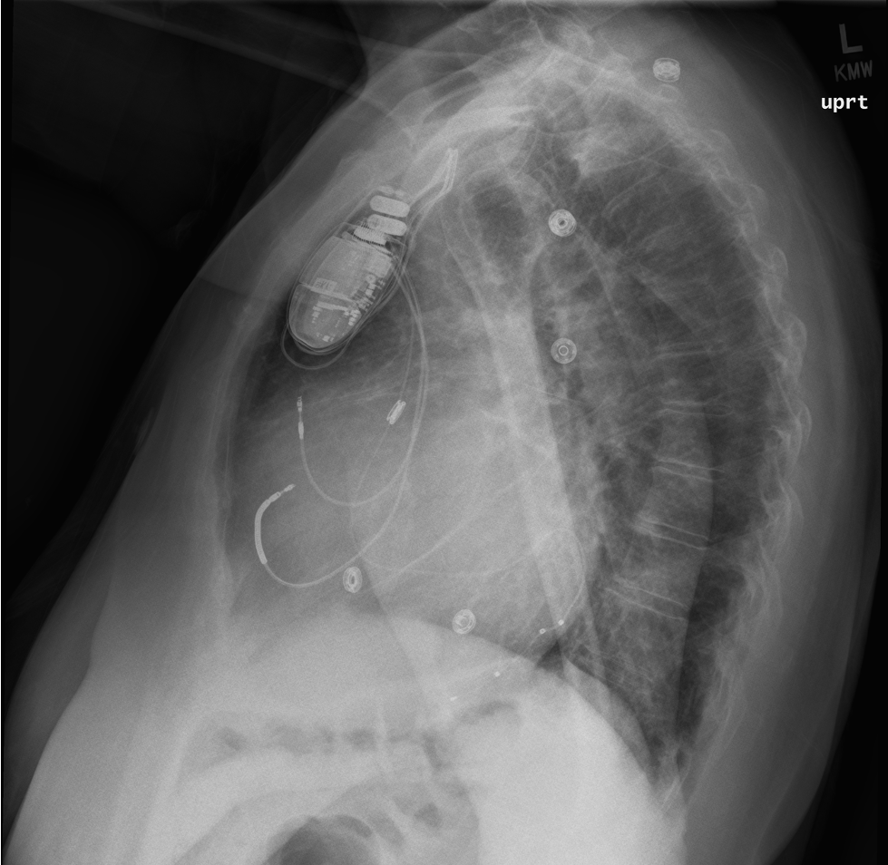
A 40yo with a history of non-ischemic cardiomyopathy presents with orthopnea.
Right atrium, right ventricle, coronary sinus. Atrial sensed, Bi-V pacer with ICD (CRT-D)
In which anatomical space does each lead terminate? And how would you describe this device?
LVEF <35%, QRS >120ms: CRT to improve EF, NYHA, hospitalizations and mortality
LVEF <35%, NYHA II-III: ICD for primary prevention of death from ventricular dysrhythmia
Given the clinical stem, what is the most likely indication(s) for this cardiac device?
1
Right atrium
2
Right ventricle
Images courtesy of
Tami Bang, MD
Coronary sinus -> LV
3
Notes:
Objectives (after this session the learner will be able to):
Differentiate between a pacemaker and ICD on chest x ray.
Identify the location of cardiac device leads on a chest x ray.
Describe the indications and benefits of a CRT-D.
Instructions: Ask a leaner to provide an overall interpretation. Advance using the arrows or scroll wheel on the mouse reveal subsequent questions with answers and graphics. You can go back to prior graphics and questions by using the back arrow or scrolling back on the mouse wheel.
Official CXR Read:. Enlarged cardiac contour. Pacing device in place. No focal consolidation. No pleural effusions.
Clinical Diagnosis:. Cardiogenic shock due to non-ischemic cardiomyopathy
Teaching: This is usually 2-4 sentences of expanded explanations for major teaching points (usually Q2). Include references if quoting rules or specific numbers.
This patient has a cardiac resynchronization therapy – defibrillator (CRT-D). This device contains three leads. The leads are introduced into the subclavian vein. One lead terminates in the right atrium and senses electrical activity. The next lead terminates in the right ventricle, where it can pace. The final lead courses from the right atrium into the coronary sinus (which drains the cardiac veins) and abuts the left ventricle, where it can pace this chamber. Simultaneous pacing of the right and left ventricle (resynchronization therapy) can improve ejection fraction, NYHA classification, reduce hospitalizations and mortality in patients with severe heart failure who have a prolonged QRS (>150ms or LBBB and >130ms). Most patients with an indication for CRT have a concomitant indication for an ICD as primary prevention of SCD. (1, 2) However, a CRT-D comes with limitations and risks including higher costs, higher infection risk, greater likelihood of recall and less reliable pacing. (3)
Take home points:
A thick charge coil seen on an intracardiac device lead is for defibrillation
Cardiac resynchronization therapy with bi-V pacing is indicated for LVEF <35% and a QRS >120ms to improve EF, HF symptoms, hospitalizations and all-cause mortality.
References:
Russo A, Stainback R, Bailey S, et al. ACCF/HRS/AHA/ASE/HFSA/SCAI/SCCT/SCMR 2013 Appropriate Use Criteria for Implantable Cardioverter-Defibrillators and Cardiac Resynchronization Therapy. J Am Coll Cardiol. 2013 Mar, 61 (12) 1318–1368.https://doi.org/10.1016/j.jacc.2012.12.017
Tang AS, Wells GA, Talajic M, Arnold MO, Sheldon R, Connolly S, Hohnloser SH, Nichol G, Birnie DH, Sapp JL, Yee R, Healey JS, Rouleau JL; Resynchronization-Defibrillation for Ambulatory Heart Failure Trial Investigators. Cardiac-resynchronization therapy for mild-to-moderate heart failure. N Engl J Med. 2010 Dec 16;363(25):2385-95. doi: 10.1056/NEJMoa1009540. Epub 2010 Nov 14. PMID: 21073365.
Providência R, Kramer DB, Pimenta D, Babu GG, Hatfield LA, Ioannou A, Novak J, Hauser RG, Lambiase PD. Transvenous Implantable Cardioverter-Defibrillator (ICD) Lead Performance: A Meta-Analysis of Observational Studies. J Am Heart Assoc. 2015 Oct 30;4(11):e002418. doi: 10.1161/JAHA.115.002418. PMID: 26518666; PMCID: PMC4845221.

