Slide 1
Bradycardia and AV blocks

Slide 2
Normal Cardiac Conduction
SA node)
(pacemaker)
AV node
His-Purkinje system

Slide 3
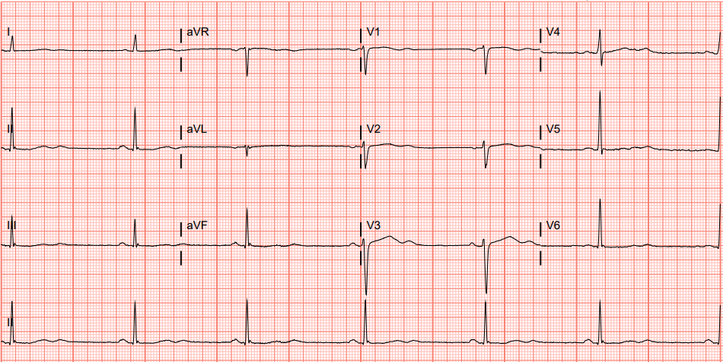
50yo presenting to the ED with hypoglycemia from an insulin overdose, BP 120/80
Sinus Bradycardia
What is the rhythm?
1. HR <60 bpm | 2. P before every QRS, QRS after every P | 3. Upright P’s in I and II
What are the characteristics of sinus bradycardia?
Patient is asymptomatic and normotensive -> observe and treat underlying condition
What are the next steps in management in this case?
Image courtesy of Brandon Fainstad, MD
teach IM .org
P
QRS
P
QRS
P
QRS
P
QRS
P
QRS
Notes:
Preparation: Plan to spend 5-10 minutes familiarizing yourself with the animations of the PowerPoint and the key findings of this ECG.
Presentation Instructions: Present the image either by expanding the window (bottom right) in a browser or downloading the PowerPoint file (downloading is recommended). Have the image pulled up in presenter mode before learners look at the screen to avoid revealing the diagnosis. Ask a learner to provide an overall interpretation. Then advance through the animations to prompt learners with key questions and reveal the associated graphics and teaching points. You can go back to prior graphics and questions by using the back arrow or scrolling back on the mouse wheel.
Official ECG Read: Sinus bradycardia at a rate of 35-40bpm with non-specific T-wave changes, likely "U" waves which are often rate dependent and more prominent in bradycardia
Diagnosis: Sinus bradycardia likely attributable to hypoglycemia in setting of insulin overdose.
Teaching:
The best method for calculating the ventricular rate for irregular rhythms or with severe bradycardia is to count the total number of QRS in a 10-second strip and multiply by six.
Atrial dependent rhythm is defined by “a P before every QRS and a QRS after every P,” upright P’s in inferior leads indicate atrial depolarization initiating in the sinus node, therefore sinus rhythm. If you have a QRS without a P there are premature ventricular contractions (PVCs) or ventricular escape. If you have a P without a QRS there is a second or third-degree AV block.
A 'U' wave is a small deflection following a T wave, often best seen in anterior precordial leads (V2-4). Prominent U waves are most commonly seen in bradycardia and hypokalemia but could be due to multiple other causes.

Slide 4
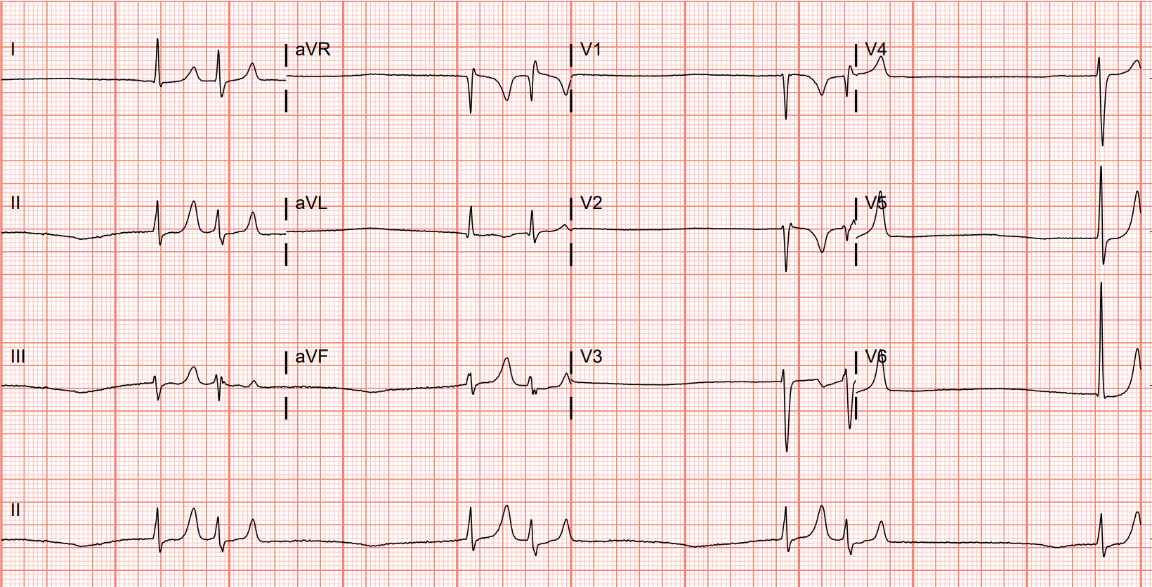
60yo presents with palpitations on propranolol for essential tremor, BP is 60/40 in ED
Suppressed sinus rate from nodal blockade allowing for junctional escape.
What is the rhythm?
Junctional escape with atrial bigeminy at a combined rate of ~40 bpm
How do you define bigeminy?
How could you explain this rhythm based on the clinical history?
Two concurrent rhythms organized in couplets. Usually sinus followed by a PAC/PVC.
1. Place transcutaneous pacer pads | 2. IVFs | 3. IV atropine/inotropes | 4. IV glucagon
What would be your next stepd in management?
What are the characteristics of a junctional escape beat?
Narrow QRS not preceded by a P wave
Image courtesy of Brandon Fainstad, MD
teach IM .org
QRS
P
QRS
QRS
P
QRS
QRS
P
QRS
QRS
P
QRS
Notes:
Preparation: Plan to spend 5-10 minutes familiarizing yourself with the animations of the PowerPoint and the key findings of this ECG.
Presentation Instructions: Present the image either by expanding the window (bottom right) in a browser or downloading the PowerPoint file (downloading is recommended). Have the image pulled up in presenter mode before learners look at the screen to avoid revealing the diagnosis. Ask a learner to provide an overall interpretation. Then advance through the animations to prompt learners with key questions and reveal the associated graphics and teaching points. You can go back to prior graphics and questions by using the back arrow or scrolling back on the mouse wheel.
Official ECG Read: Junctional escape with sinus bigeminy at a combined rate of ~40-45 bpm
Diagnosis: Severe sinus bradycardia due to nodal blockade from propranolol resulting in junctional escape and sinus bigeminy.
Teaching:
Junctional rhythm is defined by a regular, narrow complex without a P wave, indicating that the pacemaker is originating from the AV node or high up in the Purkinje fibers rather than from the atria (no ‘P’ wave). This is most commonly due to a diseased or suppressed SA node.
Bigeminy occurs when there are two concurrent rhythms that organize into couplets. The most common scenario is a normal or increased heart rate with a sinus rhythm followed shortly with a premature atrial (PAC) or ventricular (PVC) beat that is followed by a prolonged refractory period. This case differs in that the first beat is a non-sinus escape rhythm followed by a sinus or atrial rhythm.

Slide 5
What are the inherent pacemaker rates along the conduction system?
SA Node
Dependent on sympathetic & parasympathetic tone
AV Node
40-60bpm
His-Purkinje & Ventricular Myocytes
20-40 bpm
Notes:
King PH. Medical Device Technologies: A Systems Based Overview Using Engineering Standards. IEEE Pulse. 2021 Apr 16;12(2):37-.

Slide 6
65yo presents to clinic for routine follow-up
1. P before every QRS, QRS after every P | 2. PR >200ms | 3. Consistent PR interval
Sinus tachycardia with first degree AVB
What are the characteristics of first degree AVB?
What is the next step in management to address this first-degree block?
Nothing to do
What is the rhythm?
Image courtesy of Jack Stacy, MD
teach IM .org
P
P
P
QRS
QRS
QRS
Notes:
Preparation: Plan to spend 5-10 minutes familiarizing yourself with the animations of the PowerPoint and the key findings of this ECG.
Presentation Instructions: Present the image either by expanding the window (bottom right) in a browser or downloading the PowerPoint file (downloading is recommended). Have the image pulled up in presenter mode before learners look at the screen to avoid revealing the diagnosis. Ask a learner to provide an overall interpretation. Then advance through the animations to prompt learners with key questions and reveal the associated graphics and teaching points. You can go back to prior graphics and questions by using the back arrow or scrolling back on the mouse wheel.
Official ECG Read: Borderline sinus tachycardia with first-degree AVB. And RBBB with left axis deviation (suggesting left anterior fascicular block), representative of “bifascicular block.”
Diagnosis: First degree AVB
Teaching:
Atrial dependent rhythm is defined by “a P before every QRS and a QRS after every P,” upright P’s in inferior leads indicate atrial depolarization initiating in the sinus node, therefore sinus rhythm. If you have a QRS without a P there are premature ventricular contractions (PVCs) or ventricular escape. If you have a P without a QRS there is a second or third-degree AV block.
Consistent PR intervals > 200 ms = first degree atrioventricular block. First degree atrioventricular block is a misnomer since all P’s are conducted to the ventricles. It would more accurately be described as AV delay.
There are no indications for intervention in first degree AVB. However, it may represent a harbinger of developing conduction disease, and should be monitored.

Slide 7
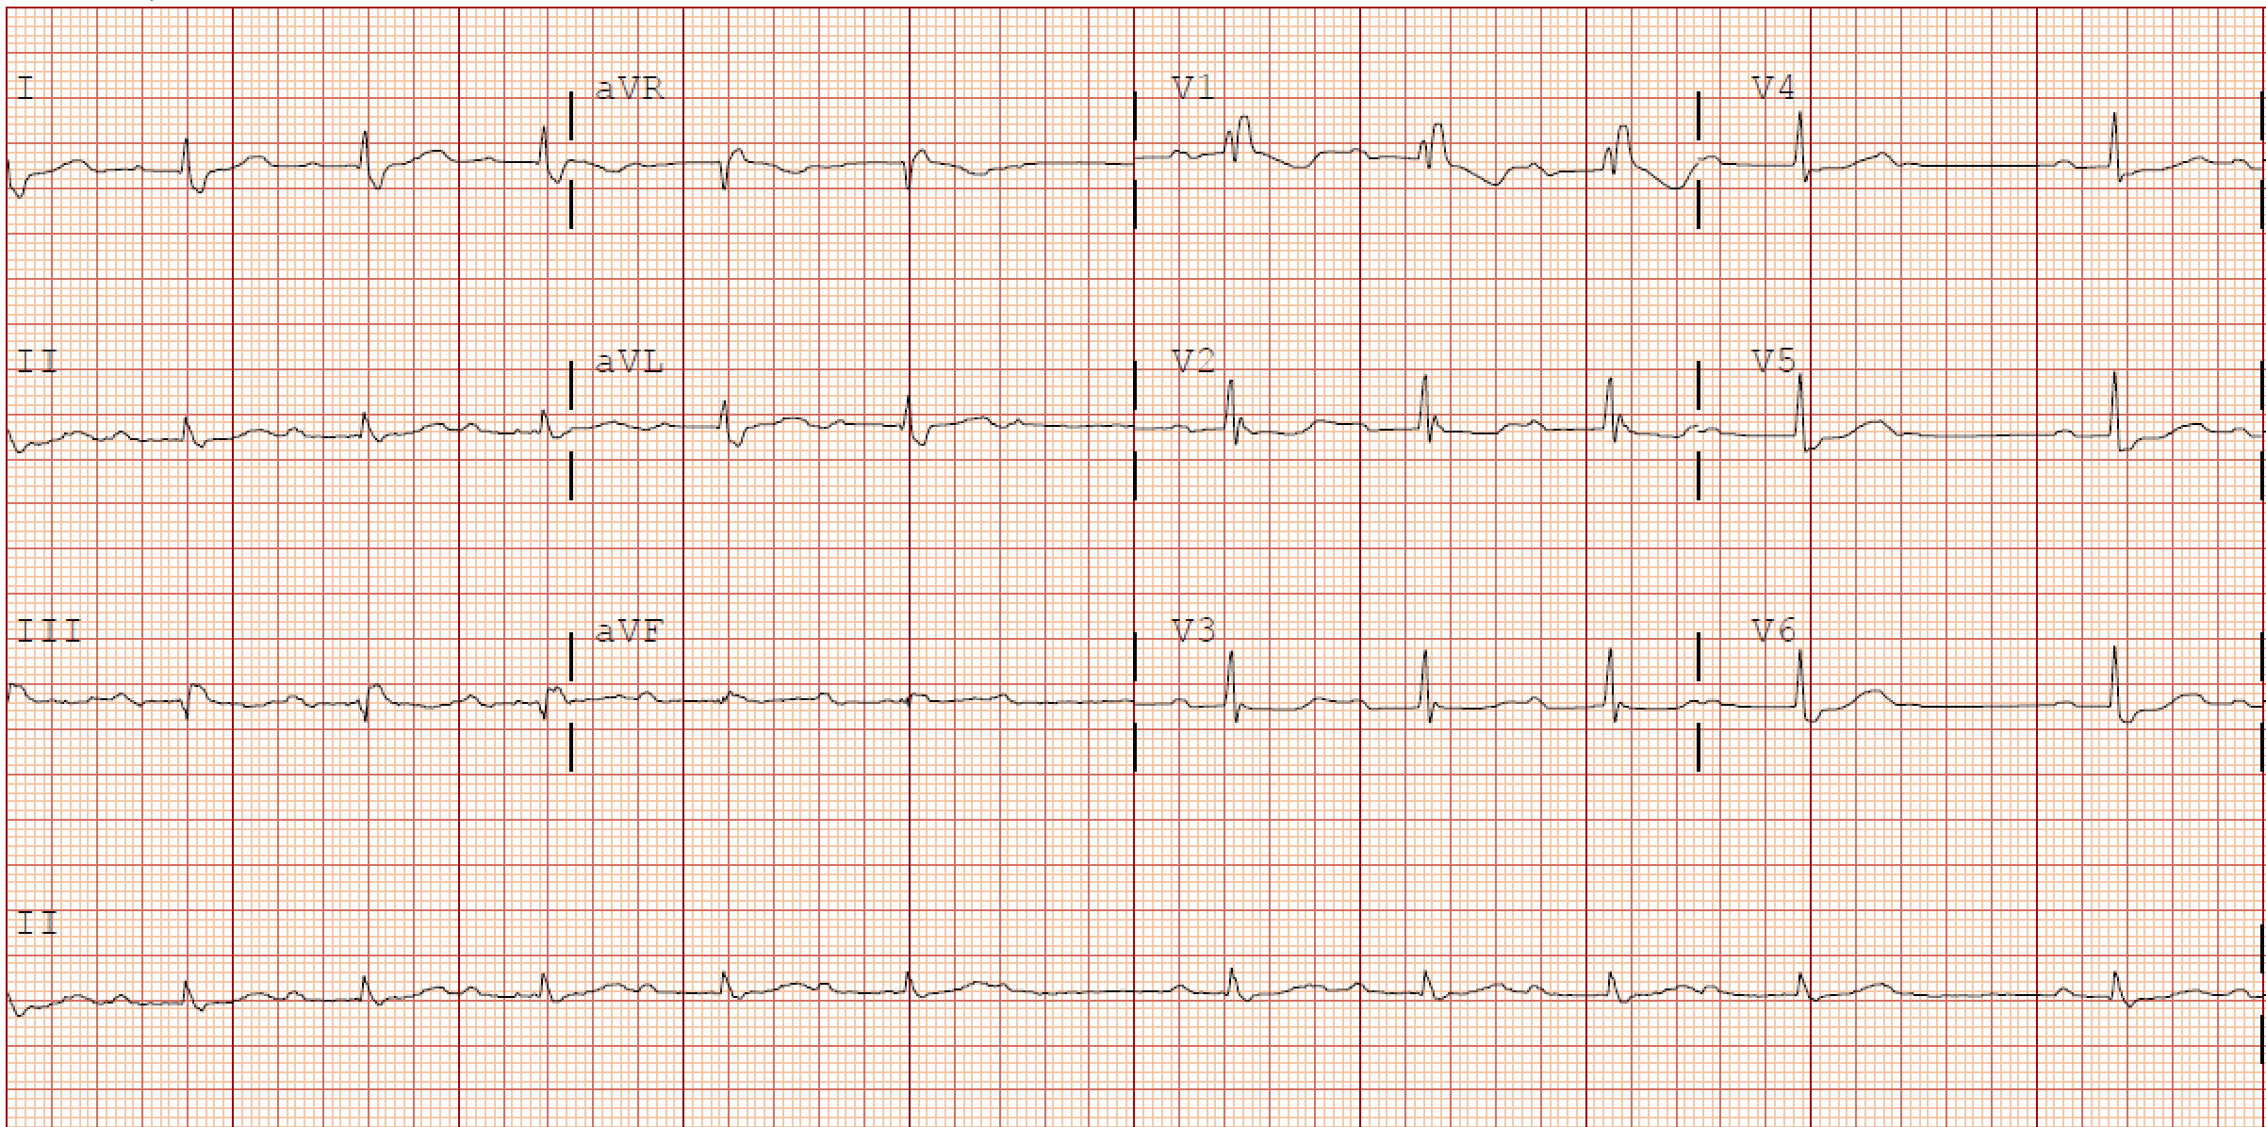
80yo presenting to the ED with syncope
What is the rhythm?
Second degree AVB, type 1 (Mobitz 1)
What are the characteristics of Mobitz type 1?
1. Consistent A Rate | 2. Dropped QRS | 3. PR before dropped QRS > PR following dropped QRS
What is the next step in management?
Pursue other etiologies for syncope
Image courtesy of Cullen Buchanan, MD
teach IM .org
P
P
P
QRS
QRS
???
Consistent A rate
Dropped QRS
PR preceding dropped beat is > PR following dropped beat
Notes:
Preparation: Plan to spend 5-10 minutes familiarizing yourself with the animations of the PowerPoint and the key findings of this ECG.
Presentation Instructions: Present the image either by expanding the window (bottom right) in a browser or downloading the PowerPoint file (downloading is recommended). Have the image pulled up in presenter mode before learners look at the screen to avoid revealing the diagnosis. Ask a learner to provide an overall interpretation. Then advance through the animations to prompt learners with key questions and reveal the associated graphics and teaching points. You can go back to prior graphics and questions by using the back arrow or scrolling back on the mouse wheel.
Official ECG Read: Sinus rhythm with second-degree type 1 AVB (Mobitz type 1)
Diagnosis: Mobitz type 1
Teaching:
Mobitz 1 involves AV nodal pathology with a healthy SA node, so the atrial rate will be regular and consistent.
Mobitz 1 is defined by progressive prolongation of the PR interval until, finally, a P wave fails to be conducted to the ventricles leading to a dropped QRS. As a result you will see “grouped beats.” In this instance you see a pattern of 4 P’s conducted to a QRS followed by one non-conducted P wave.
It can be difficult to see beat to beat prolongation of the PR interval. A trick is to compare the intervals preceding and succeeding the dropped QRS, the PR interval preceding the dropped QRS should be longer than that succeeding the dropped beat.
Conduction disease in Mobitz 1 involves intra-AV nodal pathology, as such it is less unlikely to progress to complete heart block, it is rarely symptomatic, and is not an indication for a permanent pacemaker.

Slide 8
What is the physiology of Mobitz I (2nd degree, type I)?
Intranodal Disease
Progressive PR prolongation with
intermittent loss of conduction through the AV node
P
P
P
QRS
QRS
???
teach IM .org

Slide 9
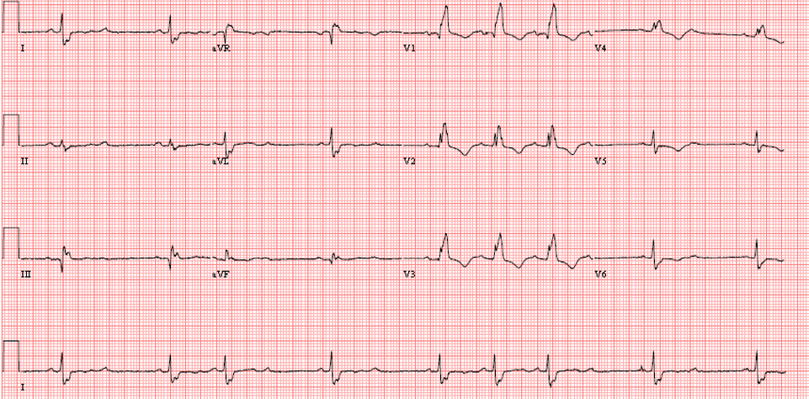
80yo presents to clinic after an episode of syncope at home.
What is the rhythm?
Second degree AVB type 2 (Mobitz type 2)
What are the characteristics of Mobitz type 2?
1. Consistent A rate | 2. Dropped QRS | PR before and after dropped QRS are equal
Next step in management?
Permanent pacemaker placement
teach IM .org
P
P
QRS
Consistent A rate
Dropped QRS
PR before and after dropped QRS are equal
???
Notes:
Abhilash SP, Dinesh Choudhary, Narayanan Namboodiri. Congenital Heart Blocks and Bradyarrhythmias. A Comprehensive approach to Congenital Heart diseases. Jaypee 2013:870-876 (ISBN 978-93-5090-267-7)
Preparation: Plan to spend 5-10 minutes familiarizing yourself with the animations of the PowerPoint and the key findings of this ECG.
Presentation Instructions: Present the image either by expanding the window (bottom right) in a browser or downloading the PowerPoint file (downloading is recommended). Have the image pulled up in presenter mode before learners look at the screen to avoid revealing the diagnosis. Ask a learner to provide an overall interpretation. Then advance through the animations to prompt learners with key questions and reveal the associated graphics and teaching points. You can go back to prior graphics and questions by using the back arrow or scrolling back on the mouse wheel.
Official ECG Read: Sinus rhythm with second degree type 2 AVB (Mobitz type 2)
Diagnosis: Mobitz type 2
Teaching:
Mobitz 2 involves AV nodal pathology with a healthy SA node, so the atrial rate will be regular and consistent.
Mobitz 2 is defined by intermittent failure of conduction of P waves to the ventricles, PR intervals of P waves that are conducted will be consistent throughout.
Mobitz 2 involves infranodal disease. As such is it often concomitant with BBBs (not in this case) and often progresses to complete heart block. Therefore management involves placement of a permanent pacemaker.

Slide 10
What is the physiology and natural history of Mobitz 2 (2nd degree, type 2)?
Infra-nodal disease
Often with BBB morphology as one fascicle is permanently blocked, and the remaining bundle is intermittently blocked.
→ progression to CHB
→ PPM indicated
Permanently blocked Right Bundle
Lead I
Diseased Left Bundle with intermittent block
teach IM .org

Slide 11
80yo with syncope.
Is this type 1 or type 2?
2nd degree AVB. Type 1 or type 2???
What makes this 2nd degree?
What is the rhythm?
How do you differentiate type 1 from type 2 in 2:1?
Increase sympathetic tone
Intermittent conduction with dropped beats
P
P
P
P
???
QRS
QRS
???
???
Can’t differentiate 2:1 since you can’t observe progressive PR prolongation
Image courtesy of Andrew Prouse, MD
teach IM .org
Notes:
Preparation: Plan to spend 5-10 minutes familiarizing yourself with the animations of the PowerPoint and the key findings of this ECG.
Presentation Instructions: Present the image either by expanding the window (bottom right) in a browser or downloading the PowerPoint file (downloading is recommended). Have the image pulled up in presenter mode before learners look at the screen to avoid revealing the diagnosis. Ask a learner to provide an overall interpretation. Then advance through the animations to prompt learners with key questions and reveal the associated graphics and teaching points. You can go back to prior graphics and questions by using the back arrow or scrolling back on the mouse wheel.
Official ECG Read: Sinus rhythm with 2:1 second degree AVB
Diagnosis: 2:1 second-degree AVB
Teaching:
It is impossible to differentiate 2:1 block into second degree type 1 or 2, as you can not observe progressive PR interval prolongation Second degree type 2 involves infranodal pathology and thus is often concomitant with BBBs, but not always.
Definitive differentiation involves increasing sympathetic tone.
Mobitz 1 = nodal. The AV node relies heavily on the autonomic nervous system. As such, increasing sympathetic tone/decreasing vagal tone with exercise or atropine will improve block in Mobitz 1, while increasing vagal tone w/vagal maneuvers or beta-blockade will worsen it.
Mobitz 2 = infranodal. The His-Purkinje system is less dependent on the autonomic nervous system, so increasing vagal tone will not effect the block in Mobitz 2. Exercise/atropine increase atrial rate, but the infranodal rate of delay remains the same, so these measures may actually worsen block in Mobitz 2

Slide 12
Differentiation of second degree 2:1 AVB
 | Increased SYMPATHATIC tone (exercise / atropine) | Increase PARASYMPATHTIC tone (β-blockers / vagal )
Mobitz I | IMPROVEMENT of block | WORSENING of block
Mobitz 2 | WORSENING of block | No Change
Mobitz 1 = inTranodal heavily dependent on autonomic nervous system
Mobitz 2 = inFranodal
Not dependent on autonomic nervous system

Slide 13
Patient presents with exertional lightheadedness
What is the rhythm?
Complete heart block
What are the characteristics of CHB?
A-V Dissociation: Consistent A rate $≠$ Consistent V rate
What is the next step in management?
1. Transcutaneous pacer pads in place | 2. Permanent pacemaker
Image courtesy of Jack Stacy, MD
teach IM .org
Consistent A rate ~125
P
P
P
P
A rate $≠$ V rate
?
?
?
?
Consistent V rate ~40
QRS
QRS
QRS
Notes:
Preparation: Plan to spend 5-10 minutes familiarizing yourself with the animations of the PowerPoint and the key findings of this ECG.
Presentation Instructions: Present the image either by expanding the window (bottom right) in a browser or downloading the PowerPoint file (downloading is recommended). Have the image pulled up in presenter mode before learners look at the screen to avoid revealing the diagnosis. Ask a learner to provide an overall interpretation. Then advance through the animations to prompt learners with key questions and reveal the associated graphics and teaching points. You can go back to prior graphics and questions by using the back arrow or scrolling back on the mouse wheel.
Official ECG Read: Sinus atrial rhythm at a rate of 125 bpm without A to V conduction, ventricular escape rhythm at 40 bpm, complete heart block
Diagnosis: Complete heart block
Teaching:
Complete heart block will present with a regular and consistent atrial rate that is not equal to a concomitant regular and consistant escape rhythm without evidence of atrial to ventricular conduction.
You can identify the origin of the escape rhythm based on the morphology of the QRS complexes.
A narrow QRS complex indicates a more superior origin of the escape rhythm, either junctional or high within the His-Perkinje system. A wide QRS indicates a ventricular origin of the escape rhythm.
More superior escape rhythms tend to be quicker while inferior escape rhythms tend to be slower. Therefore, more superior escape rhythms also tend to be more stable.

Slide 14
Pathophysiology of CHB
PERSISTENT Block
at AV node or below
Consistent A rate ~125 from SA
QRS
QRS
QRS
Consistent V rate ~40 from RV focus
(LBBB morphology)

Slide 15
Management of CHB
Assuming reversible causes have been addressed,
CHB is always an indication for PPM placement.
Stable or Unstable
Stable
Unstable
Have pacer pads in place
Transcutaneous venous pacing as bridge to PPM
Non-urgent PPM

Slide 16
Management of AVB
AVB
First degree/Mobitz 1
Mobitz 2/CHB
Observe and minimize negative inotropes
Permanent pacemaker

