Slide 1
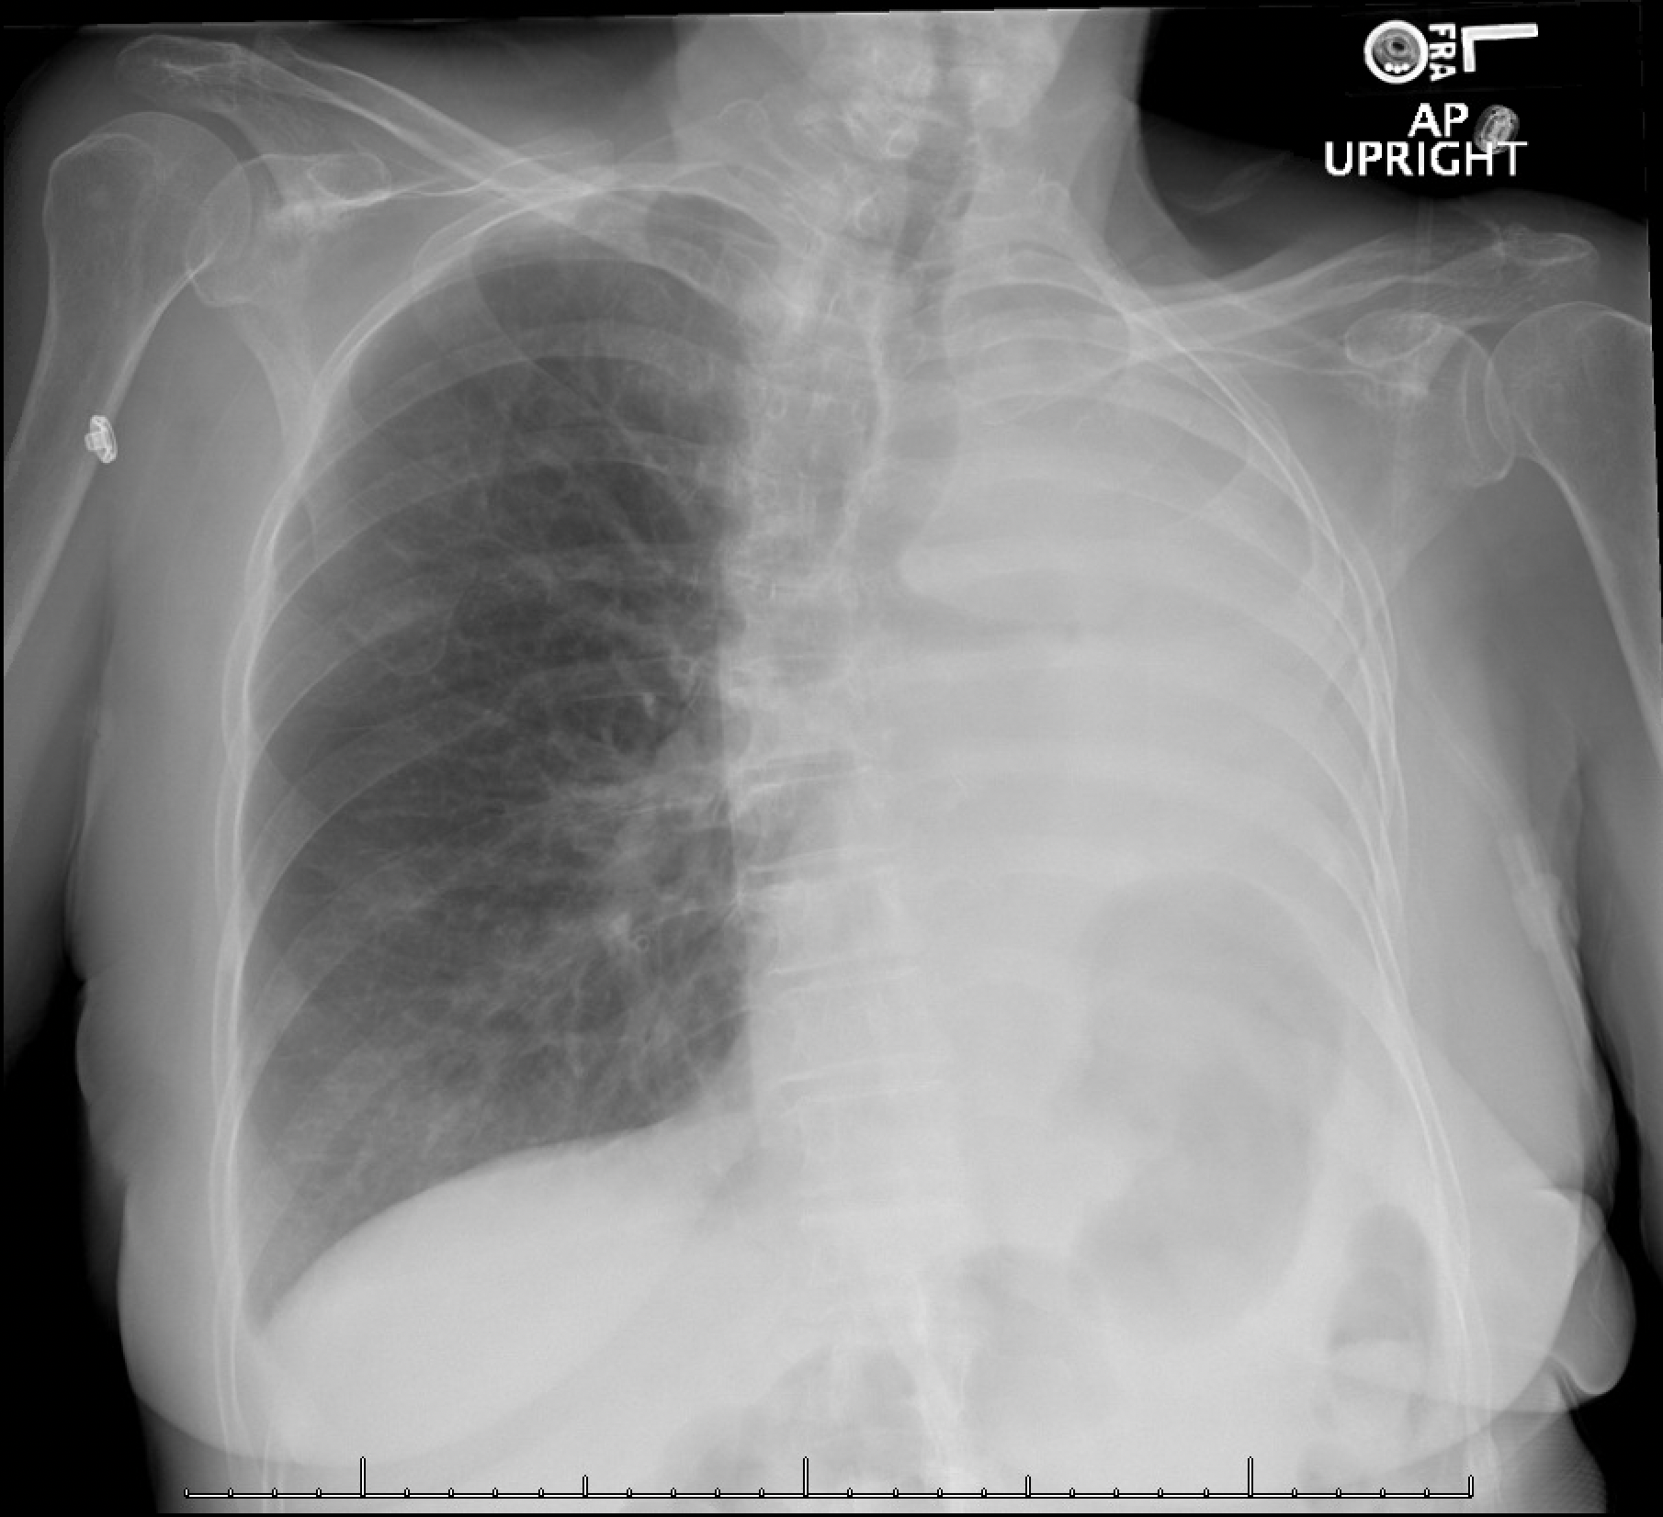
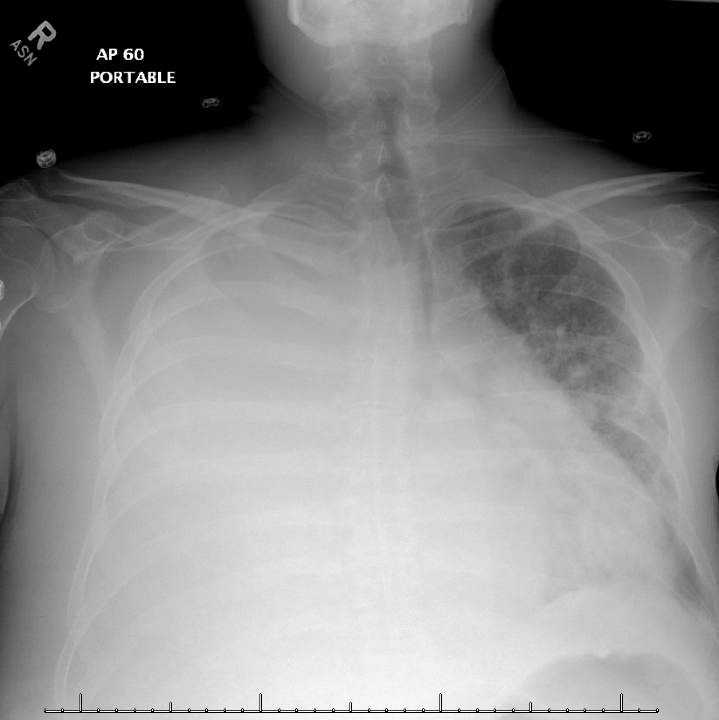
Two different patients presenting with dyspnea, hypoxemia, and hemithorax whiteout.
The left.
Which patient’s whiteout is due to lobar collapse?
Where is the obstruction?
Left mainstem bronchus.
What could be causing the right whiteout?
Tracheal shift towards whiteout
Tracheal shift away from whiteout
Tracheal Position?
Towards whiteout (volume loss) | Midline | Away from whiteout (mass effect)
Mainstem obstruction Pneumonectomy Pulmonary agenesis/hypoplasia | Consolidation Pleural mass Chest wall mass | Pleural effusion Intra-pulmonary mass Diaphragmatic hernia
Gastric bubble shift upwards
Images courtesy of
Daniel Gergen, MD
Notes:
Instructions: Ask a leaner to provide an overall interpretation. Advance the slide for subsequent questions.
Learning objective:
Use tracheal deviation either toward or away from a large lung opacity on a chest radiograph to narrow the differential of the lesion.
CXR Read:
Left: Complete whiteout of the left hemithorax. The heart is obscured. The right lung is grossly clear. There is a small right pleural effusion. No right pneumothorax. Left diaphragm is elevated due to collapse of the left lung.
Right: Right hemithorax is now completely opacified consistent with interval enlargement of the very large right pleural effusion. Interval worsening of patchy left lung opacities with air bronchograms which may represent aspiration, pneumonia and/or edema. No significant pneumothorax.
Diagnosis:
Left: Stage IV adenocarcinoma w/ massive hemoptysis and obstruction of L main bronchus
Right: cirrhosis complicated by hepatic hydrothorax
Teaching:
Approach to hemithorax whiteout:
Tracheal position? If the trachea is shifted towards the whiteout then there is volume loss. If the trachea is shifted away from the whiteout then there is volume gain/mass effect.
Other structures to consider? Gastric bubble, cardiac silhouette
A differential based on change of structure positions:
Towards whiteout (volume loss) Mainstem obstruction, Pneumonectomy
Midline: Pulmonary agenesis/hypoplasia, Consolidation, Pleural mass, Chest wall mass
MidlineAway from whiteout (mass effect): Pleural effusion, Intra-pulmonary mass, Diaphragmatic hernia

Slide 2
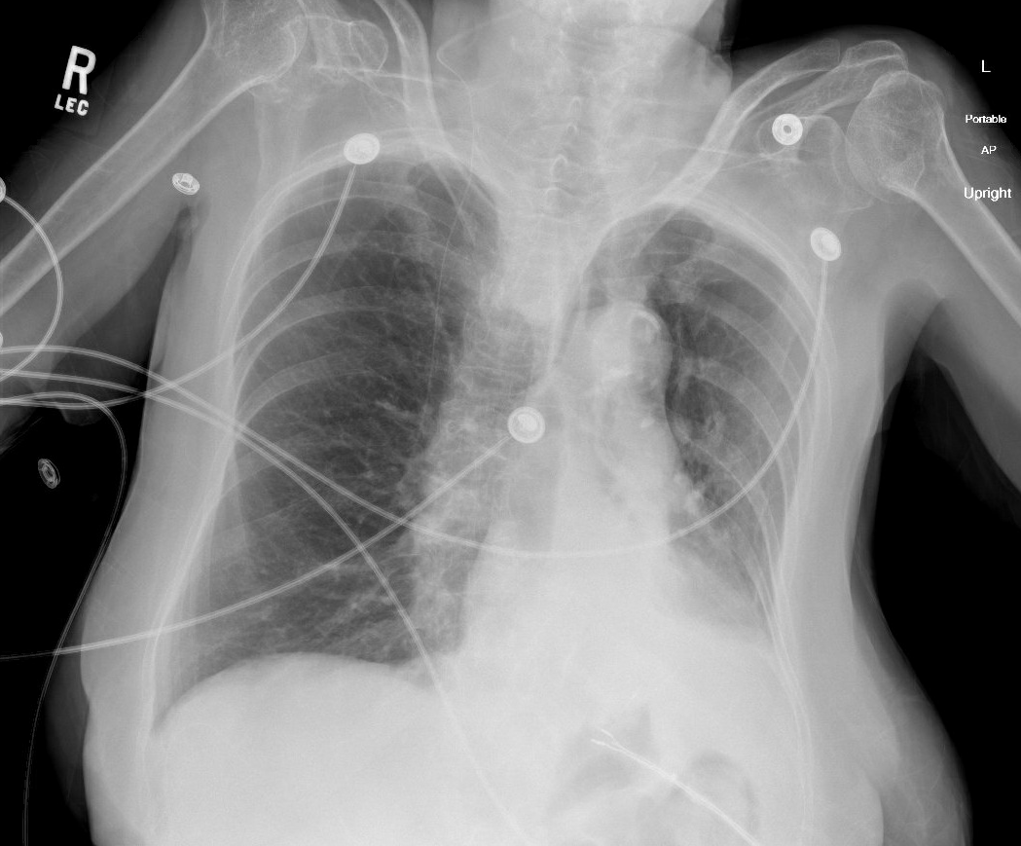
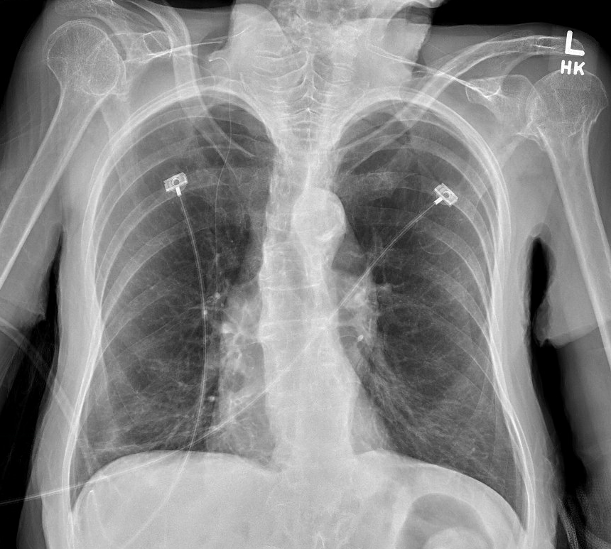
65yo immobilized woman with a thick wet cough becomes acutely hypoxemic, requiring 100% O2
Loss of volume
Is the NEW LLL lesion “space-occupying” or causing a loss of volume?
Obstructive lung disease, VP shunt, fluid-filled esophagus, left-lower lobe collapse
What is your overall interpretation?
NEW
Baseline
VP shunt
Mediastinal shift towards the lesion = volume loss from ATELECTASIS
Fluid-filled esophagus
LLL Collapse
Images courtesy of
Brandon Fainstad, MD
Notes:
Instructions: Ask a leaner to provide a full interpretation of the new radiograph. Advance the slide for subsequent questions. Ask them to describe the LLL opacity and determine if the mediastinum is shifting toward or away from the lesion. After noting the mediastinal shift, advance to the next slide to review the CT axial series.
Learning objective:
Identify left lower lobar collapse by silhouette sign of the descending aorta and diaphragm along with signs of left-sided volume loss (differentiating it from left lower lobe consolidation or effusion).
CXR read
Expanded lung fields with hyperlucent apices
Mediastinal shift to the left
Left lower lobe opacity with silhouette sign over left hemidiphragm suggesting LLL collapse
Air-fluid level in the mid esophagus
Right-sided VP shunt
Diagnosis
Left lower lobar collapse likely due to mucus plugging after an aspiration event with underlying COPD.
Teaching: The large opacification along the left lower heart boarder with mediastinal shift toward that side indicates a left sided volume loss due to left lower lobe collapse. If this dense opacity were due to a consolidation or pleural effusion the mediastinum would remain in the central chest or event slightly shifted to the patient’s right. The CT series demonstrates and occlusion of the proximal left lower airway with distal collapse. The LLL vessels remain opacified with contrast confirming her severe hypoxemia refractory to supplementary O2 is due to shunt physiology. Her condition rapidly improved after successful aspiration of a mucus plug by bronchoscopy.

Slide 3
Why is this patient so hypoxemic?
Shunt physiology! Blood perfusing her LLL is passing to her left heart without gas exchange.
Bronchopulmonary hygiene and potentially bronchoscopy to remove the mucus plug.
How would you manage this patient?
Images courtesy of
Brandon Fainstad, MD
Notes:
Atelectasis = general term for “incomplete expansion” of lung
Individual lobes may collapse due to obstruction of oxygen supply to bronchus
Most common collapse of lobe is secondary to bronchial obstruction causing resorptive atelectasis. Etiologies include: aspiration of foreign material, mucus plugging, endobronchial mass, misplaced endotracheal tube
Classical findings:
Bowing or displacement of a fissure(s) occurs TOWARDS collapsing lobe
Volume loss, which causes air space opacification
Collapsed lung appears triangular or pyramidal, with apex pointing toward the hilum
Indirect signs: elevation of ipsilateral hemidiaphragm, crowing of ipsilateral ribs, shift of mediastinum towards the side of atelectasis, compensatory hyperinflation of normal lobes
Hilar displacement towards the collapse

Slide 4
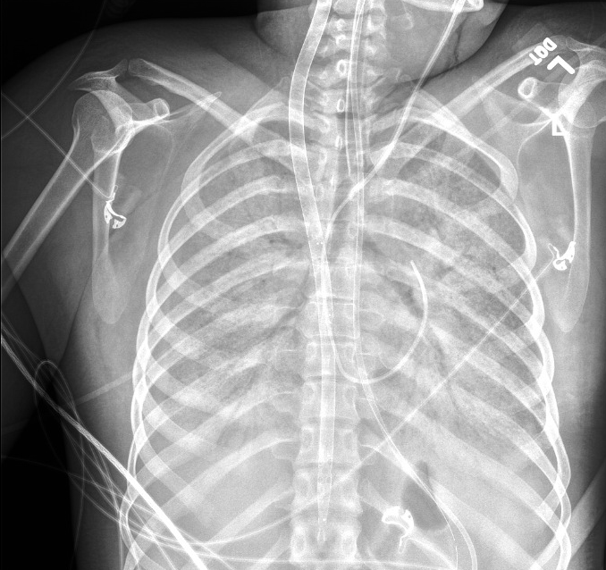
30yo with dermatomyositis-associated ILD develops refractory hypoxemic respiratory failure.
What is your overall interpretation?
Diffuse, extensive bilateral consolidative opacities with air bronchograms.
What pathologic process creates air bronchograms on a chest x ray?
Bonus: what invasive devices are present?
Dense alveolar filling processes.
In healthy lungs, airways and alveoli are filled with air.
Same density = indistinguishable on CXR (same principle as silhouette sign).
Pathologic alveolar filling process → contrast between airways and alveoli → air bronchograms.
PA (Swan-Ganz) catheter
ET tube
ECMO cannula
Widespread air bronchograms
Complete silhouetting of both heart borders, both diaphragms
Complete opacification of both hemithoraces
Images courtesy of
Samantha King, MD
OG tube
Notes:
Objectives:
Identify air bronchograms on a chest radiograph and describe why an alveolar filling process can lead to this appearance
Official CXR Read:. Endotracheal tube, enteric tube, and ECMO cannula remain in place. Swan-Ganz catheter tip projects over the main pulmonary trunk.
There is complete opacification of both hemithoraces, obscuring both hemidiaphragms and heart borders. Small right pleural effusion is present. Widespread air bronchograms are present.
Diagnosis: Rapidly progressive interstitial lung disease associated with anti-MDA5 dermatomyositis leading to refractory hypoxemic respiratory failure necessitating ECMO.
Take home points:
Typically, the only airways that are visible are the trachea and proximal bronchi because they are surrounded by dense tissue. The smaller airways are surrounded by aerated lungs and are not distinguishable. Vessels are typically the only viable structure in the aerated lungs.
An air bronchogram refers to when air-filled airways become visible due to increased density of the surrounding tissue in lung disease. The diffuse air bronchograms in this case suggests diffuse alveolar filling or consolidation.
References:

Slide 5
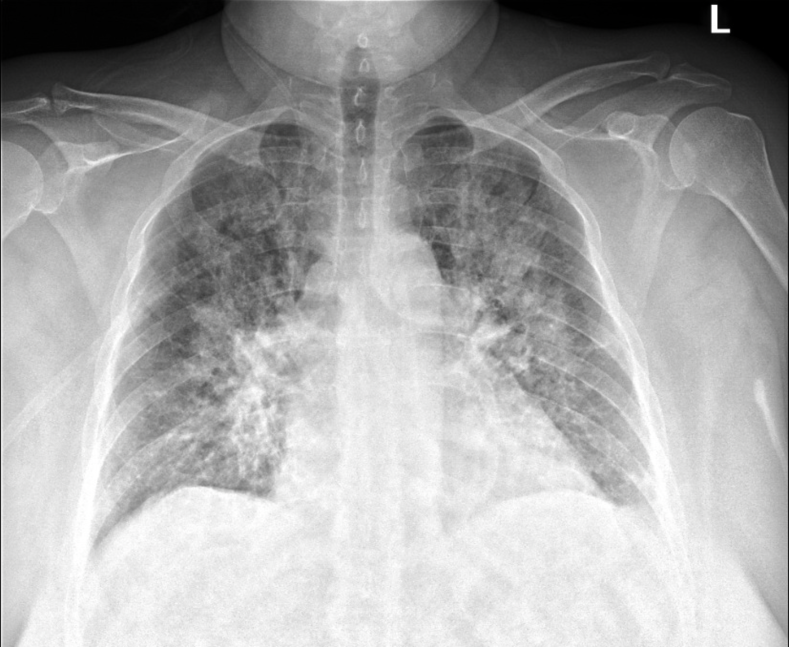
55yo s/p STEMI with dyspnea and cool extremities.
What is your overall interpretation?
Enlarged cardiac silhouette w/ bilateral perihilar enlargement and diffuse alveolar opacities.
Pulmonary edema due to cardiogenic shock.
What is the likely diagnosis?
Alveolar opacities
Perihilar enlargement
Enlarged cardiac silhouette
Images courtesy of
Daniel Gergen, MD
Notes:
Instructions: Ask a leaner to provide an overall interpretation. Advance the slide for subsequent questions.
Learning objectives: Identify key features and severity of cardiogenic pulmonary edema on chest x-ray.
CXR Read: enlarged cardiac silhouette with bilateral perihilar enlargement, haziness, and congestion. In addition, diffuse interstitial and alveolar opacities. Peribronchial cuffing is present. Kerley B lines are also observed at the periphery. Small left pleural effusion.
Diagnosis: pulmonary edema secondary to cardiogenic shock
Teaching:
Enlarged cardiac silhouette is defined as a cardiac silhouette that is greater than half of the internal thoracic diameter. The differential for an enlarged cardiac silhouette on chest radiograph includes, cardiomegaly, pericardial effusion, and portable/AP film.
The differential for perihilar enlargement includes, lymphadenopathy, malignancy, pulmonary arterial hypertension, and pulmonary venous hypertension. In the setting of STEMI and cardiogenic shock, acute perihilar enlargement is attributed to pulmonary venous hypertension.
This radiograph demonstrates a diffuse interstitial pattern. Other terms that could be utilized to describe this pattern are linear or reticular. In this case, the interstitial markings emanate from the hilum bilaterally and reach approximately 2/3 of the way to the pleural surface. Considering the clinical context, this is most consistent with cardiogenic pulmonary edema.
Radiographic stages of acute left heart failure (based on pulmonary capillary wedge pressure):
18 mmHg: cephalization of the upper lobe pulmonary vasculature. Best described as increased prominence of the upper lobe vasculature due to redistribution of blood flow.
22 mmHg: increased interstitial prominence, peribronchial cuffing, perihilar enlargement, and Kerley B lines
25 mmHg: alveolar opacities

Slide 6
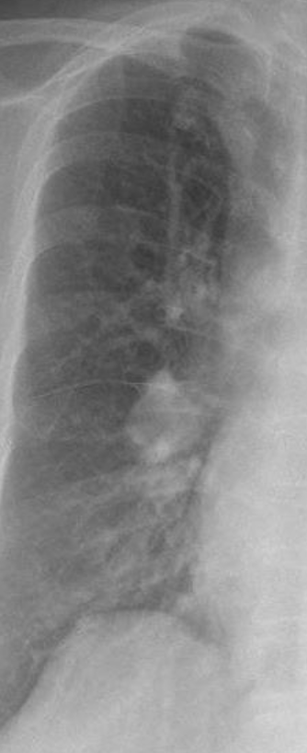
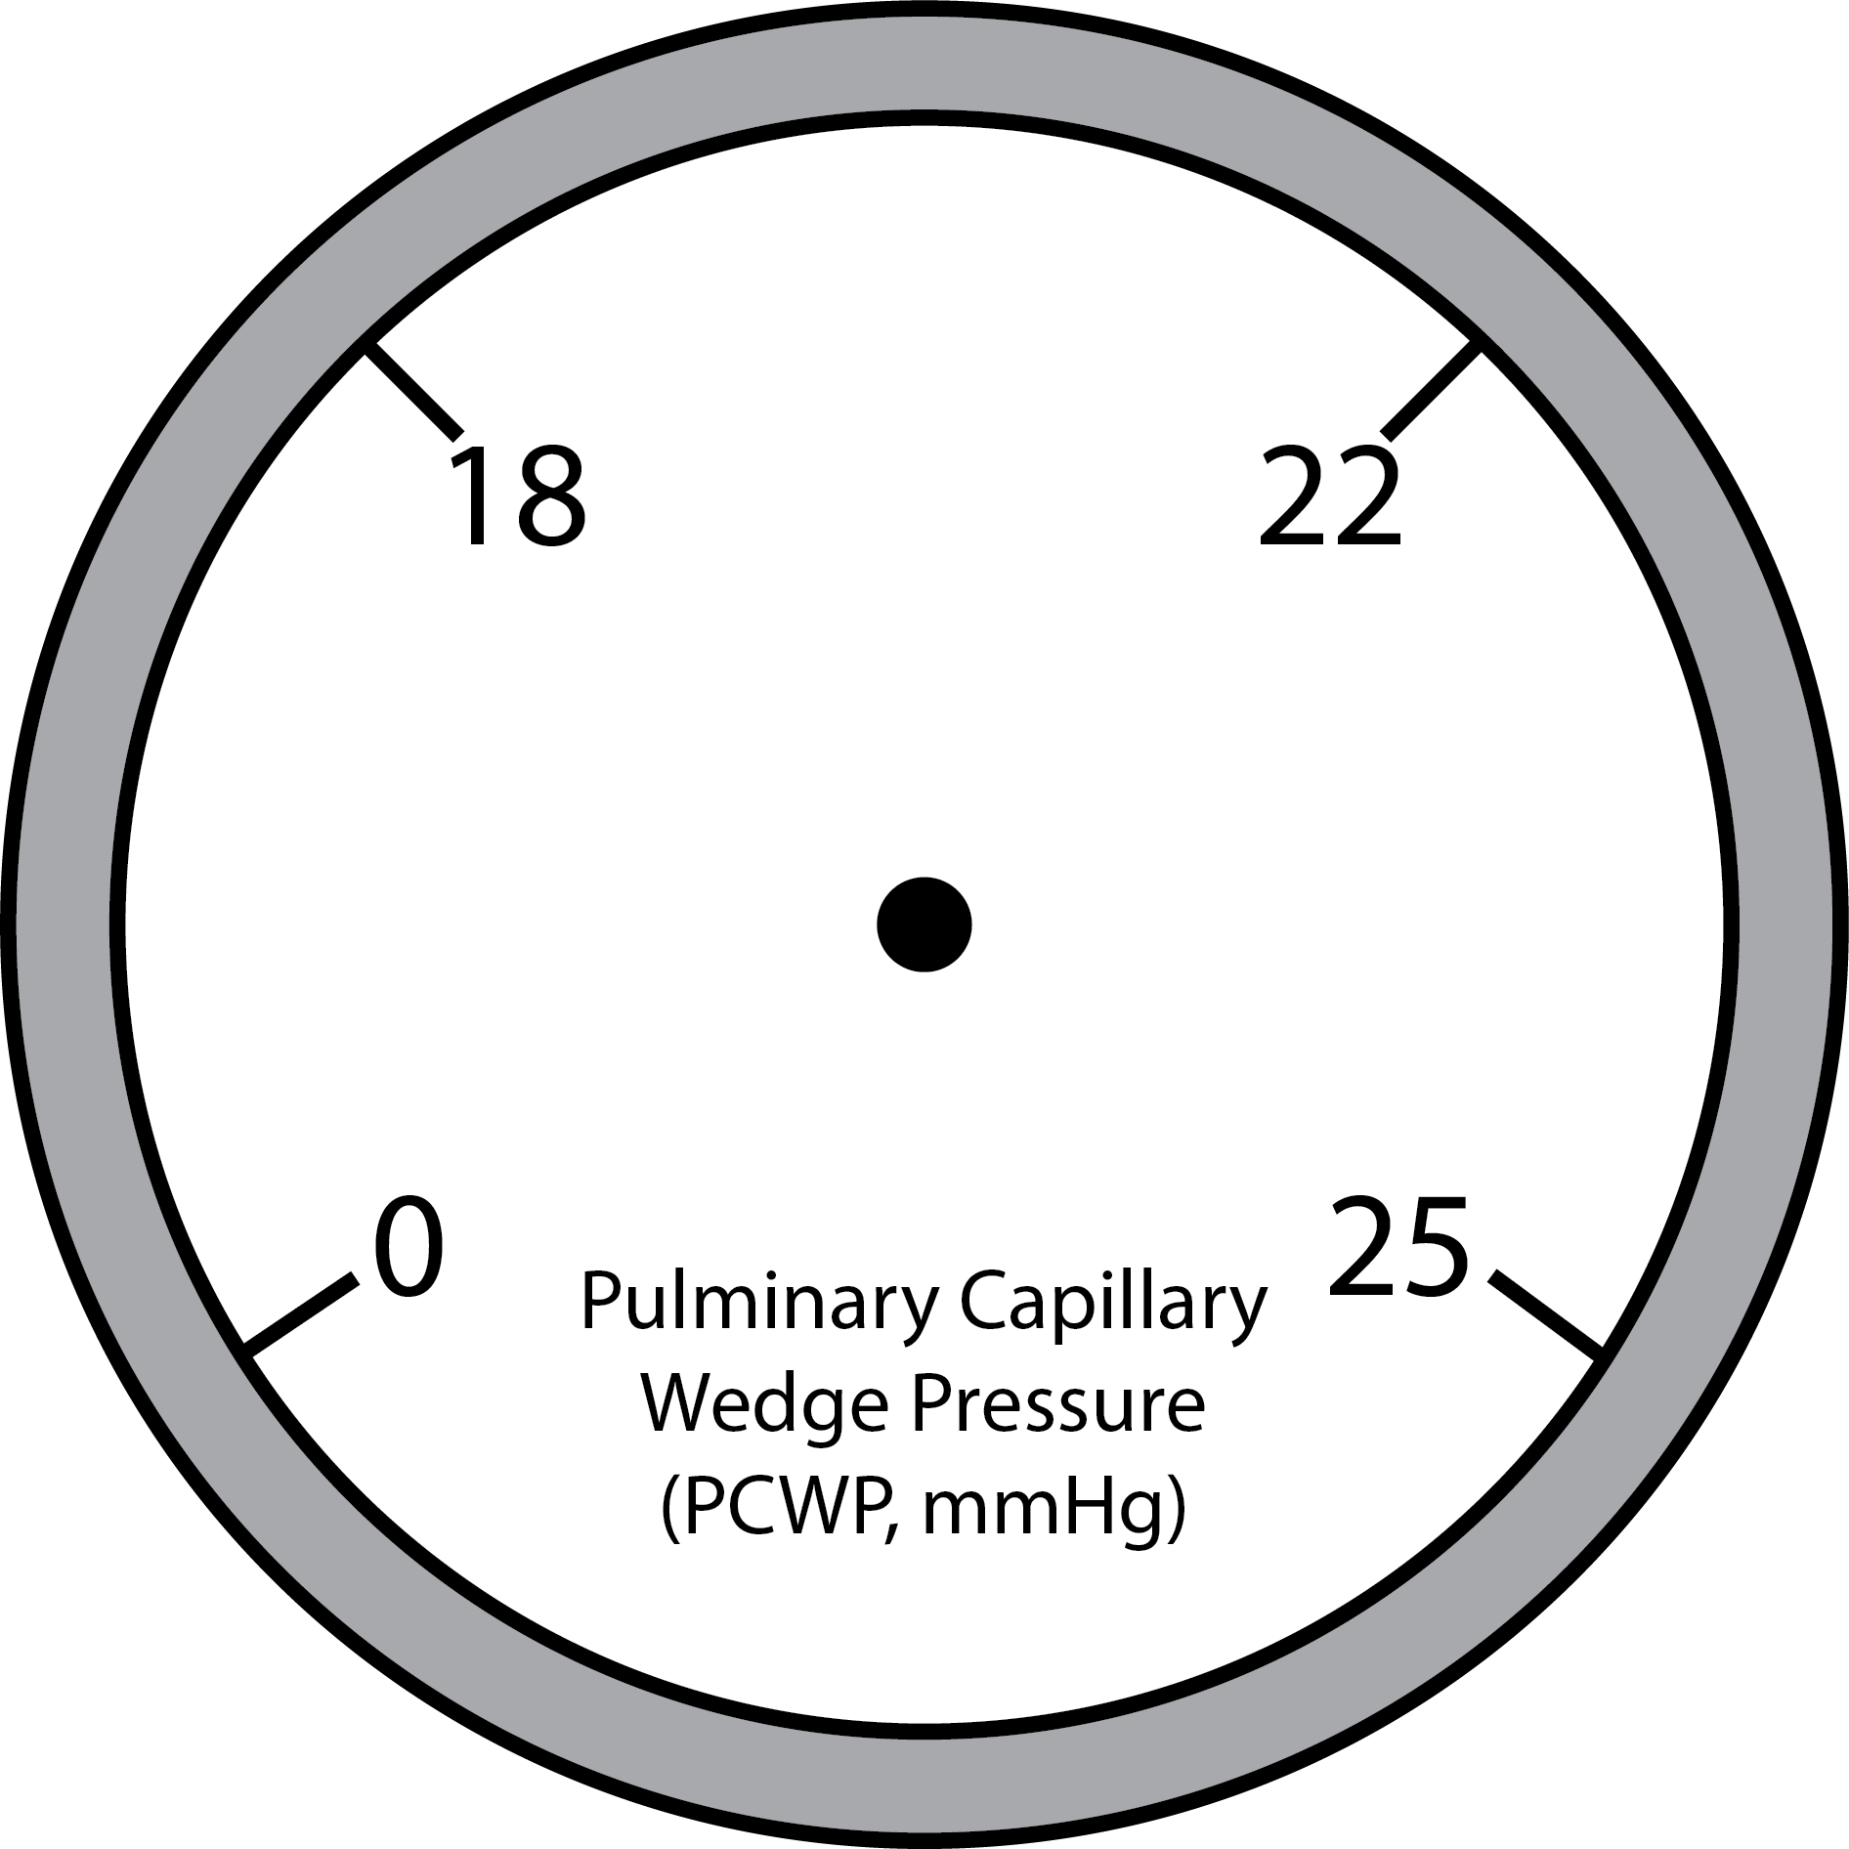
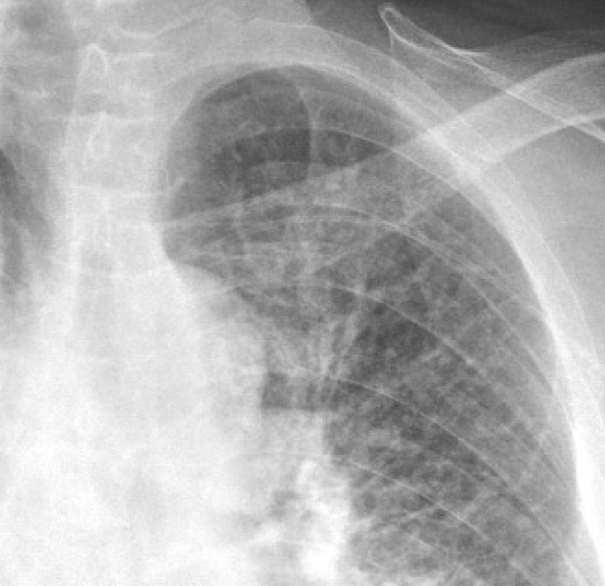
55yo s/p STEMI with dyspnea and cool extremities.
What is your overall interpretation?
Enlarged cardiac silhouette w/ bilateral perihilar enlargement and diffuse alveolar opacities.
Pulmonary edema due to cardiogenic shock.
What is the likely diagnosis?
What are the radiographic stages of left heart failure?
1
3
Cephalization
(Vessels)
Alveolar opacities
2
Kerley B lines
Interstitial prominence
Peribronchial cuffing
Images courtesy of
Daniel Gergen, MD
Notes:
Instructions: Ask a leaner to provide an overall interpretation. Advance the slide for subsequent questions.
CXR Read: enlarged cardiac silhouette with bilateral perihilar enlargement, haziness, and congestion. In addition, diffuse interstitial and alveolar opacities. Peribronchial cuffing is present. Kerley B lines are also observed at the periphery. Small left pleural effusion.
Diagnosis: pulmonary edema secondary to cardiogenic shock
Teaching:
Enlarged cardiac silhouette is defined as a cardiac silhouette that is greater than half of the internal thoracic diameter. The differential for an enlarged cardiac silhouette on chest radiograph includes, cardiomegaly, pericardial effusion, and portable/AP film.
The differential for perihilar enlargement includes, lymphadenopathy, malignancy, pulmonary arterial hypertension, and pulmonary venous hypertension. In the setting of STEMI and cardiogenic shock, acute perihilar enlargement is attributed to pulmonary venous hypertension.
This radiograph demonstrates a diffuse interstitial pattern. Other terms that could be utilized to describe this pattern are linear or reticular. In this case, the interstitial markings emanate from the hilum bilaterally and reach approximately 2/3 of the way to the pleural surface. Considering the clinical context, this is most consistent with cardiogenic pulmonary edema.
Radiographic stages of acute left heart failure (based on pulmonary capillary wedge pressure):
18 mmHg: cephalization of the upper lobe pulmonary vasculature. Best described as increased prominence of the upper lobe vasculature due to redistribution of blood flow.
22 mmHg: increased interstitial prominence, peribronchial cuffing, perihilar enlargement, and Kerley B lines
25 mmHg: alveolar opacities

Slide 7
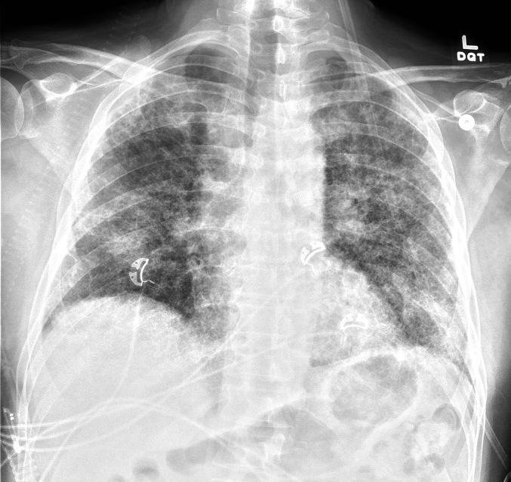
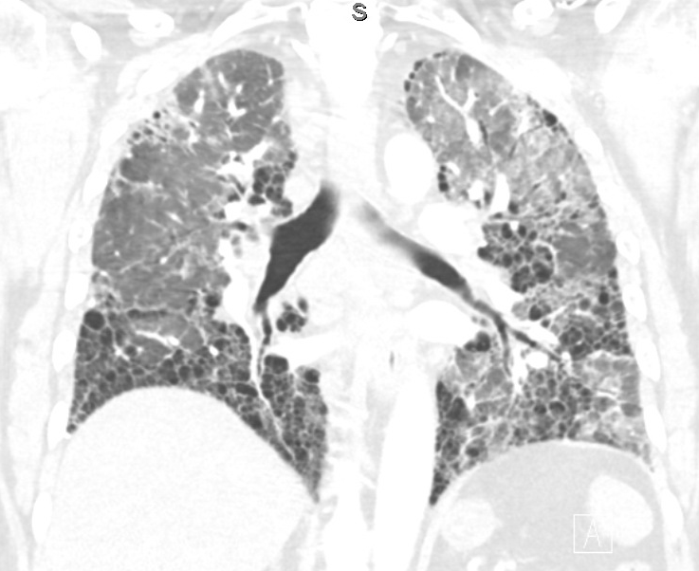
55yo with well-controlled HIV and pulmonary fibrosis presenting with worsening dyspnea.
What is your overall interpretation?
Bilateral patchy alveolar and extensive diffuse interstitial opacities.
Can you identify an ectatic airway?
Dilated airway surrounded by fibrosis: fibrosis -> traction -> pull airway walls apart.
Alveolar filling process superimposed on IPF; infection ruled out, diagnosed with IPF flare.
What is your final diagnosis?
CT comparison
Extensive reticular or ”lacy” interstitial opacities
Patchy groundglass opacities
Bilateral “patchy” alveolar opacities
Traction bronchiectasis
Traction bronchiectasis
Images courtesy of
Samantha King, MD
Basilar predominant peripheral fibrosis, honeycombing
Notes:
Objectives:
Identify alveolar and interstitial opacities on a chest x ray
Identify traction bronchiectasis
Instructions: Ask a leaner to provide an overall interpretation. Advance using the arrows or scroll wheel on the mouse reveal subsequent questions with answers and graphics. You can go back to prior graphics and questions by using the back arrow or scrolling back on the mouse wheel.
Official CXR Read: Cardiac silhouette is partially obscured. Near diffuse interstitial opacities are redemonstrated throughout both lungs, with elements of traction bronchiectasis, presumed honeycombing, and architectural distortion. No definite pneumothorax is identified. Osseous structures appear intact.
Diagnosis:. Flare/progression of known pulmonary fibrosis
Take home points:
The differential for interstitial infiltrates on chest x ray includes atypical infection, fluid (Kerley B lines), and fibrosis
In fibrotic lung disease, fibrosis creates traction, pulling the walls of airways apart, a phenomenon known as traction bronchiectasis
References:

Slide 8
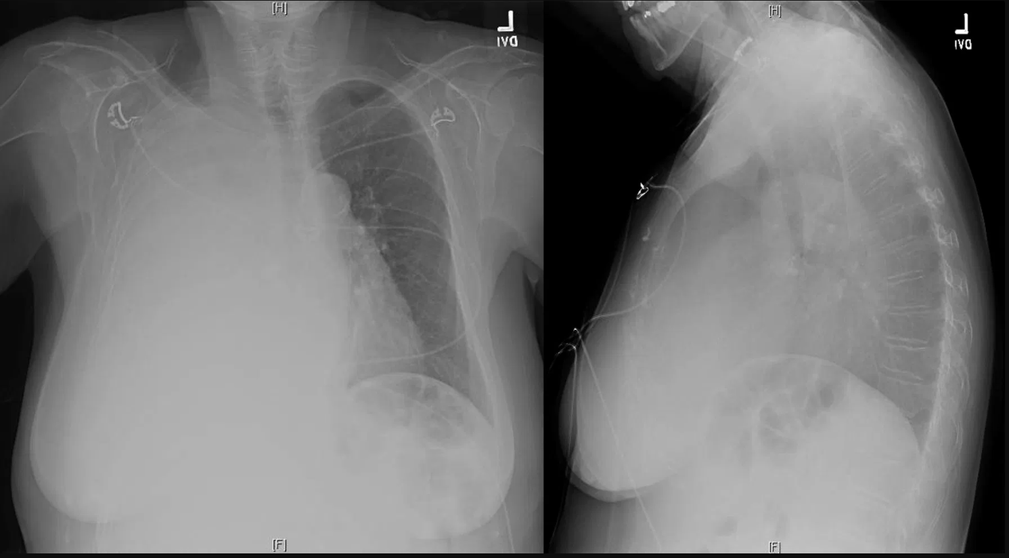
70yo woman with metastatic renal cell carcinoma presents with dyspnea and hypoxemia.
What is your overall interpretation?
Opacification of the right hemithorax with tracheal deviation away from the opacity.
What is the likely diagnosis?
Malignant pleural effusion.
What is the next best step in management for this patient?
Diagnostic and therapeutic thoracentesis.
What are other processes cause structure deviation away from the opacity?
Deviate towards opacity (volume losing lesion) | No deviation | Deviate away from opacity (volume occupying lesion)
Pneumonectomy Lobar or lung collapse Pulmonary agenesis and hypoplasia | Consolidation Diffuse pleural mass Chest wall mass | Massive pleural effusion Diaphragmatic hernia Large Pulmonary mass
Images courtesy of
Lauren Brown, MD
Notes:
Instructions: Ask a leaner to provide an overall interpretation. Advance the slide for subsequent questions.
CXR Read: Opacification of right hemithorax with tracheal deviation away from the opacity. No notable opacities or effusion on the left.
Diagnosis: Malignant right sided pleural effusion from metastatic RCC.
Teaching: The differential for any large lung opacity is often narrowed by determining if it is a volume occupying (mass) lesion by deviation of mediastinum and trachea away from the lesion versus volume losing (collapse) by deviation toward the lesion. This is particularly notable with opacification of a hemithorax, as in this case. The differential of a volume occupying opacification of a hemithorax is exclusively a large pleural effusion.

