Slide 1
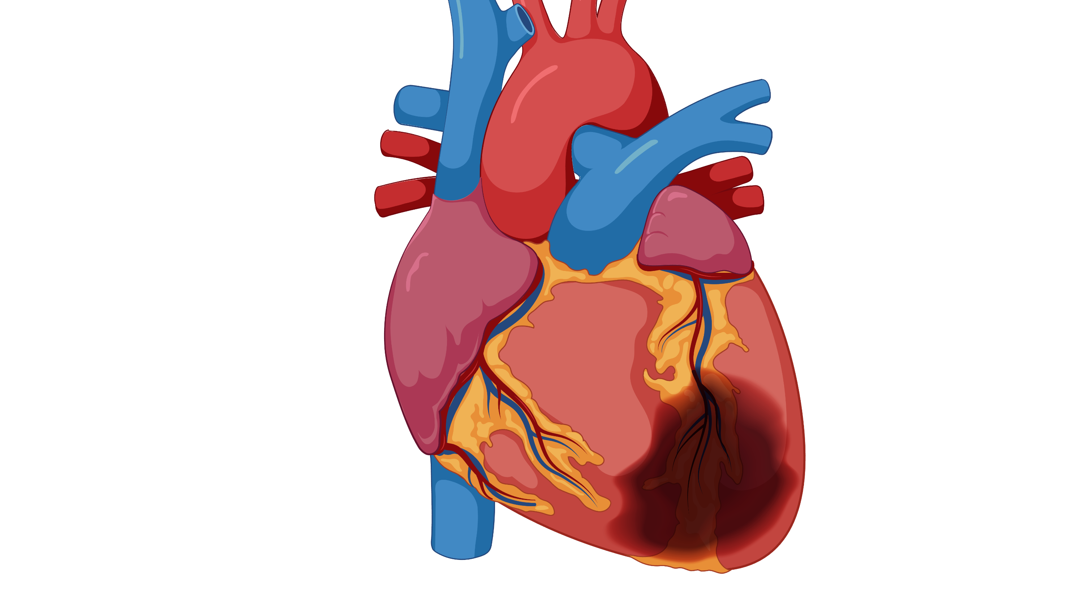
ECG Case Conference: STEMIs

Slide 2
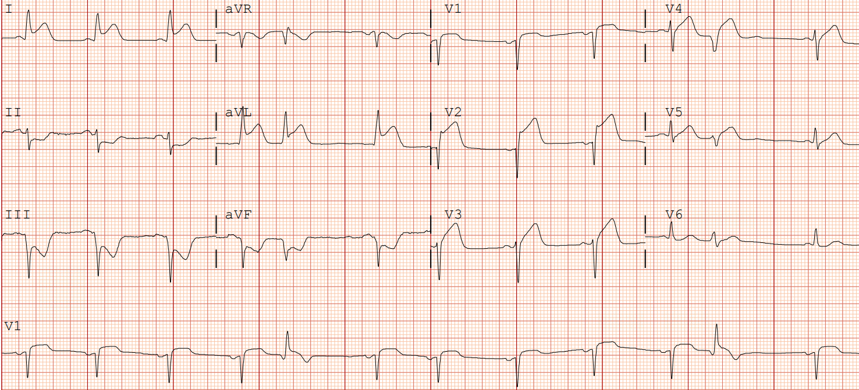
75yo man with 10/10 substernal chest pain
What is your overall interpretation?
Sinus rhythm with PVCs, left axis deviation, and…
STE in anterolateral leads (I, aVL, V1-V4), reciprocal depressions in inferior leads (II, III, aVF)
Acute Anterior STEMI, 100% occlusion mid-LAD
What region of the myocardium is involved and which vessel is most likely occluded?
LAD
Lateral ST-elevation
Anterior ST-elevation
Reciprocal ST-depression
PVC
ST elevation V1-V3 + ST-depression II,III, aVF (> 1 mm)
PPV – 93%
NPV – 68%
Images courtesy of
Benjamin Titus, MD
Images courtesy of Benjamin Titus, MD
Notes:
Official ECG Interpretation:
Pre-cath ECG: Sinus rhythm, left axis deviation, PVC, ST-elevation in anterolateral leads (I, aVL, V1-V4), reciprocal depressions in inferior leads (II, III, aVF)
Post-cath ECG: Sinus bradycardia, left axis deviation, poor R-wave progression with new Q-waves in V1-3
Diagnosis: Acute Anterior STEMI due to 100% occlusion mid-LAD
Teaching:
The anterior wall is supplied by the left anterior descending artery, which is seen electrocardiographically in the precordial leads.
Reciprocal depressions can be seen in the inferior leads.
If ST elevation is present in V1-V3 with reciprocal ST depression II, III, aVF (> 1 mm), PPV 93% and NPV – 68%².
Anterior wall myocardial damage is demonstrated by:
Poor R-wave progression in the precordial leads.
Any Q in V1-V3 or >30ms and >1mm depth in V4-V6 ¹.
Next step in management: Goal door to balloon time < 90 minutes. Patient was taken to the cath lab where they underwent balloon angioplasty and stent placement to the mid-LAD with resultant TIMI-3 flow.
Is this sufficiently precise? Would it be better to list the relevant leads, not just ‘precordial’?

Slide 3
I
-90
Left axis
L main
aVR
aVL
Circumflex
aVR
aVL
+180
I
0
LAD
RCA
Right axis
Normal axis occurs between -30º and + 90º
V₁
V₂
III
aVF
II
PDA
+90
V₃
12-lead ECG
V₄
V₅
V₆
Anterior / Lateral
Septal
I
aVR
V₁
V₄
II
III
II
aVL
V₂
V₅
aVF
III
aVF
V₃
V₆
Inferior
Anterior
Lateral

Slide 4
What are the criteria for STEMI?
All patients: >1 mm in contiguous leads
Except V2 and V3 depends on demographic:
Men (< 40 years): 2.5 mm elevation
Men (> 40 years): 2 mm elevation
Women (all ages): 1.5 mm elevation

Slide 5
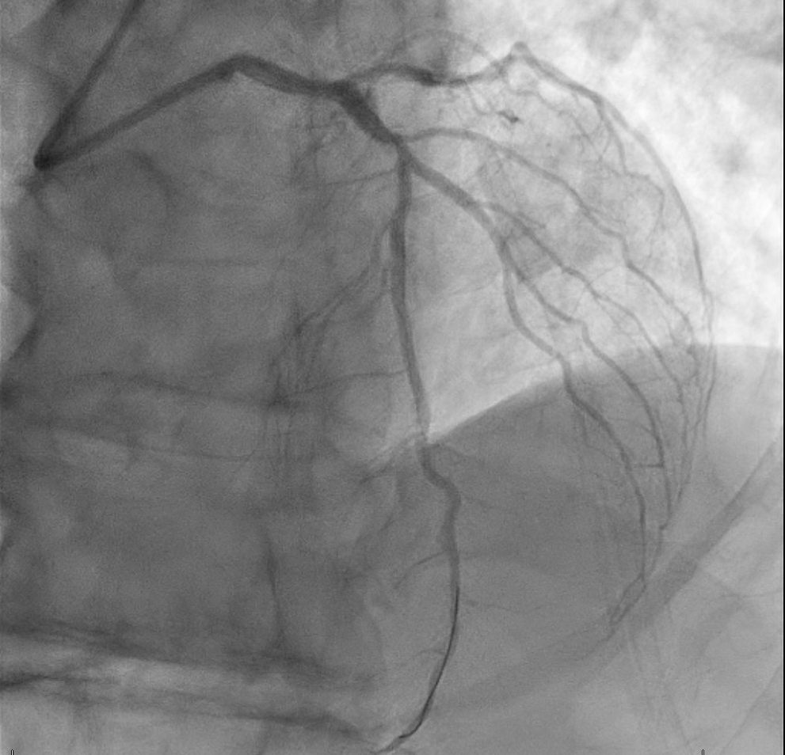
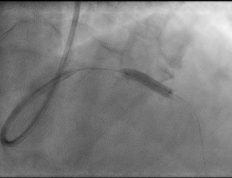
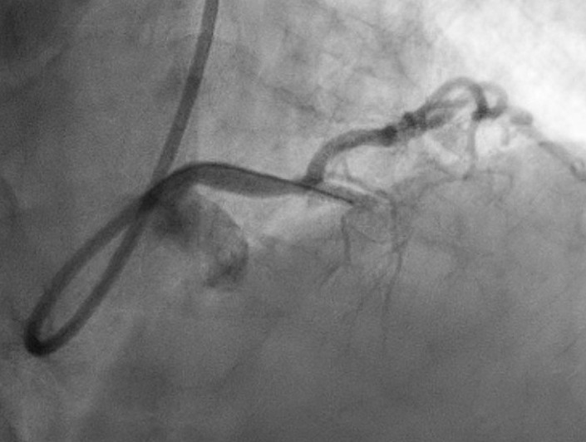
Coronary Angiography Films
75yo man with acute anterior STEMI, 100% occlusion mid-LAD
Where the LAD
should be
Deploying the balloon/stent
LAD with TIMI-3 flow
LAD Stent
Images courtesy of Benjamin Titus, MD
Notes:
Official ECG Interpretation:
Pre-cath ECG: Sinus rhythm, left axis deviation, PVC, ST-elevation in anterolateral leads (I, aVL, V1-V4), reciprocal depressions in inferior leads (II, III, aVF)
Post-cath ECG: Sinus bradycardia, left axis deviation, poor R-wave progression with new Q-waves in V1-3
Diagnosis: Acute Anterior STEMI due to 100% occlusion mid-LAD
Teaching:
The anterior wall is supplied by the left anterior descending artery, which is seen electrocardiographically in the precordial leads.
Reciprocal depressions can be seen in the inferior leads.
If ST elevation is present in V1-V3 with reciprocal ST depression II, III, aVF (> 1 mm), PPV 93% and NPV – 68%².
Anterior wall myocardial damage is demonstrated by:
Poor R-wave progression in the precordial leads.
Any Q in V1-V3 or >30ms and >1mm depth in V4-V6 ¹.
Next step in management: Goal door to balloon time < 90 minutes. Patient was taken to the cath lab where they underwent balloon angioplasty and stent placement to the mid-LAD with resultant TIMI-3 flow.
Is this sufficiently precise? Would it be better to list the relevant leads, not just ‘precordial’?

Slide 6
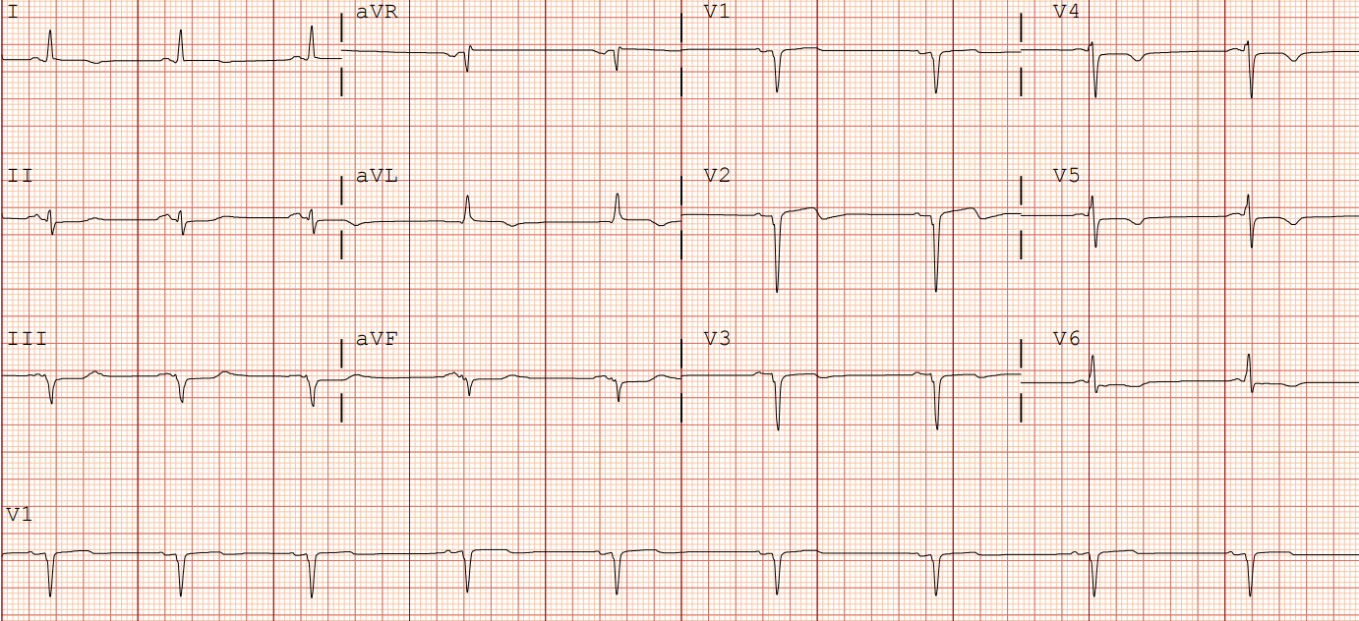
75yo man with acute anterior STEMI, s/p PCI to LAD…1 week latter
Sinus bradycardia, left axis deviation, poor R-wave progression with Q-waves in V1-3
What is your overall interpretation?
Resolved anterior STEMI
Poor R-wave progression in anterior leads
Large anterior Q-waves
Images courtesy of
Benjamin Titus, MD
Images courtesy of Benjamin Titus, MD
Notes:
Official ECG Interpretation:
Pre-cath ECG: Sinus rhythm, left axis deviation, PVC, ST-elevation in anterolateral leads (I, aVL, V1-V4), reciprocal depressions in inferior leads (II, III, aVF)
Post-cath ECG: Sinus bradycardia, left axis deviation, poor R-wave progression with new Q-waves in V1-3
Diagnosis: Acute Anterior STEMI due to 100% occlusion mid-LAD
Teaching:
The anterior wall is supplied by the left anterior descending artery, which is seen electrocardiographically in the precordial leads.
Reciprocal depressions can be seen in the inferior leads.
If ST elevation is present in V1-V3 with reciprocal ST depression II, III, aVF (> 1 mm), PPV 93% and NPV – 68%².
Anterior wall myocardial damage is demonstrated by:
Poor R-wave progression in the precordial leads.
Any Q in V1-V3 or >30ms and >1mm depth in V4-V6 ¹.
Next step in management: Goal door to balloon time < 90 minutes. Patient was taken to the cath lab where they underwent balloon angioplasty and stent placement to the mid-LAD with resultant TIMI-3 flow.
Is this sufficiently precise? Would it be better to list the relevant leads, not just ‘precordial’?

Slide 7
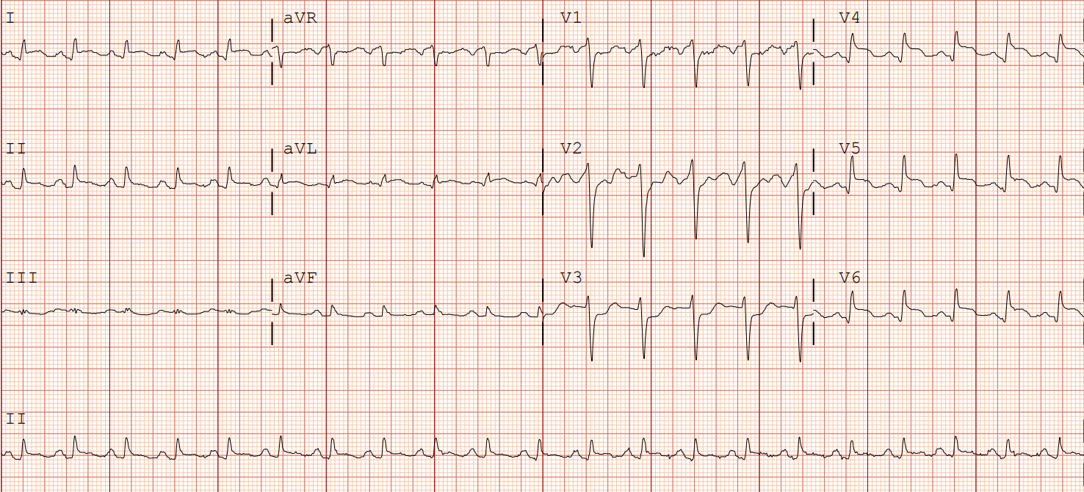
40yo man with substernal chest pain
Sinus tachycardia, normal axis, STE in lateral leads (I, aVL, V4-V6), reciprocal depressions in V1-V3
What is your overall interpretation?
What region of the myocardium is involved and which vessel is most likely occluded?
Acute lateral STEMI, 100% occlusion left circumflex (LCx)
Lateral ST-elevation
Reciprocal ST-depression
Lateral ST-elevation
ST Elevation in I, aVL, V5, V6 + ST Depression V1-V3
PPV – 91%
NPV – 93%
Images courtesy of
Benjamin Titus, MD
*Lateral STEMIs may present with inferior ST-elevation pattern!*
Images courtesy of Benjamin Titus, MD
Notes:
Case 2: Lateral STEMI
Official ECG Interpretation:
Pre-cath: Sinus tachycardia, normal axis, STE in lateral leads (I, aVL, V4-V6), reciprocal depressions in V1-V3
Post-cath: Sinus tachycardia, normal axis, persistent ST depression V2-V5
Diagnosis: Acute Lateral STEMI, 100% occlusion left circumflex
Teaching:
The lateral wall is supplied by the left circumflex artery, which is typically depicted electrocardiographically in leads I, aVL, V5, V6. Classic presentation is only seen in ~50% of cases³. Otherwise presents as ST elevation in the inferior leads².
Overall, 12-lead ECG demonstrates poor sensitivity for left circumflex involvement⁴ .
If ST elevation present in I, aVL, V5, V6 with reciprocal ST depression in V1-V3, PPV 91% and NPV 93%².
Next step in management: The goal door to balloon time is < 90 minutes. Patient was taken to the cath lab where they underwent balloon angioplasty and stent placement to the proximal left circumflex with resultant TIMI-3 flow.
Interesting! Is this saying that many left circ STEMIs are missed on a 12 lead? If there is a percent in your reference, it would be nice to include here and maybe on the slide

Slide 8
I
-90
Left axis
L main
aVR
aVL
Circumflex
aVR
aVL
+180
I
0
LAD
RCA
Right axis
Normal axis occurs between -30º and + 90º
V₁
V₂
III
aVF
II
PDA
+90
V₃
12-lead ECG
V₄
V₅
V₆
Anterior / Lateral
Septal
I
aVR
V₁
V₄
II
III
II
aVL
V₂
V₅
aVF
III
aVF
V₃
V₆
Inferior
Anterior
Lateral

Slide 9
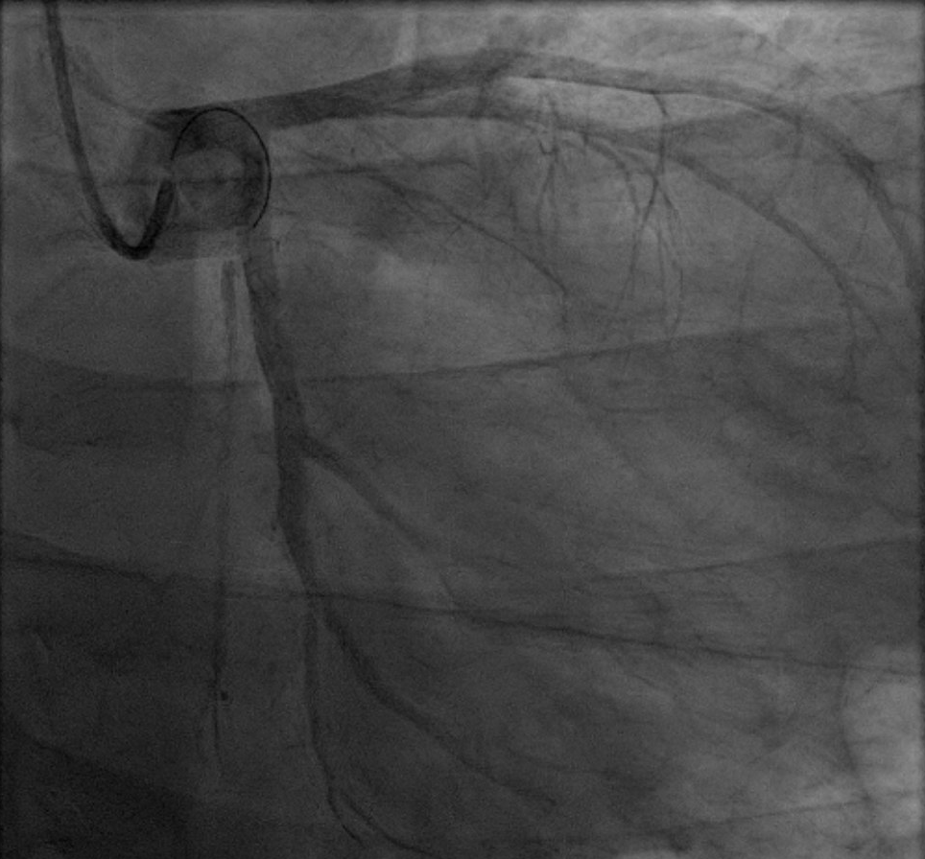
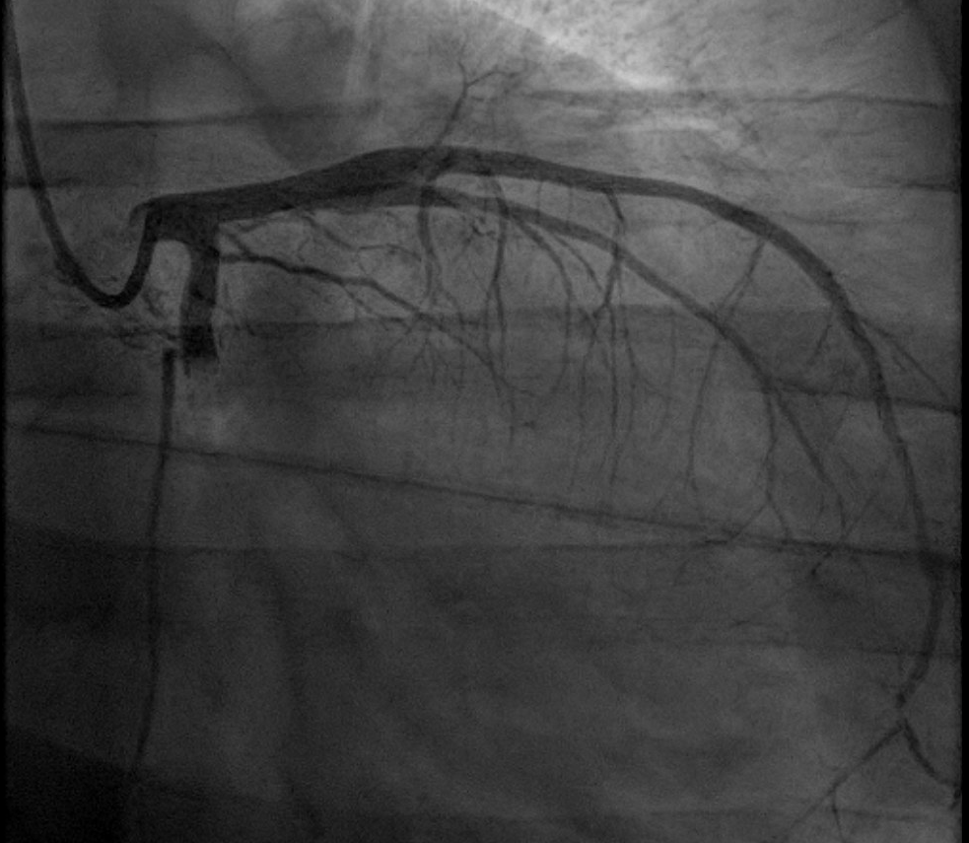
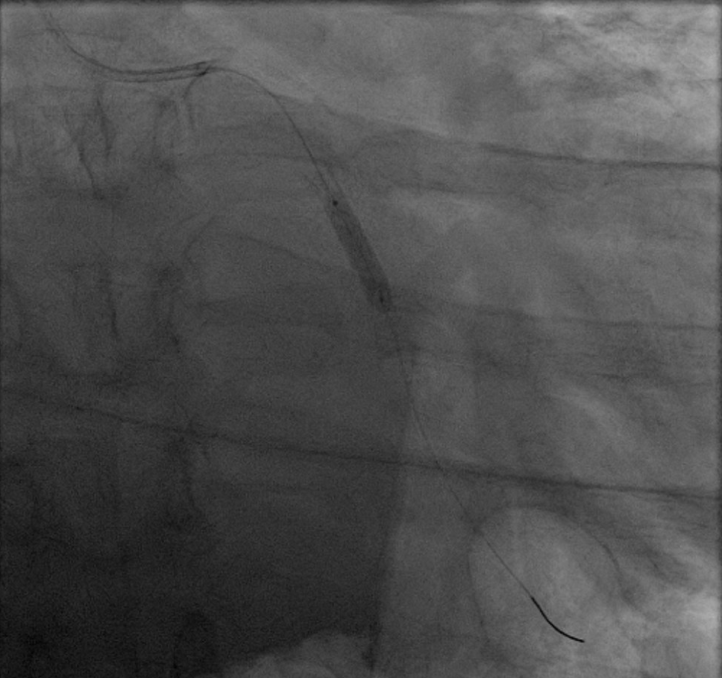
Coronary Angiography Films
40yo man with acute lateral STEMI, 100% occlusion LCx
Deploying the balloon/stent
Where the LCx
should be
LCx with TIMI 3 flow
post PCI
Images courtesy of Benjamin Titus, MD
Notes:
Case 2: Lateral STEMI
Official ECG Interpretation:
Pre-cath: Sinus tachycardia, normal axis, STE in lateral leads (I, aVL, V4-V6), reciprocal depressions in V1-V3
Post-cath: Sinus tachycardia, normal axis, persistent ST depression V2-V5
Diagnosis: Acute Lateral STEMI, 100% occlusion left circumflex
Teaching:
The lateral wall is supplied by the left circumflex artery, which is typically depicted electrocardiographically in leads I, aVL, V5, V6. Classic presentation is only seen in ~50% of cases³. Otherwise presents as ST elevation in the inferior leads².
Overall, 12-lead ECG demonstrates poor sensitivity for left circumflex involvement⁴ .
If ST elevation present in I, aVL, V5, V6 with reciprocal ST depression in V1-V3, PPV 91% and NPV 93%².
Next step in management: The goal door to balloon time is < 90 minutes. Patient was taken to the cath lab where they underwent balloon angioplasty and stent placement to the proximal left circumflex with resultant TIMI-3 flow.
Interesting! Is this saying that many left circ STEMIs are missed on a 12 lead? If there is a percent in your reference, it would be nice to include here and maybe on the slide

Slide 10
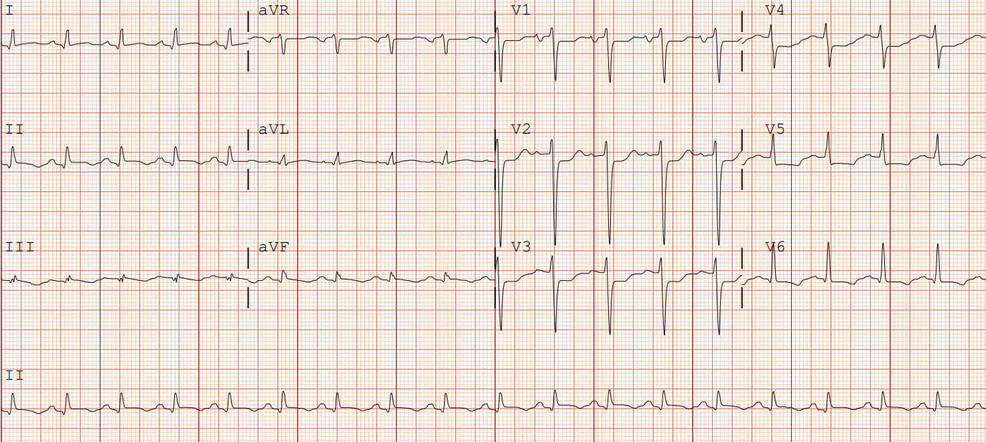
40yo man with acute lateral STEMI, s/p PCI to LCx…1 week latter
Sinus tachycardia, normal axis, persistent ST depression V2-V5
What is your interpretation of the ECG?
Resolution/evolution of lateral STEMI
Persistent ST-depression
Images courtesy of
Benjamin Titus, MD
Images courtesy of Benjamin Titus, MD
Notes:
Case 2: Lateral STEMI
Official ECG Interpretation:
Pre-cath: Sinus tachycardia, normal axis, STE in lateral leads (I, aVL, V4-V6), reciprocal depressions in V1-V3
Post-cath: Sinus tachycardia, normal axis, persistent ST depression V2-V5
Diagnosis: Acute Lateral STEMI, 100% occlusion left circumflex
Teaching:
The lateral wall is supplied by the left circumflex artery, which is typically depicted electrocardiographically in leads I, aVL, V5, V6. Classic presentation is only seen in ~50% of cases³. Otherwise presents as ST elevation in the inferior leads².
Overall, 12-lead ECG demonstrates poor sensitivity for left circumflex involvement⁴ .
If ST elevation present in I, aVL, V5, V6 with reciprocal ST depression in V1-V3, PPV 91% and NPV 93%².
Next step in management: The goal door to balloon time is < 90 minutes. Patient was taken to the cath lab where they underwent balloon angioplasty and stent placement to the proximal left circumflex with resultant TIMI-3 flow.
Interesting! Is this saying that many left circ STEMIs are missed on a 12 lead? If there is a percent in your reference, it would be nice to include here and maybe on the slide

Slide 11
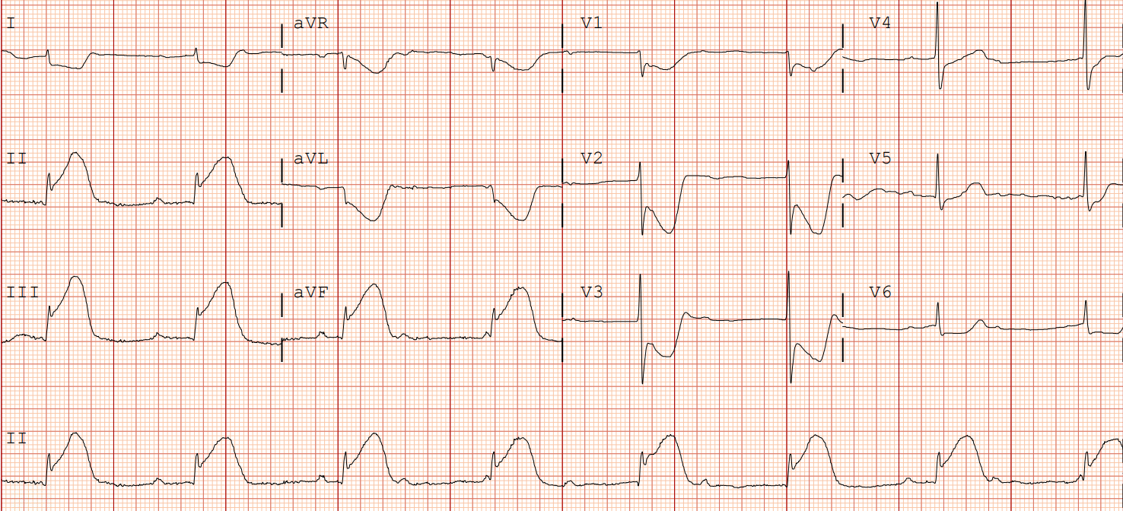
50yo woman with chest pain
3rd Degree AV block, RAD, STE in inferior leads (II, III, AVF), reciprocal depressions in I, aVL, V1-V6
What is your overall interpretation?
Inferior STEMI 100% RCA occlusion, complicated by 3rd degree AV block
What region of the myocardium is involved, and which vessel is most likely occluded?
ST Depression
RAD
Inferior ST elevation
Dissociated P-waves
Images courtesy of
Benjamin Titus, MD
ST elevation III > ST elevation in II AND ST depression I, aVL
PPV – 94%
NPV – 70%
Images courtesy of Benjamin Titus, MD
Notes:
Case 3: Inferior STEMI
Official ECG Interpretation:
Pre-cath: 3rd Degree AV block, right axis deviation, STE in inferior leads (II, III, AVF), reciprocal depressions in I, aVL, V1-V6
Post-cath: Sinus brady, normal axis, normal ST-segments (notice return of 1:1 P-QRS)
Diagnosis: Inferior STEMI 100% RCA occlusion, complicated by 3rd degree AV block
Teaching:
The inferior wall is supplied by the right coronary artery in approximately 80% of cases vs left circumflex in 20% of cases, which is typically depicted electrocardiographically in leads II, III, aVF⁴.
High-degree AV block (2nd or 3rd) is a complication in ~12% of inferior wall MI because the AV nodal artery arises from the right coronary artery⁵.
If ST elevation in lead III is > ST elevation in II AND ST depression I, aVL, PPV 94% and NPV 70%².
A Q-wave in lead III is not significant. Q-waves must be > 30 ms and > 1 mm of depth in both II and aVF to indicate past MI¹.
Next step in management: The goal door to balloon time is < 90 minutes. This patient was taken to the cath lab where they had a temporary intravenous pacer placed. They also underwent balloon angioplasty and stent placement to the RCA with resultant TIMI-3 flow.

Slide 12
I
-90
Left axis
L main
aVR
aVL
Circumflex
aVR
aVL
+180
I
0
LAD
Right axis
Normal axis occurs between -30º and + 90º
RCA
V₁
V₂
III
aVF
II
PDA
+90
V₃
12-lead ECG
V₄
V₅
V₆
Anterior / Lateral
Septal
I
aVR
V₁
V₄
II
III
II
aVL
V₂
V₅
aVF
III
aVF
V₃
V₆
Inferior
Anterior
Lateral

Slide 13
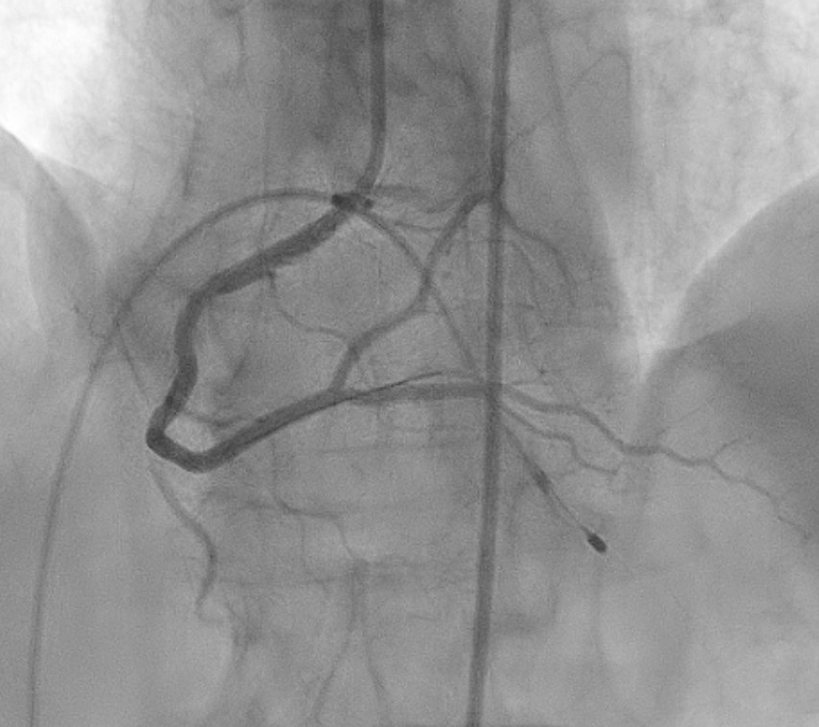
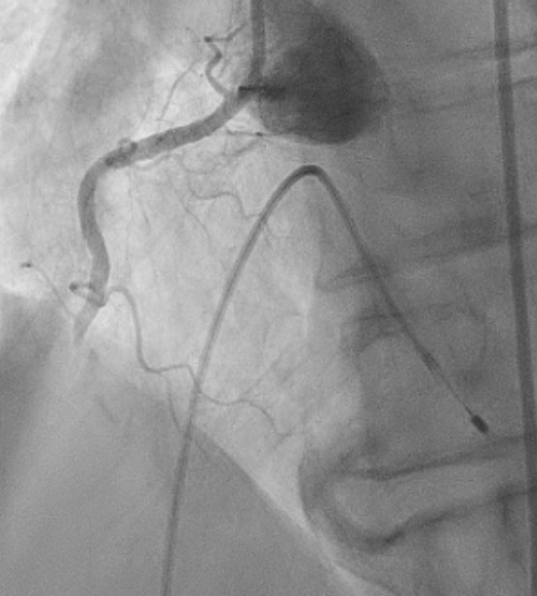
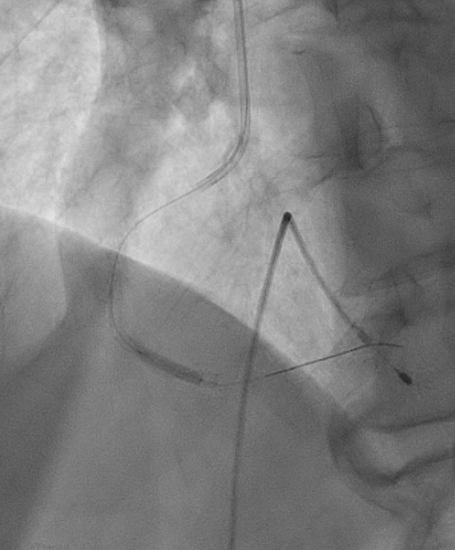
Coronary Angiography Films
50yo woman with acute inferior STEMI, 100% occlusion of RCA
Where the RCA
should be
RCA with TIMI 3 flow, post PCI
Deploying the balloon/stent
Images courtesy of Benjamin Titus, MD
Notes:
Case 3: Inferior STEMI
Official ECG Interpretation:
Pre-cath: 3rd Degree AV block, right axis deviation, STE in inferior leads (II, III, AVF), reciprocal depressions in I, aVL, V1-V6
Post-cath: Sinus brady, normal axis, normal ST-segments (notice return of 1:1 P-QRS)
Diagnosis: Inferior STEMI 100% RCA occlusion, complicated by 3rd degree AV block
Teaching:
The inferior wall is supplied by the right coronary artery in approximately 80% of cases vs left circumflex in 20% of cases, which is typically depicted electrocardiographically in leads II, III, aVF⁴.
High-degree AV block (2nd or 3rd) is a complication in ~12% of inferior wall MI because the AV nodal artery arises from the right coronary artery⁵.
If ST elevation in lead III is > ST elevation in II AND ST depression I, aVL, PPV 94% and NPV 70%².
A Q-wave in lead III is not significant. Q-waves must be > 30 ms and > 1 mm of depth in both II and aVF to indicate past MI¹.
Next step in management: The goal door to balloon time is < 90 minutes. This patient was taken to the cath lab where they had a temporary intravenous pacer placed. They also underwent balloon angioplasty and stent placement to the RCA with resultant TIMI-3 flow.

Slide 14
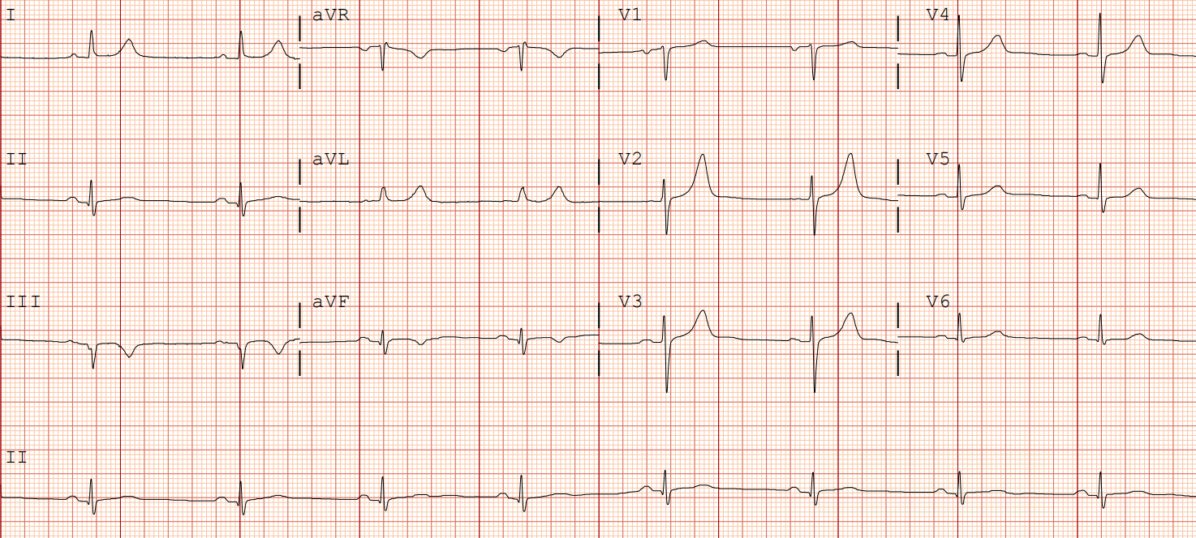
50yo woman with acute inferior STEMI, s/p PCI to RCA…1 week later
Sinus brady, normal axis, normal ST-segments
What is your overall interpretation?
Resolution of inferior STEMI with return of sinus activity
Images courtesy of
Benjamin Titus, MD
1:1 P wave to QRS complex
Images courtesy of Benjamin Titus, MD
Notes:
Case 3: Inferior STEMI
Official ECG Interpretation:
Pre-cath: 3rd Degree AV block, right axis deviation, STE in inferior leads (II, III, AVF), reciprocal depressions in I, aVL, V1-V6
Post-cath: Sinus brady, normal axis, normal ST-segments (notice return of 1:1 P-QRS)
Diagnosis: Inferior STEMI 100% RCA occlusion, complicated by 3rd degree AV block
Teaching:
The inferior wall is supplied by the right coronary artery in approximately 80% of cases vs left circumflex in 20% of cases, which is typically depicted electrocardiographically in leads II, III, aVF⁴.
High-degree AV block (2nd or 3rd) is a complication in ~12% of inferior wall MI because the AV nodal artery arises from the right coronary artery⁵.
If ST elevation in lead III is > ST elevation in II AND ST depression I, aVL, PPV 94% and NPV 70%².
A Q-wave in lead III is not significant. Q-waves must be > 30 ms and > 1 mm of depth in both II and aVF to indicate past MI¹.
Next step in management: The goal door to balloon time is < 90 minutes. This patient was taken to the cath lab where they had a temporary intravenous pacer placed. They also underwent balloon angioplasty and stent placement to the RCA with resultant TIMI-3 flow.

Slide 15
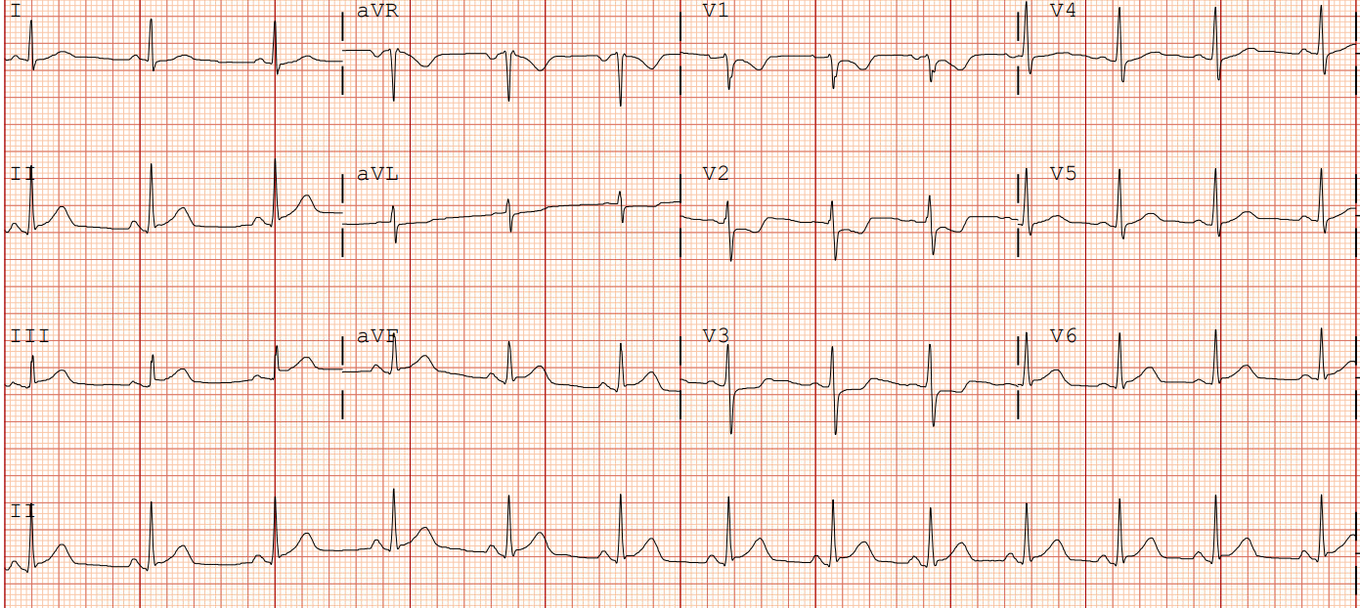
58yo man who with chest pain
Sinus rhythm, normal axis, STE in inferior leads (II, III, AVF), ST depressions V2-V3
What is your overall interpretation?
Septal ST-dep with dominant R in V2 suggests post-MI. How could this be confirmed?
Are the V1-V2 depressions reciprocal changes or do they suggest something else?
V7
Posterior leads
Dominant R wave (R>S)
V8
Inferior ST elevation
ST Depression V2-3
V9
Images courtesy of
Benjamin Titus, MD
Posterior lead ST-elevation (V7-9) > 0.5 mm
Images courtesy of Benjamin Titus, MD
Notes:
Case 4: Posterior STEMI
Official ECG Interpretation:
Initial ECG: Sinus rhythm, normal axis, dominant R-wave V2-V3 ST elevation inferior leads (II,III, aVF), ST depression V2-V3
Posterior leads: 1 mm ST elevation in V7-V9
Diagnosis: Posterior Wall MI due to 100% RCA occlusion
Teaching:
Involvement of the posterior wall is best evaluated by posterior chest leads (V7-9).
Posterior lead ST elevation is defined as > 0.5 mm in 2 or more leads⁶.
Isolated posterior wall MI may also present with reciprocal ST depression in V1-V4⁷.
Next step in management: Goal door to balloon time < 90 minutes. Patient was taken to the cath lab where they underwent balloon angioplasty and stent placement to the RCA with resultant TIMI-3 flow.

Slide 16
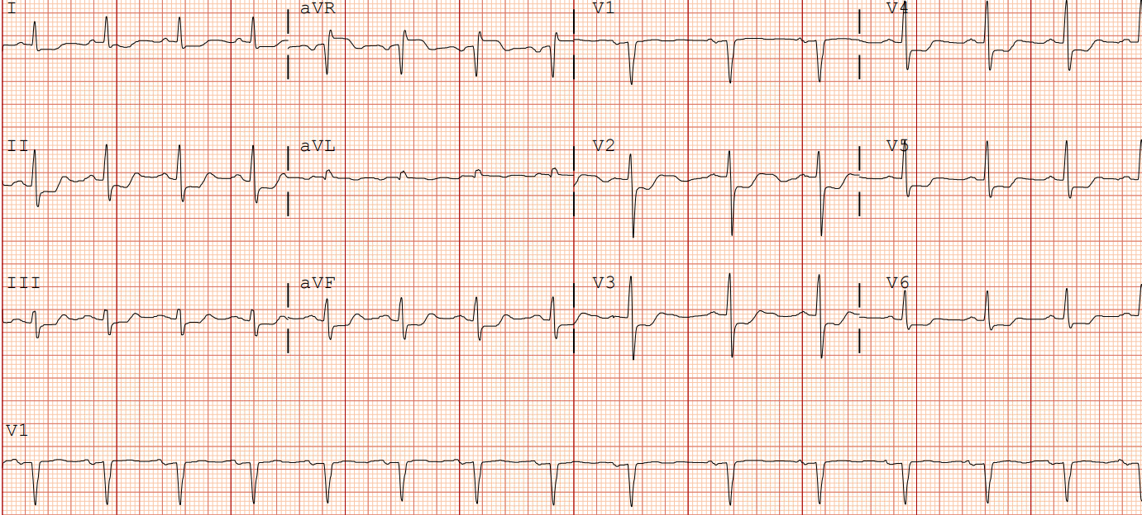
70yo man with chest pain x 3 months
Sinus rhythm, normal axis, ST depression (I, II, aVF, V2-V6), ST elevation in aVR
What is your overall interpretation?
LM stenosis. Patient underwent CABG x3
Which vascular distribution could explain this pattern of ST changes?
ST elevation
Diffuse ST-depression
Images courtesy of
Benjamin Titus, MD
LMCA or Multi-vessel disease:
ST elevation in aVR > V1
ST depression in V2-V6, I, II, aVL
Images courtesy of Benjamin Titus, MD
Notes:
Case 5: LM stenosis with multi-vessel coronary artery disease
Official ECG Interpretation:
Initial ECG: Sinus rhythm, normal axis, ST depression (I, II, aVF, V2-V6), ST elevation in aVR
Diagnosis: Subtotal LM occlusion with three vessel disease
Teaching:
LMCA infarctions present with two common phenotypes⁸:
Subtotal occlusion: diffuse ST depressions with reciprocal ST elevation in aVR
Acute total occlusion: ST elevation in anterior and lateral leads with reciprocal ST depressions in the inferior leads (with or without aVR elevation)
ST elevation in aVR > 1mm (but can be absent in ~20-40% of cases).
LMCA or severe multivessel disease can affect nuclear perfusion studies, which leads to normalization of tracer uptake as there is diffuse ischemia (false negative study).
Next step in management: This patient underwent a three vessel CABG.
In addition to what happened with this patient, include a statement about the standard of care in general as you did with door to balloon times in the other cases.

