Slide 1
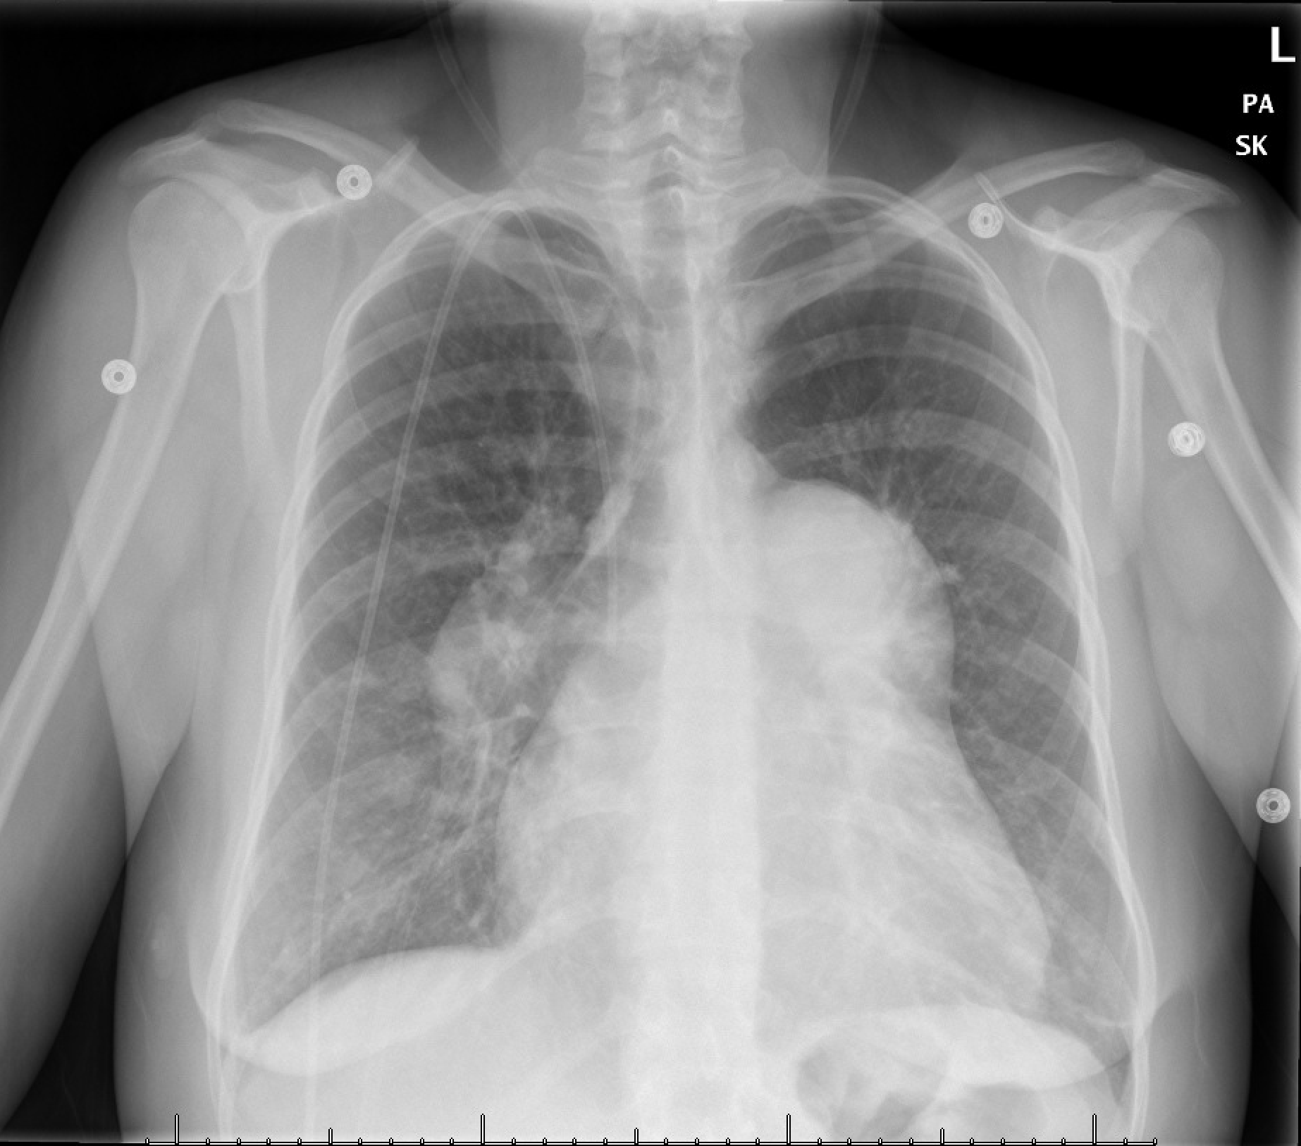
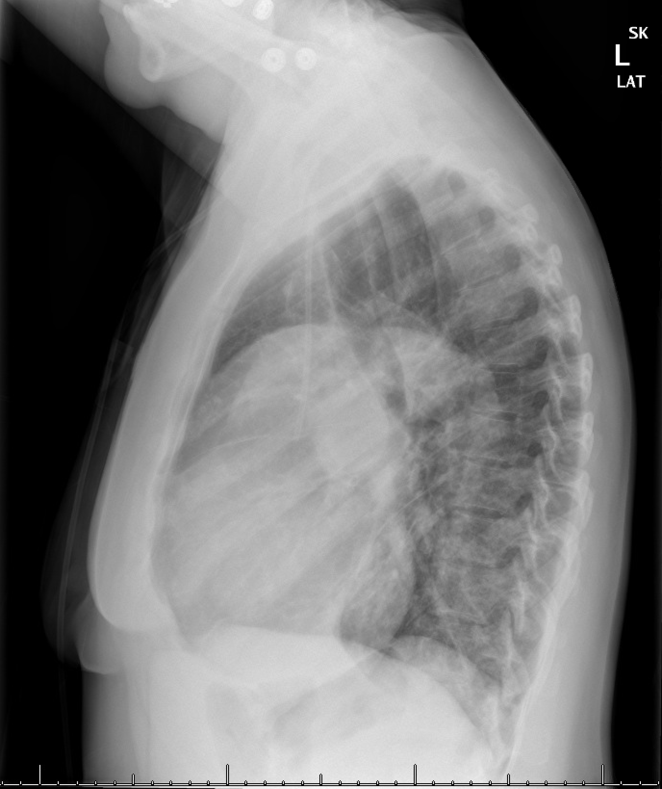
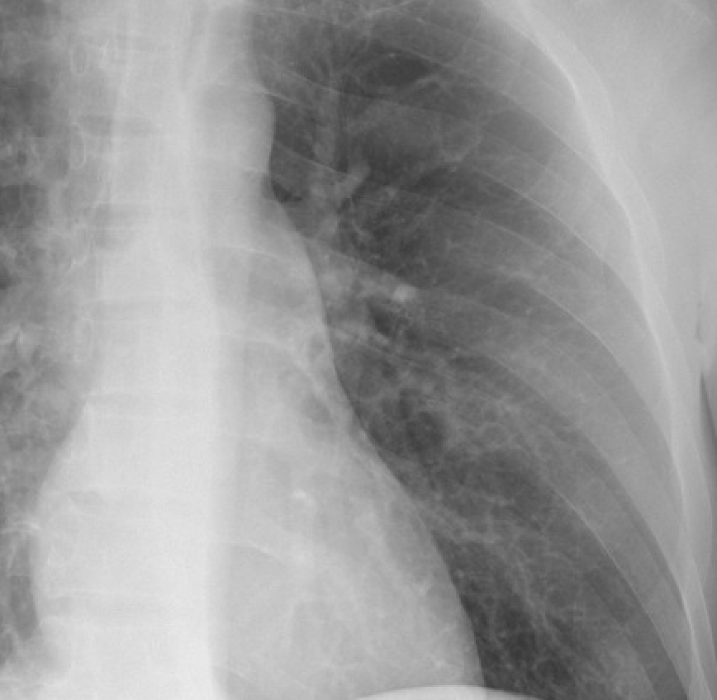
35yo woman with chronic progressive dyspnea and lower extremity edema.
What is your overall interpretation?
Cardiomegaly with massive enlargement of the central pulmonary arteries.
How do you evaluate for PA enlargement on a chest radiograph?
Enlarged “moguls” of the cardiomediastinal silhouette.
Identify the normal “moguls” of the cardiomediastinal silhouette.
Aortic knob
Main PA
Left ventricle
Enlarged PAs
Images courtesy of
Daniel Gergen, MD
Cardiomegaly
Notes:
CXR interpretation:
Right-sided central venous catheter with tip terminating in the SVC. Cardiomegaly with massive enlargement of the central pulmonary arteries. Faint ill-defined opacities bilaterally are redemonstrated and unchanged when compared to prior CTs. Minimal left basal atelectasis/scarring. No consolidation pleural effusion, or pneumothorax. No acute osseous abnormality.
Severe enlargement of the main pulmonary artery measuring up to 6.2 cm
Diagnosis: familial PAH (Class 1) with severe enlargement of the main pulmonary artery
Teaching:
Enlarged cardiac silhouette is defined as a cardiac silhouette that is greater than half of the internal thoracic diameter. The differential for an enlarged cardiac silhouette on chest radiograph includes, cardiomegaly, pericardial effusion, and portable/AP film.
The differential for perihilar enlargement includes, lymphadenopathy, malignancy, pulmonary arterial hypertension, and pulmonary venous hypertension. In this case, the smooth contours of the of the vessels, lack of interstitial pattern to indicate pulmonary edema, and the clinical history, indicate pulmonary arterial hypertension.
The “moguls” are used to identify pathologic enlargement of left-sided structures of the cardiomediastinal silhouette. Enlargement of a mogul indicates pathology.
From top to bottom, the normal moguls are the aortic knob, left main pulmonary artery, and left ventricle. A possible fourth mogul (between the left main PA and LV) is the left atrial appendage (not visualized in this image).

Slide 2
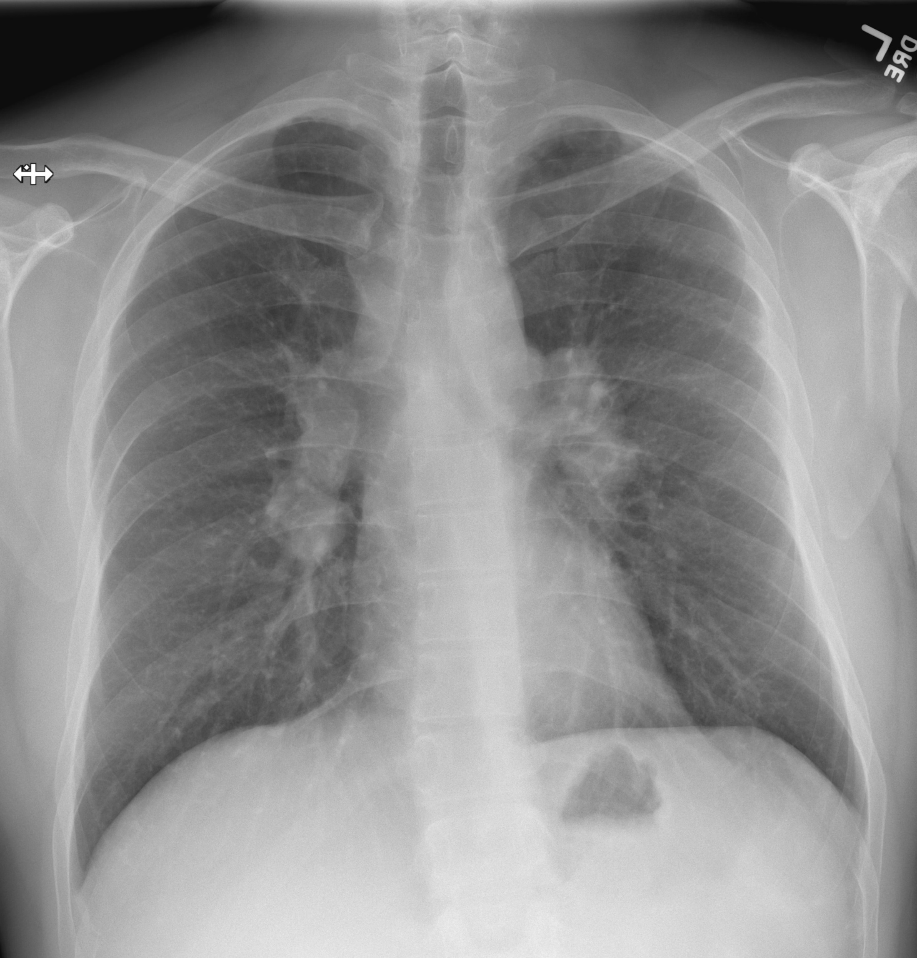
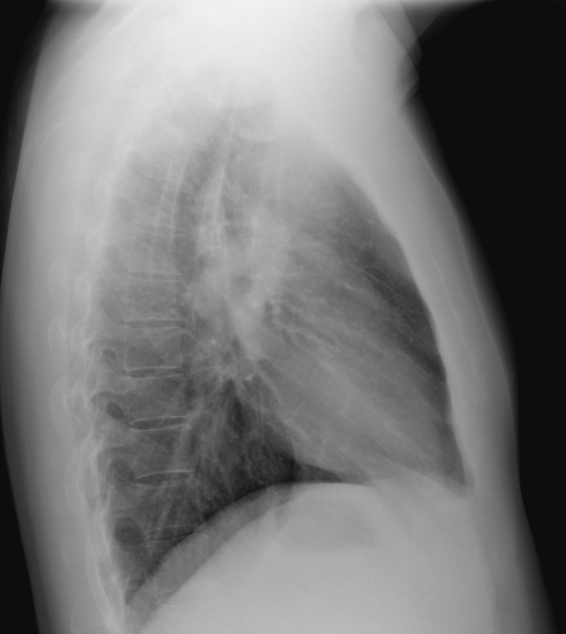
35yo man presents with malaise, ankle pain and a painful nodule on his shin.
Bilateral bulky hilar and paratracheal lymphadenopathy
What is your overall interpretation?
For bilateral enlarged hila, how can you differentiate between enlarged PA and LAN?
V-shaped “hilar points” identify bifurcations of normal RPA and LPA.
LAN appears as lumpy bumpy opacities with rounded margins.
Löfgren’s syndrome: hilar adenopathy, acute arthritis, and erythema nodosum
CRP/ESR, NSAIDs, and re-eval in 1-2 weeks. Other cases of suspected sarcoid require biopsy.
What is the differential for bilateral LAN and the most likely diagnosis in this patient?
What is the next step in management?
Paratracheal LAN
Right PA
Left PA
Hilar
LAN
Hilar LAN
Right Ventricle
DDx - Bilateral Hilar LAN
Sarcoidosis
Infection (TB and endemic fungi)
Malignancy (lymphoma and carcinoma)
Inorganic dust (silicosis, berylliosis)
Bulky LAN = Potato-like opacity that does not taper
Images courtesy of
Brandon Fainstad, MD
Notes:
Official CXR Read: Rounded, bulky densities in the bilateral hila and paratracheal region.
Diagnosis: Sarcoidosis with bulky hilar lymphadenopathy. This is a case of Lofgrens syndrome: acute arthritis, EN, and hilar lymphadenopathy
Teaching:
The hilum consists of blood vessels (pulmonary arteries and veins) and the main bronchi of the lung. On CXR, “hilar points” are the angles (which look like horizontal ‘vees’) formed by pulmonary arteries sloping up and down. The fact that these opacities do not taper (look more like potatoes) tells you this is lymphadenopathy, not pulmonary hypertension. On a normal CXR, hilar lymph nodes cannot be seen. When there are enlarged lymph nodes, they will disrupt the normal appearance of a tapering pulmonary vessel.
Common causes of hilar lymphadenopathy include inflammation (sarcoidosis, silicosis), neoplasm (lymphoma, metastases, bronchogenic carcinoma), and infection (TB, infectious mono).
Typically, a case of suspected sarcoidosis requires biopsy for confirmation. The case of Lofgren’s syndrome (the triad of hilar LAN, acute arthritis, and EN), is an exception given the high specificity of this triad in a young adult. It is appropriate to treat empirically with NSAIDs and escalate to steroids if there is not a good response to NSAIDs alone. If still not responding, may require additional imaging or biopsy.

Slide 3
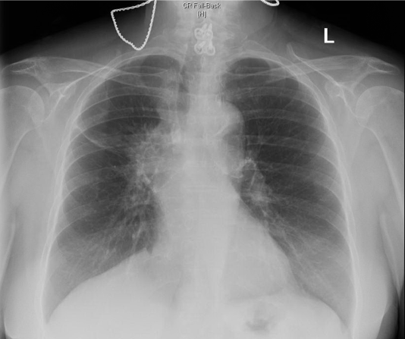
65yo woman with extensive tobacco smoking history, presenting with worsening chronic cough.
Right hilar spiculated mass with right sided volume loss.
Large unilateral mass concerning for hilar invasion or lymphadenopathy.
What is your overall interpretation?
What characteristics of this lesion suggest malignancy?
Squamous Cell or Small Cell Lung Cancer
If this is primary lung cancer, what is the most likely type?
Primary Lung Cancer Alliteration
Central Squamous Small
Trachea toward side of lesion
Minor fissure shifted up
Diaphragm shifted up
Images courtesy of
Lauren Brown, MD
Notes:
CXR Interpretation: Right hilar pulmonary mass with right upper lobe volume loss suggesting at least partial bronchial obstruction centrally.
Diagnosis: Primary Squamous Cell Carcinoma of the Lung.
Teaching:
There is a partial upper lobe collapse from compression of the R bronchus. Signs of volume loss (light green arrows) include upward displacement of the minor fissure, “peaking” of the right hemidiaphragm, and rightward displacement of the trachea. This may be confusing because malignancies are 'space-occupying' lesions. This case demonstrates how the mass is obstructing part of the upper lobe airways, leading to partial collapse. The remaining right upper lobe remains lucent, so there is not a complete upper lobar collapse.
Squamous cell and Small cell lung cancers are more commonly Central than adenocarcinomas.

Slide 4
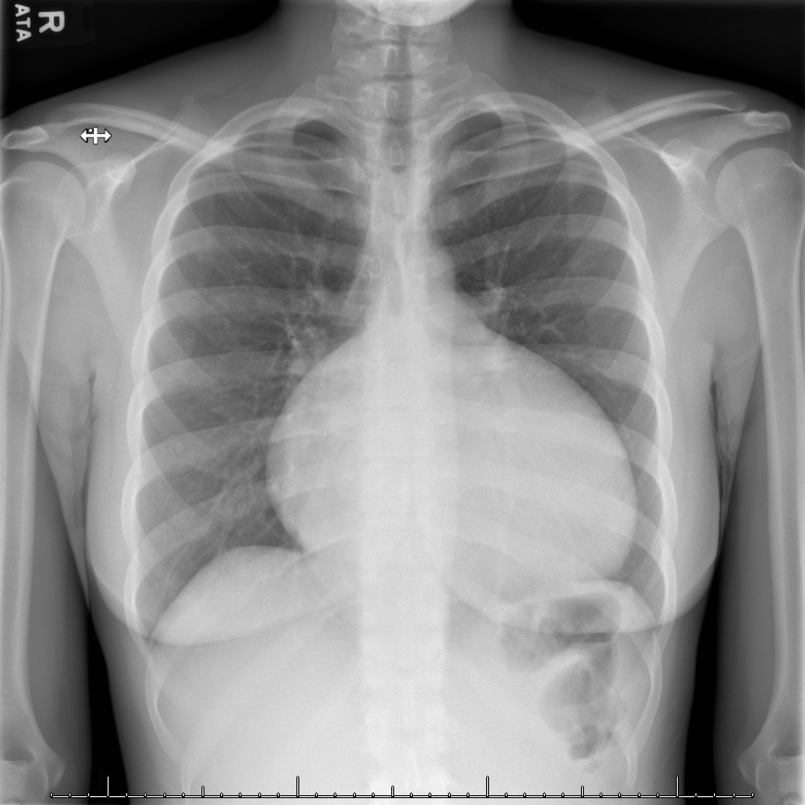
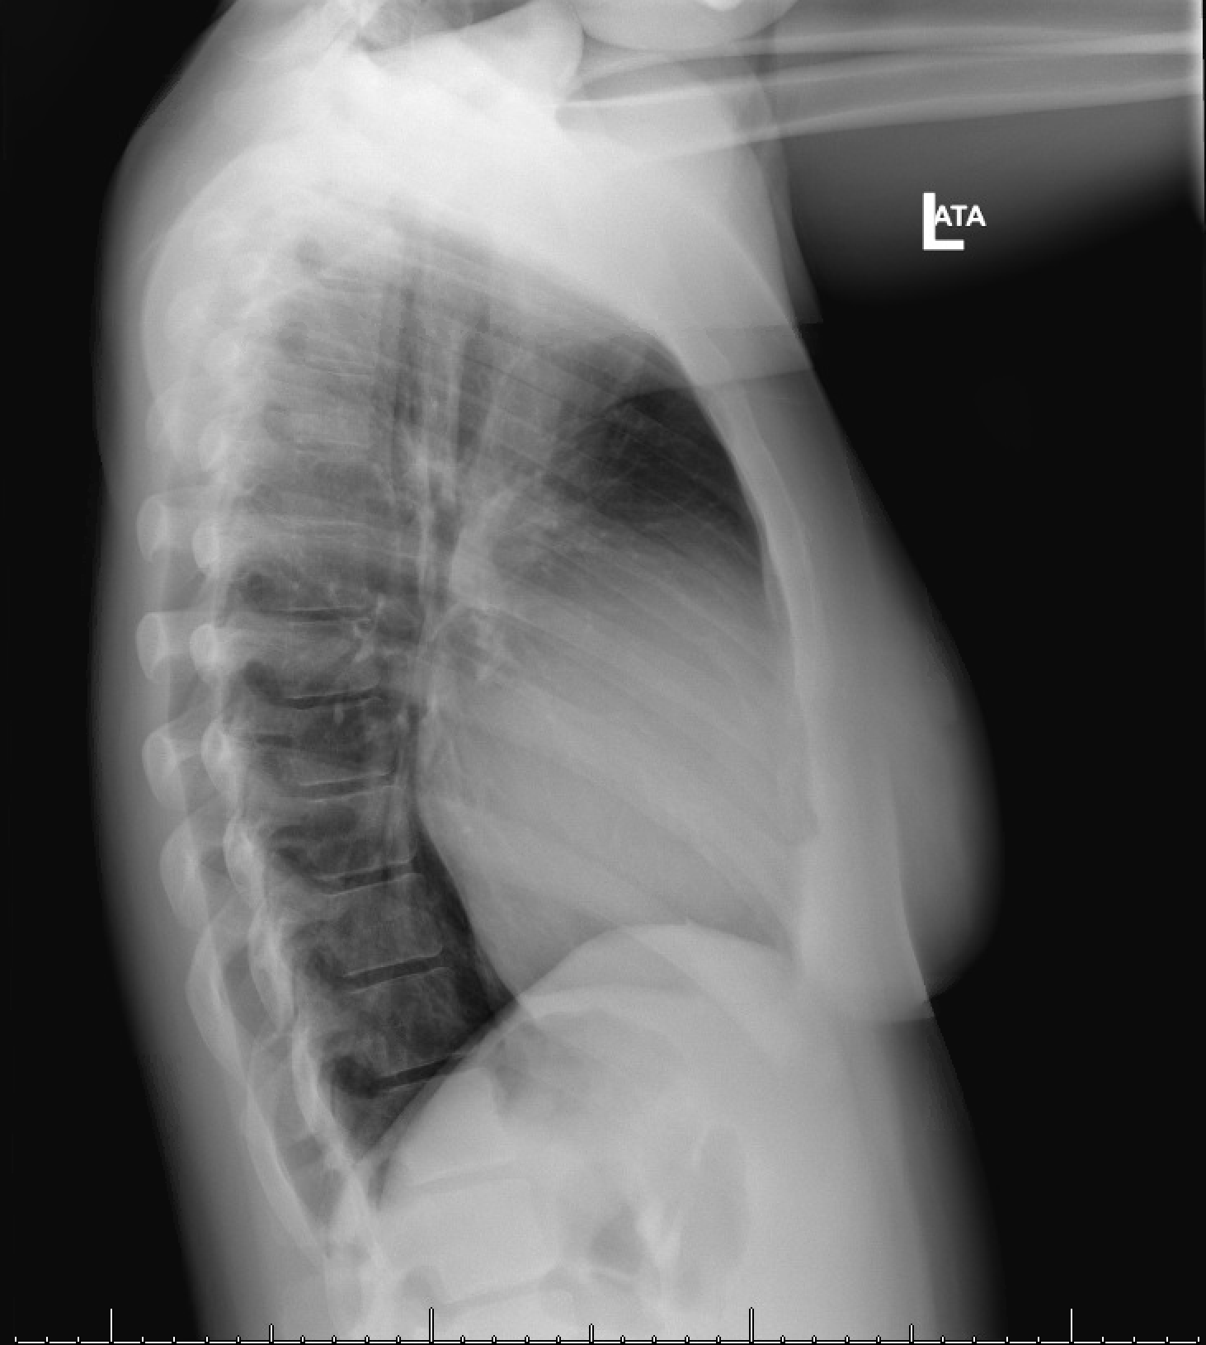
30yo woman with evaluated for cough and nasal congestion.
What is your overall interpretation?
Enlarged cardiac silhouette due to cardiomegaly.
Right atrium & right ventricle. This is a patient with Ebstein anomaly
Which cardiac chamber(s) account for the enlarged heart?
Partial loss of retrosternal
clear space
Right Atrium & Right Ventricle
$$\frac{Width of heart}{Internal diameter of thorax}≥0.5$$
Images courtesy of
Daniel Gergen, MD
Notes:
Instructions: The stem is meant to suggest no concerning chest symptoms. The could have also been an asymptomatic patient.
CXR Read: The heart is markedly enlarged. No focal regions of consolidation are appreciated. No free air is noted below the diaphragm.
Diagnosis: Ebstein anomaly complicated by severe tricuspid regurgitation and right ventricular failure
Teaching:
Enlarged cardiac silhouette is defined as a cardiac silhouette that is greater than half of the internal thoracic diameter. The differential for an enlarged cardiac silhouette on chest radiograph includes, cardiomegaly, pericardial effusion, and portable/AP film.
An enlarged right heart border with smooth contours is due to enlargement of either the right atrium, right ventricle, or both structures.
The right ventricle is an anterior structure. The lateral view demonstrates partial loss of the retrosternal clear space, the area between the sternum and the right ventricle. Loss of the retrosternal clear space is due to right ventricular enlargement.
Shown is the apical 4-chamber view from the patient’s echocardiograph. This images demonstrates a significantly enlarged right ventricle as well as an enlarged right atrium.
Ebstein anomaly is a congenital malformation of the tricuspid valve and right ventricle.
- How reliably does this image suggest enlarged R sided cardiac structures over left sided? What features are most suggestive?

Slide 5
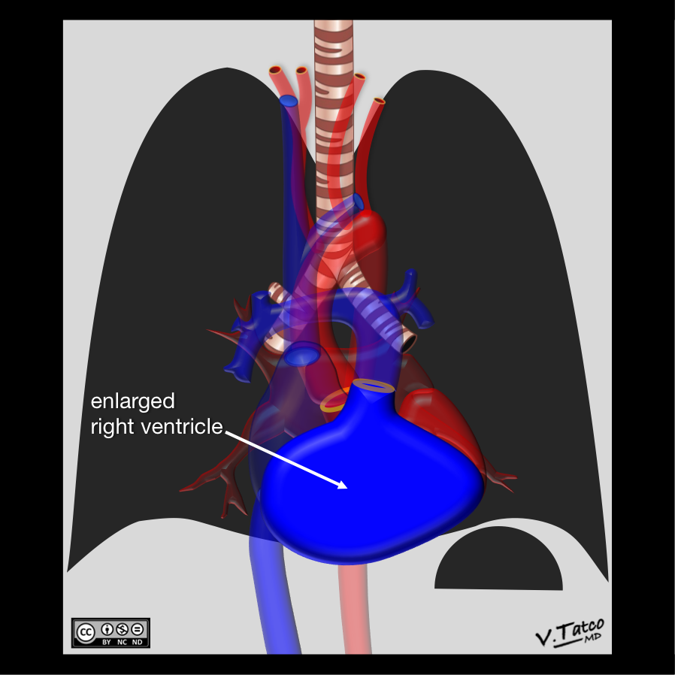
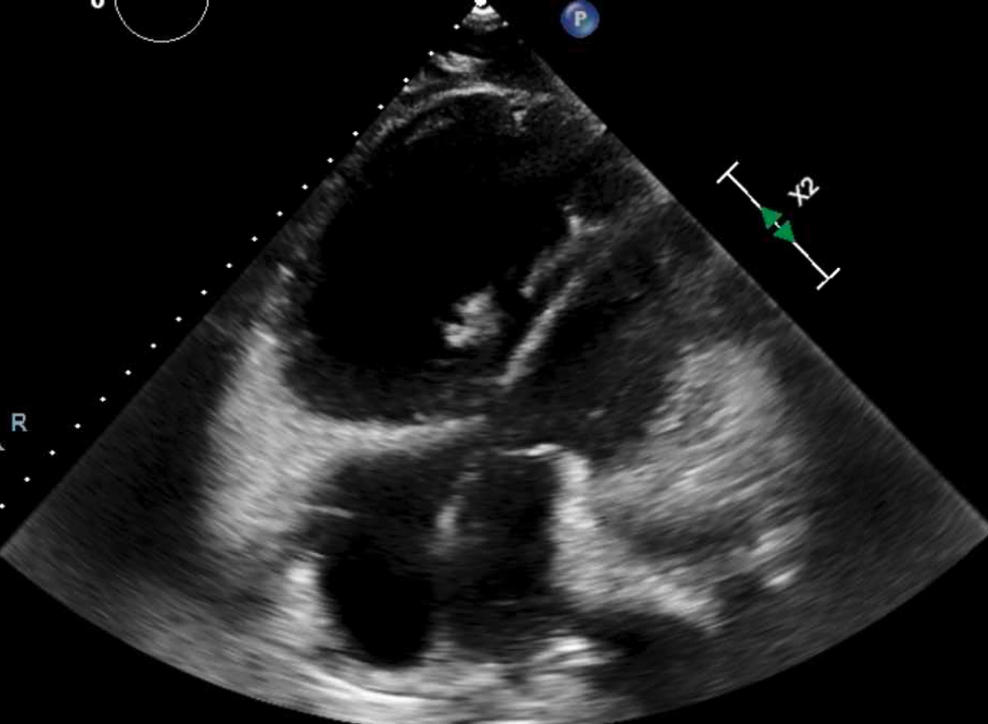
32-year-old woman w/ Ebstein anomaly.
What is your overall interpretation?
Enlarged cardiac silhouette due to cardiomegaly.
Right atrium & right ventricle. This is a patient with Ebstein anomaly
Which cardiac chamber(s) account for the enlarged heart?
What is the differential for an enlarged cardiac silhouette?
Patient’s TTE
RV
LV
RA
LA
Right Atrium & Right Ventricle
DDx – Enlarged Cardiac Silhouette
Cardiomegaly
Pericardial effusion
Portable (AP) film
Case courtesy of Vincent Tatco, Radiopaedia.org rID: 46378
$$\frac{Width of heart}{Internal diameter of thorax}≥0.5$$
Images courtesy of
Daniel Gergen, MD
Notes:
CXR Read: The heart is markedly enlarged. No focal regions of consolidation are appreciated. No free air is noted below the diaphragm.
Diagnosis: Ebstein anomaly complicated by severe tricuspid regurgitation and right ventricular failure
Teaching:
Enlarged cardiac silhouette is defined as a cardiac silhouette that is greater than half of the internal thoracic diameter. The differential for an enlarged cardiac silhouette on chest radiograph includes, cardiomegaly, pericardial effusion, and portable/AP film.
An enlarged right heart border with smooth contours is due to enlargement of either the right atrium, right ventricle, or both structures.
The right ventricle is an anterior structure. The lateral view demonstrates partial loss of the retrosternal clear space, the area between the sternum and the right ventricle. Loss of the retrosternal clear space is due to right ventricular enlargement.
Shown is the apical 4-chamber view from the patient’s echocardiograph. This images demonstrates a significantly enlarged right ventricle as well as an enlarged right atrium.
Ebstein anomaly is a congenital malformation of the tricuspid valve and right ventricle.

Slide 6
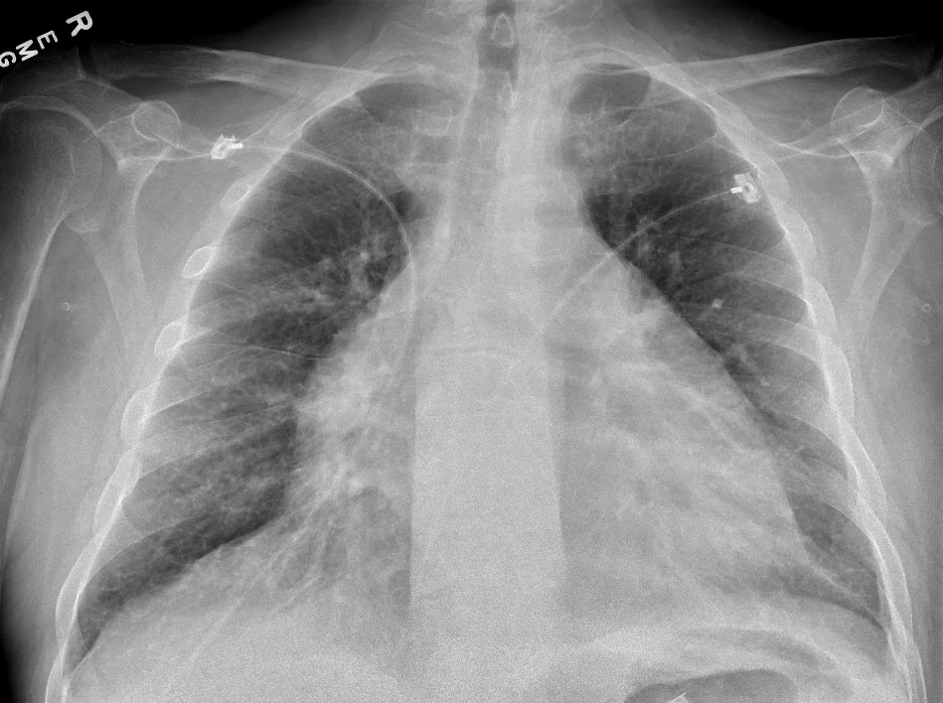
55yo man with ESKD admitted for confusion and dyspnea after missing multiple HD sessions.
Prominent vasculature, bibasilar hazy opacities, Kerley B lines, and enlarged cardiac silhouette.
What is your overall interpretation?
Images courtesy of
Brandon Fainstad, MD
Notes:
Official CXR Read: There are diffuse bibasilar hazy opacities and prominent vasculature with a visible right minor fissure all consistent with vascular congestion. There is also a large balloon-shaped cardiac silhouette with loss of the usual contours suggesting pericardial effusion.
Diagnosis: Uremic pericardial effusion
Teaching:
This patient presented after missing multiple rounds of dialysis found to have volume overload and symptomatic uremia with confusion and a large pericardial effusion. He underwent HD with resolution of his symptoms
The recently normal cardiac silhouette suggests this is less likely due to cardiomegaly.
While the patient has a pericardial effusion, there is no concern for tamponade given he is hypertensive and not tachycardic.

Slide 7
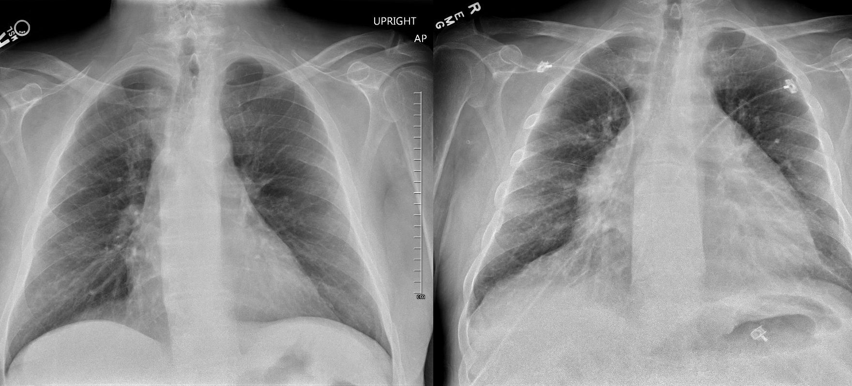
55yo man with ESKD admitted for confusion and dyspnea after missing multiple HD sessions.
Prominent vasculature, bibasilar hazy opacities, Kerley B lines, and enlarged cardiac silhouette.
What is your overall interpretation?
Pericardial effusion and AP film.
What is the most likely cause of this patient’s newly enlarged cardiac silhouette?
Afebrile, HR 90bpm, 160/90, SpO2 92% on 2Lnc. What is the next best step in management?
Hemodialysis with ultrafiltration.
Aortic arch
Main pulmonary artery
Loss
of “ski bump” contours
Left
Ventricle
DDx – Enlarged Cardiac Silhouette
Cardiomegaly
Pericardial effusion
Portable (AP) film
Enlarged silhouette
Images courtesy of
Brandon Fainstad, MD
4 months prior
Current admission
Notes:
Official CXR Read: There are diffuse bibasilar hazy opacities and prominent vasculature with a visible right minor fissure all consistent with vascular congestion. There is also a large balloon-shaped cardiac silhouette with loss of the usual contours suggesting pericardial effusion.
Diagnosis: Uremic pericardial effusion
Teaching:
This patient presented after missing multiple rounds of dialysis found to have volume overload and symptomatic uremia with confusion and a large pericardial effusion. He underwent HD with resolution of his symptoms
The recently normal cardiac silhouette suggests this is less likely due to cardiomegaly.
While the patient has a pericardial effusion, there is no concern for tamponade given he is hypertensive and not tachycardic.

Slide 8
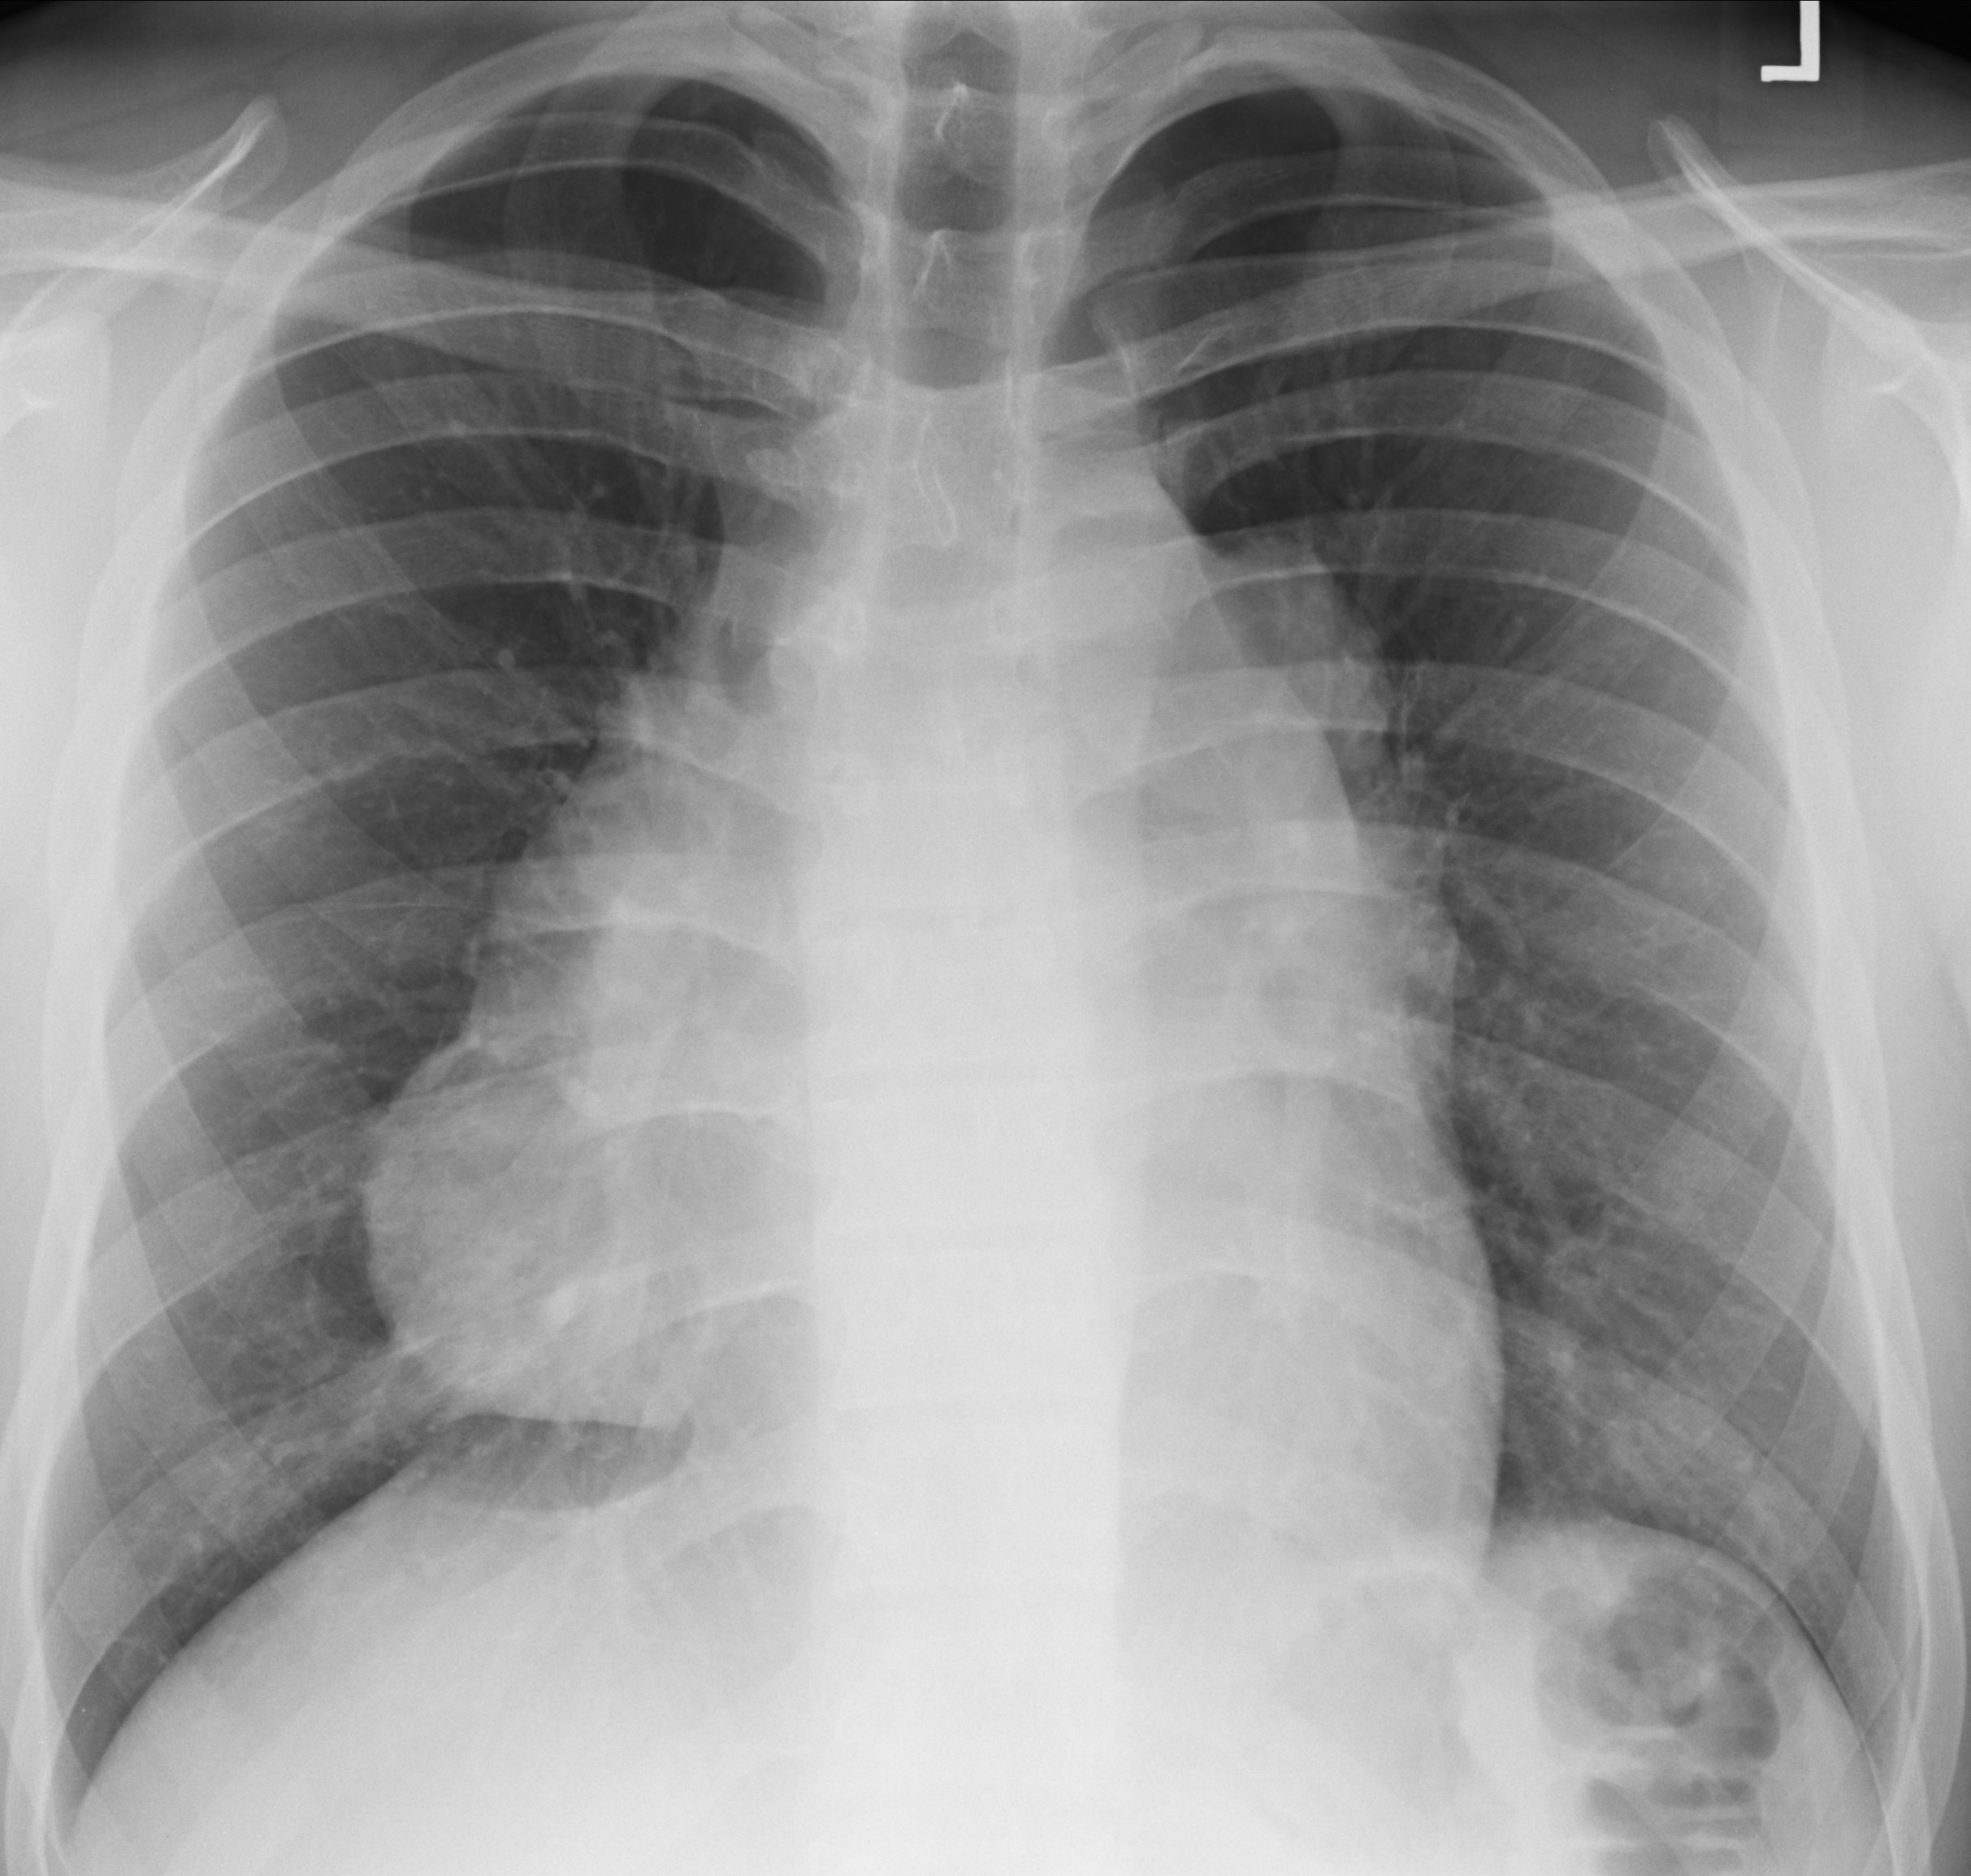
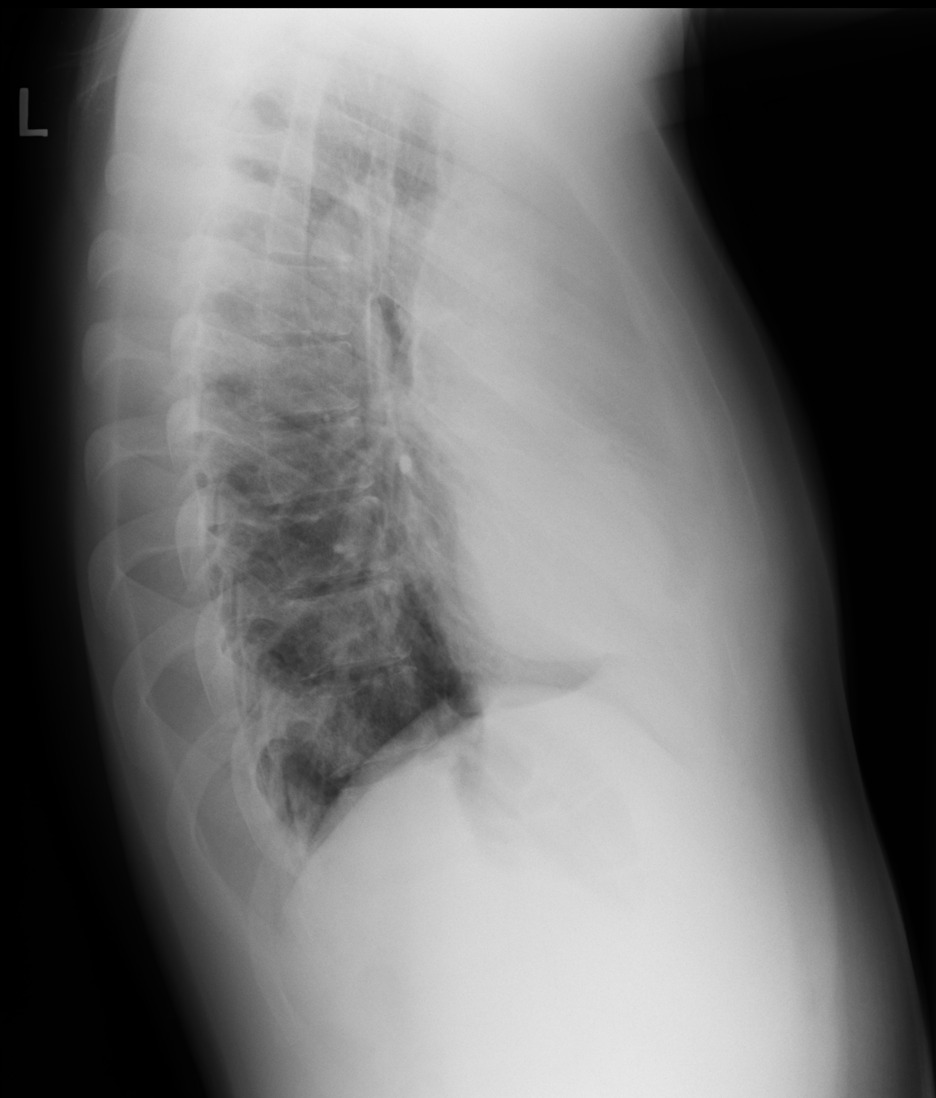
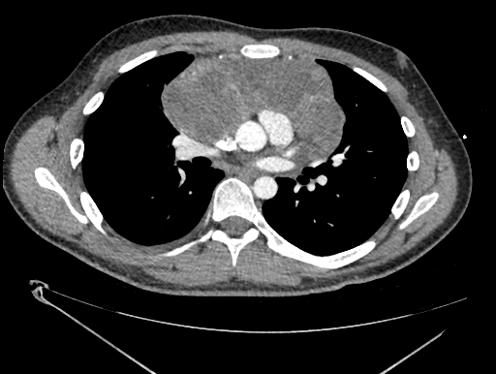
60-year-old man presenting with cough and 20 lb unintentional weight loss.
25yo man presenting with fatigue and weight loss.
What is your overall interpretation?
Soft tissue mass in the anterior mediastinum.
What features on the radiograph suggests this is in the anterior mediastinum?
Anterior Mediastinal Mass
Loss of retrosternal clear space
‘Hilar overlay sign’
Notes:
CXR Read: Soft tissue mass in the pre-vascular (anterior) mediastinum. Lateral projection shows loss of retrosternal clear space. Frontal projection shows hilar overlay sign. No pulmonary vascular engorgement, no infiltrates, no nodules, and no pleural abnormalities identified.
Diagnosis: Anterior mediastinal germ cell tumor.
Teaching:
Visualization of the hilar vessels through the mass, the “hilar overlay sign”, shows this mass is not involving the hila.
Loss of retrosternal clear space suggests anterior mediastinal process.
The differential for anterior mediastinal mass: the terrible T’s (thymoma, thyroid, terrible lymphoma, and teratoma (germ cell tumors))

Slide 9
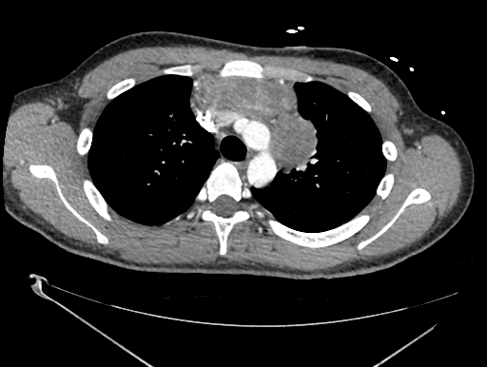
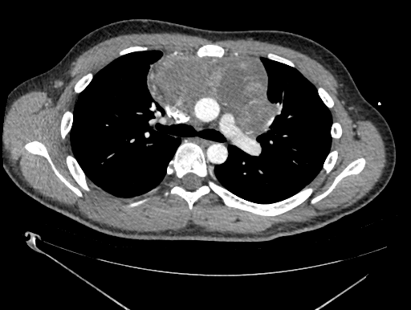
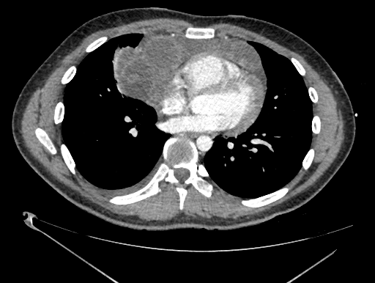
Notes:
CXR Read: Soft tissue mass in the pre-vascular (anterior) mediastinum. Lateral projection shows loss of retrosternal clear space. Frontal projection shows hilar overlay sign. No pulmonary vascular engorgement, no infiltrates, no nodules, and no pleural abnormalities identified.
Diagnosis: Anterior mediastinal germ cell tumor.
Teaching:
Visualization of the hilar vessels through the mass, the “hilar overlay sign”, shows this mass is not involving the hila.
Loss of retrosternal clear space suggests anterior mediastinal process.
The differential for anterior mediastinal mass: the terrible T’s (thymoma, thyroid, terrible lymphoma, and teratoma (germ cell tumors))

Slide 10
60-year-old man presenting with cough and 20 lb unintentional weight loss.
25yo man presenting with fatigue and weight loss.
What is the differential for an anterior mediastinal mass?
Anterior Mediastinal Mass
Anterior Mediastinal Masses: The ‘4 Ts’
Thymoma
Teratoma (germ cell tumor)
“Terrible” lymphoma
Thyroid
This case
Notes:
CXR Read: Soft tissue mass in the pre-vascular (anterior) mediastinum. Lateral projection shows loss of retrosternal clear space. Frontal projection shows hilar overlay sign. No pulmonary vascular engorgement, no infiltrates, no nodules, and no pleural abnormalities identified.
Diagnosis: Anterior mediastinal germ cell tumor.
Teaching:
Visualization of the hilar vessels through the mass, the “hilar overlay sign”, shows this mass is not involving the hila.
Loss of retrosternal clear space suggests anterior mediastinal process.
The differential for anterior mediastinal mass: the terrible T’s (thymoma, thyroid, terrible lymphoma, and teratoma (germ cell tumors))

