Slide 1
Introduction
Lung Cancer: Diagnosis and First Steps for the Internist
Diagnosis & Screening
Testing & counseling
Importance and Impact?
Importance and Impact?
#1 in cancer deaths worldwide
#1 cause of cancer in men
#2 cause of cancer in women
Systemic Tx
Cases
Image created with BioRender.com

Slide 2
Introduction
Diagnosis & Screening
Diagnosis & Screening
Cough, hemoptysis, dyspnea, or chest pain?
Bone pain, weight loss, fatigue?
Symptoms?
no
yes
Asymptomatic
Screening
CXR
Symptomatic
Biopsy
Testing & counseling
Systemic Tx
Cases
Notes:
CXR 1: Case courtesy of Dr Ian Bickle, <a href="https://radiopaedia.org/?lang=us">Radiopaedia.org</a>. From the case <a href="https://radiopaedia.org/cases/50353?lang=us">rID: 50353</a>
CXR 2: Case courtesy of Dr Chris O'Donnell, <a href="https://radiopaedia.org/?lang=us">Radiopaedia.org</a>. From the case <a href="https://radiopaedia.org/cases/17945?lang=us">rID: 17945</a>
CT 3: Case courtesy of Dr Ahmed Abdrabou, <a href="https://radiopaedia.org/?lang=us">Radiopaedia.org</a>. From the case <a href="https://radiopaedia.org/cases/29002?lang=us">rID: 29002</a>

Slide 3
Introduction
Diagnosis & Screening
Diagnosis & Screening
Cough, hemoptysis, dyspnea, or chest pain?
Bone pain, weight loss, fatigue?
no
yes
Asymptomatic
Screening
CXR
Symptomatic
Risk assessment
Risk assessment
Other Risk Factors for Lung Cancer
Biopsy
Exposures
Smoking history
Second hand smoking exposure
Radon exposure
Occupational exposures
History
Family history of lung cancer (1st degree relative)
Cancer history
COPD
Pulmonary fibrosis
Exposures
History
High risk
Low risk
Testing & counseling
High risk
Low risk
≥50 yo AND ≥20 pack-year smoking history
≥50 yo OR ≥20 pack-year smoking history
Systemic Tx
Cases
Low dose CT (LDCT) q1 year
Reassess risk annually

Slide 4
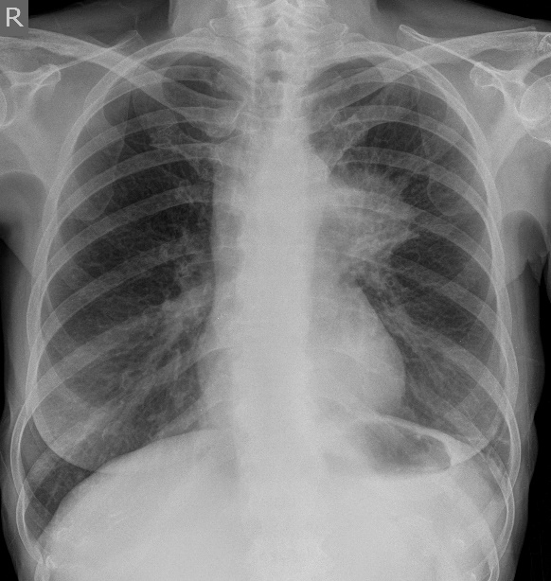
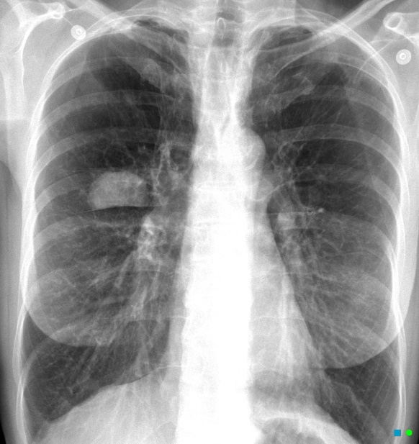
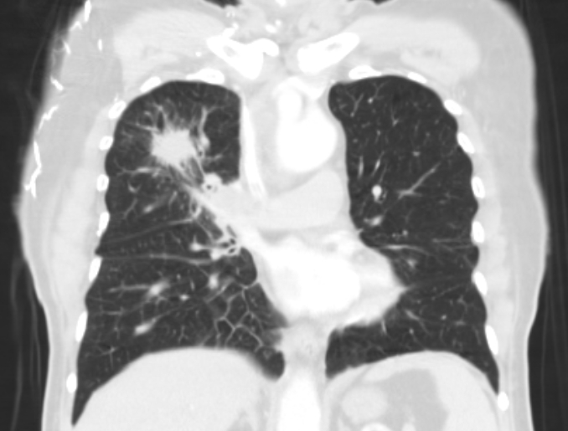
Introduction
Diagnosis & Screening
Diagnosis & Screening
Cough, hemoptysis, dyspnea, or chest pain?
Bone pain, weight loss, fatigue?
no
yes
Asymptomatic
Screening
CXR
Symptomatic
CT Findings Concerning For Malignancy
Not concerning
Concerning
Not concerning
Concerning
Biopsy
>15 mm
Risk assessment
Risk assessment
Testing & counseling
CT Chest +/- Abd/Pelvis
High risk
OR
Persistent sx
Low risk & sx improve
CT Chest +/- Abd/Pelvis
Systemic Tx
Irregular/ spiculated
Cases
No further work-up
Thick-walled cavitation
Growth
Solid component in ground glass
Extrapulmonary lesions
Biopsy
Notes:
- CXR 1: Case courtesy of Dr Ian Bickle, <a href="https://radiopaedia.org/?lang=us">Radiopaedia.org</a>. From the case <a href="https://radiopaedia.org/cases/50353?lang=us">rID: 50353</a>
- CXR 2: Case courtesy of Dr Chris O'Donnell, <a href="https://radiopaedia.org/?lang=us">Radiopaedia.org</a>. From the case <a href="https://radiopaedia.org/cases/17945?lang=us">rID: 17945</a>
- CT 3: Case courtesy of Dr Ahmed Abdrabou, <a href="https://radiopaedia.org/?lang=us">Radiopaedia.org</a>. From the case <a href="https://radiopaedia.org/cases/29002?lang=us">rID: 29002</a>

Slide 5
Introduction
Where and How to Biopsy?
Which lesion would you biopsy to make a diagnosis?
Diagnosis & Screening
Click on each biopsy sites to determine which specialist would perform the biopsy.
Which lesion would you biopsy to make a diagnosis?
Biopsy most advanced lesion as it can give you diagnosis and staging.
Asymptomatic
Peripheral lung (IR/Surgery)
May be amenable to CT guided biopsy
Symptomatic
Endobronchial (Pulmonology)
Masses near airways may be biopsied by bronchoscopy
Biopsy
Testing & counseling
Hepatic lesions (IR)
May be amenable to CT/US guided biopsy
Skin/ soft tissue / lymph nodes (General surgery/ IR)
Excisional lymph node biopsy is typically done by general surgery.
CT/US guided punch/core biopsy is done by IR.
Systemic Tx
Cases
Bone lesions (Ortho/IR)
Can be biopsied by orthopedic surgery or IR
Created with BioRender.com

Slide 6
Introduction
Lung Cancer: Diagnosis and First Steps for the Internist
Diagnosis & Screening
Biopsy-proven diagnosis
Testing & counseling
Staging
(extent of cancer)
Staging
(extent of cancer)
Assessment of surgical candidacy
Assessment of surgical candidacy
Additional labs?
Additional labs?
SCLC
NSCLC
CT CAP + IV contrast OR PET-CT
MRI brain with and without contrast
Bronchoscopy +/- mediastinoscopy*
PFTs*
Assess metastatic involvement
CBC
BMP + Ca
LFTs
Determine targeted therapy (NSCLC only)
PD-L1 percentage
Molecular testing
Summary
Systemic Tx
Cases
*varies with initial staging; typically when considering surgical resection
Notes:
Shorten, less words, maybe put PFTs and bronch/media in guide only. Maybe just say tumor markers in the guide

Slide 7
Introduction
Small Cell Lung Cancer
Diagnosis & Screening
Overview
Overview
Staging
Staging
10-15% of all lung cancers
Limited Stage
Extensive Stage
Testing & counseling
Smoking is major RF
Rapidly progressive
Brain metastases
Associated with paraneoplastic syndromes
SCLC
NSCLC
Confined to ipsilateral chest that can be treated with single radiation field
Spread beyond ipsilateral chest
Distant metastases
Summary
Systemic Tx
Treatment
Cases
Treatment
OR
5-year survival rate
10-13%
Prognosis
1-2%
Median survival
15-20 mos
8-13 mos
Created with BioRender.com
Notes:
Smoking
Fast growing
Brain mets
Chemo & radiation sensitive
Frequent recurrence
Poor prognosis
Paraneoplastic syndromes
Consider prophylactic cranial irradiation

Slide 8
Introduction
Non-Small Cell Lung Cancer
Diagnosis & Screening
Overview
Overview
Staging
Staging
80-85% of all lung cancers
I
II
III
IV
Testing & counseling
Metastases to…
Brain
Liver
Lung/pleura
Adrenals
Bone
Lymph nodes
Histological subtypes:
Adenocarcinoma
Squamous
Other
Treatment dependent on histology and molecular testing
SCLC
NSCLC
Summary
Systemic Tx
Treatment
Treatment
OR
OR
Cases
5-year survival rate
Prognosis
73-90%
56-65%
12-41%
0-10%
Median survival
N/R
66 mos
11-41.9 mos
6-11.5 mos
Created with BioRender.com
Notes:
Less common:
Pericardium
Muscle/soft tissue
Ovaries
Pancreas
Kidney
Other sites
*Most patients are diagnosed at advanced stages as that is when they present with symptoms

Slide 9
Introduction
SCLC vs NSCLC
Diagnosis & Screening
SCLC
NSCLC
10-15% of all lung cancers
80-85% of all lung cancers
Testing & counseling
Characteristics
Characteristics
Smoking associated
Brain mets
Paraneoplastic syndromes
Different histological subtypes
Molecular characteristics important
SCLC
NSCLC
Staging
Staging
Limited vs Extensive Stage
Stage I - IV
Summary
Depends on stage
Depends on stage and molecular markers
Systemic Tx
Treatment
Treatment
Cases
Immuno-/ chemotherapy
Immuno-/ chemo-/ targeted therapy
Prognosis
Prognosis
Poor
Good (stage I) to Poor (stage IV)
Created with BioRender.com

Slide 10
Introduction
Systemic Therapies
Diagnosis & Screening
Chemotherapy
Immunotherapy
Targeted Therapy
Testing & counseling
Indication
Indication
NSCLC with molecular mutations
NSCLC and SCLC
NSCLC and SCLC
Indication
Systemic Tx
Osimertinib
Erlotinib
Carboplatin/ Cisplatin
Pemetrexed
Etoposide
Docetaxel/ Paclitaxel
Lurbinectedin
Pembrolizumab
Nivolumab ± ipilimumab
Atezolizumab
Durvalumab
EGFR
Examples
Examples
Examples
Cases
Alectinib
Crizotinib
ALK
Crizotinib
Entrectinib
Lorlatinib
ROS1
Nausea/ vomiting/ diarrhea
Mouth sores
Neuropathy
Nephropathy (AKI)
Cytopenias
Hair loss
The “-itises”
Anemia
Pneumonitis
Rash
GI symptoms
Toxicities
pneumonitis, myositis, hypophysitis, thyroiditis, colitis, myocarditis
Toxicities
Toxicities
Created with BioRender.com

Slide 11
Introduction
Case 1
Case 2
Diagnosis & Screening
47-year-old with history of hyperlipidemia, HTN, CAD who presents to establish care. They have no complaints today. Social history is notable for a 20 pack-year smoking history. Strong family history of lung cancer in his mother, father, and paternal grandparent – all of whom were smokers.
The patient represents 5 years later (at age 52) with 3 months of cough and 2 weeks of hemoptysis. They additionally report fatigue, 20 lb weight loss in 6 months, and persistent right upper quadrant pain. They continue to smoke 1 pack per day.
Testing & counseling
What is your next step in evaluation?
What are their risk factors for lung cancer?
Systemic Tx
For symptomatic patients, a CXR can be the first step in evaluation. Additional laboratory evaluation (e.g., CBC, BMP, LFTs) to evaluate for other causes of symptoms.
Smoking history/pack years, family history of lung cancer
Cases
Would you screen for lung cancer?
…CXR shows 2.5 cm ill defined nodule.
No. While they are at higher risk based on family history and smoking history, screening for asymptomatic patients with high risk of lung cancer is recommended starting at age 50.
What is your next step in evaluation?
CT chest + abdomen/pelvis with IV contrast for staging
…CT chest, abdomen, pelvis shows 2.5 cm spiculated nodule with multiple hypodensities in the liver.
How would you counsel this patient?
Emphasize smoking cessation, low dose CT in 3 years at 50
What is your next step in evaluation?
Consult IR for liver biopsy. This will aid in diagnosis and staging.

